Slide 1
SRWG Meeting
1/29/25
will.satterthwaite@noaa.gov

Slide 2
B. Workgroup Updates
1. November 2024 Council Meeting Summary
  commended the SRWG on the progress to date on the work items specified in the TOR
  use the F_{MSY} value adopted under Agenda Item F.2 Salmon Methodology Review to derive an updated S_{MSY} value per the formula described in Agenda Item F.2, Attachment 2,
  develop options for an updated conservation objective based on total escapement (natural and hatchery areas combined) and based on an S_{MSY} based on natural-area spawners, and
  work towards modifying the current harvest control rule to account for potential updates to the S_{MSY} and in terms of an updated conservation objective.
2. 2024 Salmon Methodology Review Summary
3. Review TOR and Progress to Date
Notes:
Re: 4th bullet: Note the current HCR does not depend directly on or use the conservation objective in any way, it is parameterized based on Smsy
By describing updates to HCR in terms of Smsy and conservation objective updates, does that imply HCR is a later step / lower priority?

Slide 3
B. Workgroup Updates
1. November 2024 Council Meeting Summary
2. 2024 Salmon Methodology Review Summary (link to motion)
  As recommended by the SSC and STT, use the updated F_{MSY} proxy value of 0.58 for Sacramento River Fall Chinook for management beginning in 2025 with a review in 2028.
  Cohort reconstruction approved for use in a phased approach
    Use post-season ER estimates from CR, as available, for status determinations starting in 2025
    Include fishery impacts from North of Cape Falcon as soon as reasonably possible (likely 2026+)
    As a matter of policy, components of methodology may be applied all or in part as appropriate and available
3. Review TOR and Progress to Date

Slide 4
B. Workgroup Updates
1. November 2024 Council Meeting Summary
2. 2024 Salmon Methodology Review Summary
3. Review TOR and Progress to Date
Notes:
See next few slides.

Slide 5
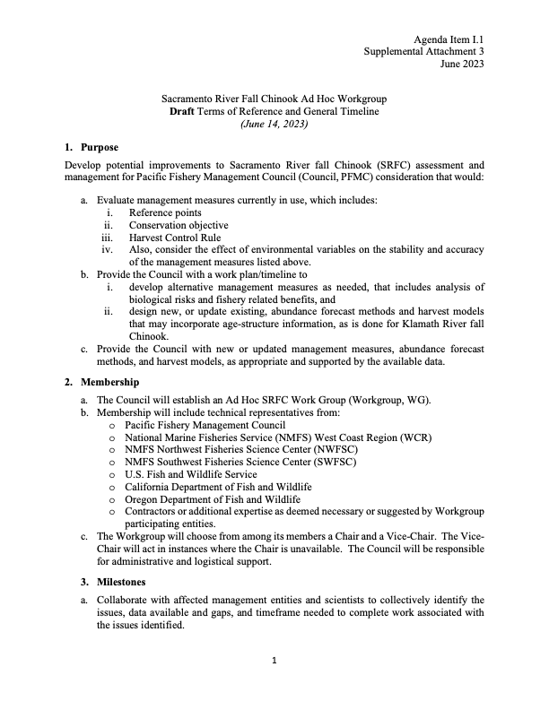
Notes:
Green = done (measures half-highlighted green since Fmsy complete, Smsy not)
Yellow = in progress
Orange = work deferred by Council choice not to have methodology review of Satterthwaite and Shelton 2023 paper
Red = needs work
Skipped over “membership” because not really under our control or directly reflective of progress

Slide 6
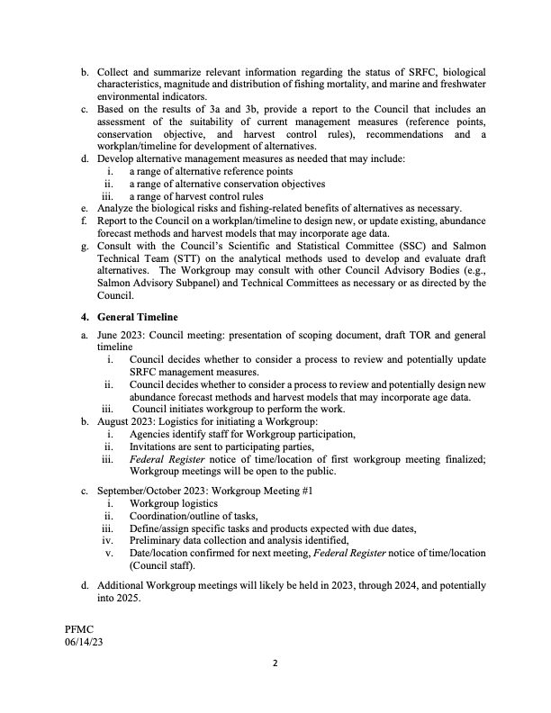
Notes:
Green = done (again reference points partially green since Fmsy done, Smsy not)
Yellow = in progress
Orange = deferred by Council choice not to have MR of Satterthwaite and Shelton 2023 paper
Red = needs work

Slide 7
C. Workgroup Tasks
1. Derivation of S_{MSY}
  Considering guidance to focus on natural-areas, approval of F_{MSY} proxy
2. Conservation Objective
3. Harvest Control Rule
4. Other Items, as appropriate

Slide 8
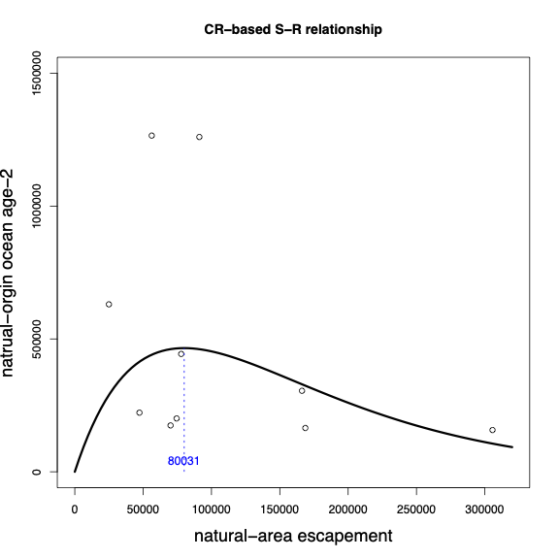
Cohort Reconstruction-based, no flow metric
(brood years 2007-2016)
BY16 BY10
CR natural-origin ocean age-2
Natural-area
Implied composite number would be greater
Natural area adult SRFC
S_{MP}=80,031 natural-area adults implies S_{MSY}=46,418 using F_{MSY}=0.58 proxy
R²=0.04 (at least it’s not negative!)
Notes:
Given the guidance to focus on natural-area Smsy, approval of Fmsy proxy as ratio between Smp and Smsy for a Ricker, and approval of the Cohort Reconstruction; I did a spawner-recruit analysis using natural-area spawners as spawners and natural-origin ocean age-2 abundance (from the CR) as recruits. With no flow covariate, spawners explain very little of the variance in recruits. Note the influence of the two points of really high recruitment around 80K spawners.

Slide 9
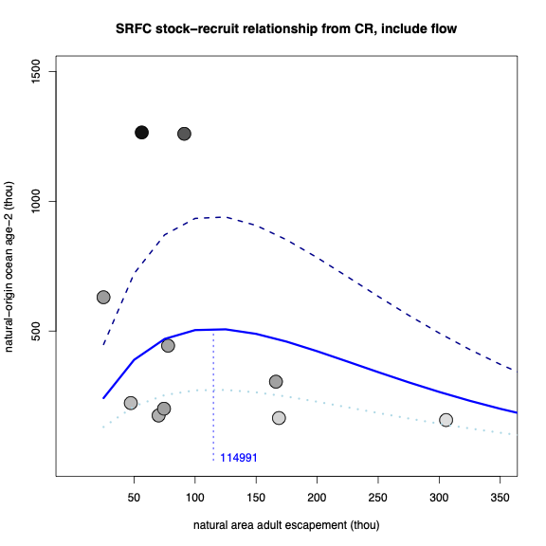
Cohort Reconstruction -based, with flow metric
(brood years 2007-2016)
BY16 BY10
CR natural-origin ocean age-2 (thou)
Natural-area
Implied composite number would be greater
Natural area adult SRFC (thou)
S_{MP}=114,991 natural-area adults implies S_{MSY}=66,695 using F_{MSY}=0.58 proxy
R²=0.73
Notes:
Adding a flow covariate (note darker dots – higher flows) improves fit substantially, also increases Smp and thus Smsy by a bit, still these are both quite a bit smaller than what we got using the Munsch et al fry production index from a wider range of years. Note those two high recruitment years are the darkest dots, representing the highest flows (BY 16 ~2SD above mean, BY10 ~1SD above mean).

Slide 10
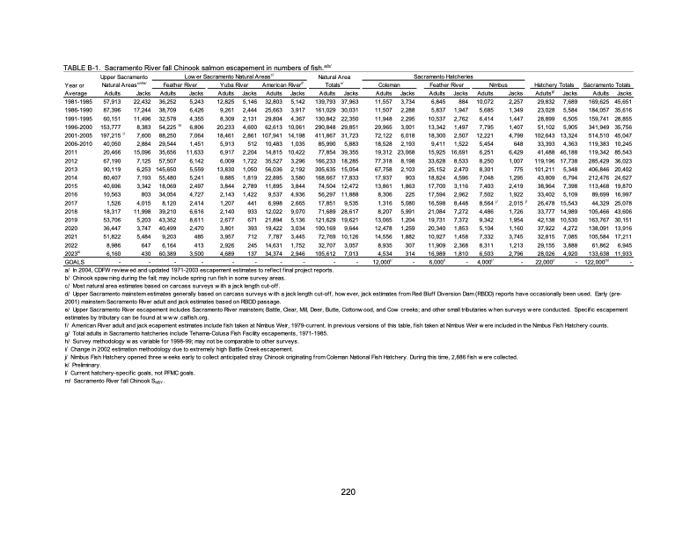
Notes:
67K natural area adults may sound a lot lower than the 122K composite used currently, still it was missed 3x since 2016 (all times 122K was missed also) and pretty close a few other times (generally when 122K narrowly missed).
Although this would imply that at least historically 67K natural-area would be easier to meet than 122K total, recent Upper Sac shortfalls may change that

Slide 11
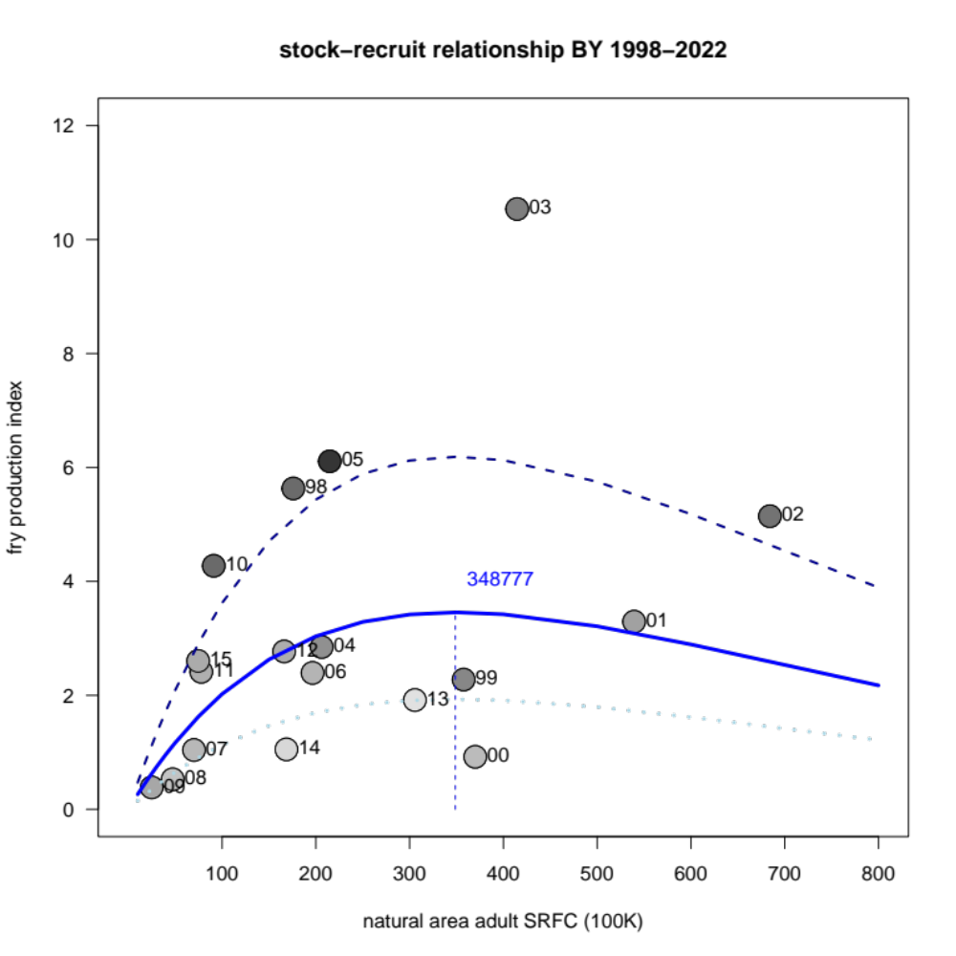
Spawner-recruit fit, BY 1998-2015,
based on Munch et al. (2020) fry index
S_{MP}=348,777 natural-area adult SRFC
Implies S_{MSY}=202,291 using F_{MSY}=0.58 proxy
R² = 0.41
Fry production index
High flow
Low flow
Natural area adult SRFC (thou)
Notes:
Note BY 10 is the highest recruitment at around its escapement, but nothing special in the longer term
But also note that BY 05 2nd highest juvenile index, corresponded to very low SI in 2008. Highest index for BY03 corresponds roughly to SI in 2006, 578K. Other high juvenile indices (10, 02, 98) corresponded to SIs of 800K+.

Slide 12
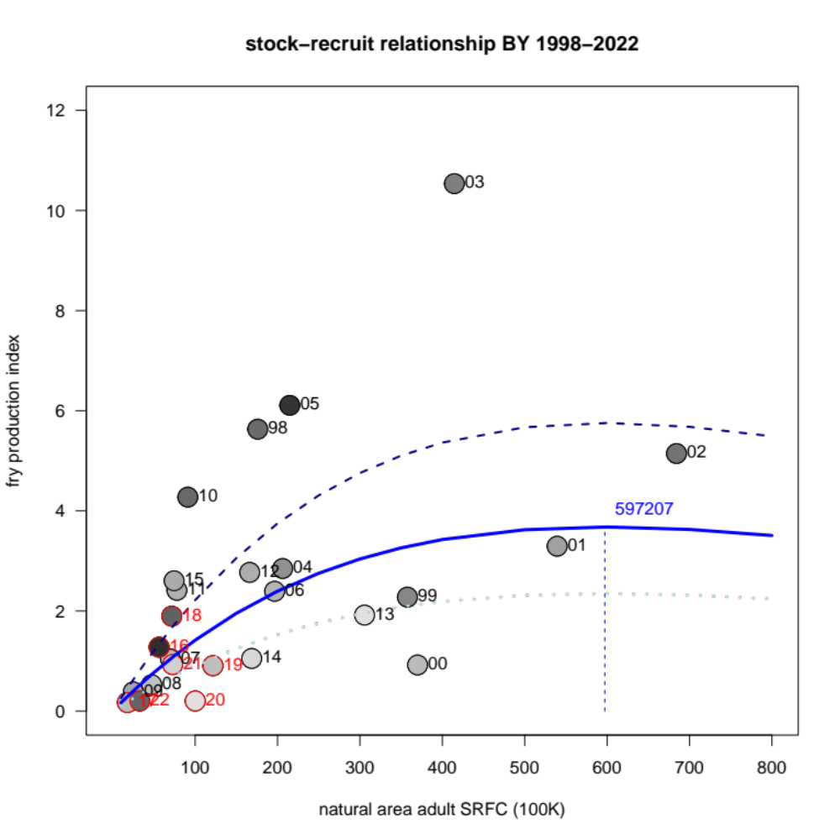
Spawner-recruit fit, BY 1998-2022, based on Munch et al. (2020) fry index
S_{MP}=597,207 natural-area adult SRFC
Implies S_{MSY}=346,380 using F_{MSY}=0.58 proxy
R² = 0.56
High flow
Fry production index
Natural-area
Corresponding composite number would be greater
Low flow
Natural area adult SRFC (thou)
Notes:
Why does adding points at low abundance change shape of curve at high abundance?
Shape of Ricker is constrained by the 2 parameters, can’t change just part of the curve.
Seven new years at low abundance, versus only a handful of years at high abundance.
Minimizing lognormal error, so sensttive to proportional errors which may look small at low abundance, not trying to minimize arithmetic-scale distance from points.
BY16 less of a standout in this analysis.

Slide 13
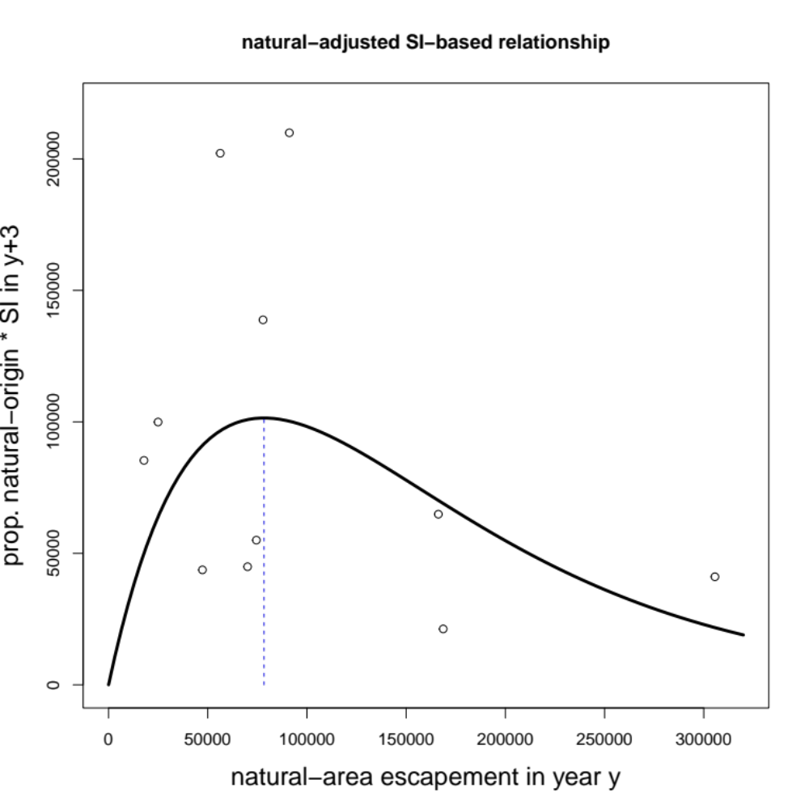
Remember the SI-based analysis?
(brood years 2007-2017)
R²=0.12
Not much variance explained, also problematic range of escapements and flows
Notes:
So why are numbers from CR-based analysis so much smaller? Recall that using SI * proportion natural also gave a small Smp (about 80K if not using a flow covariate).

Slide 14
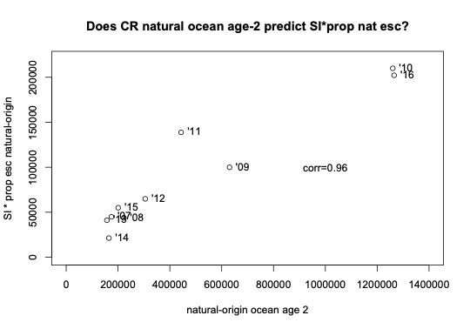
SI x natural.prop and cohort reconstructed natural-origin ocean abundance are closely correlated
Notes:
While the CR corrects some important biases in the SI, and is likely more precise, still as a coarse signal of ocean abundance they are pretty well correlated, and thus tell similar stories about where the S-R curve peaks
And since it covers a similar range of years, similar caveats apply in terms of lack of data at high escapements and high flows…

Slide 15
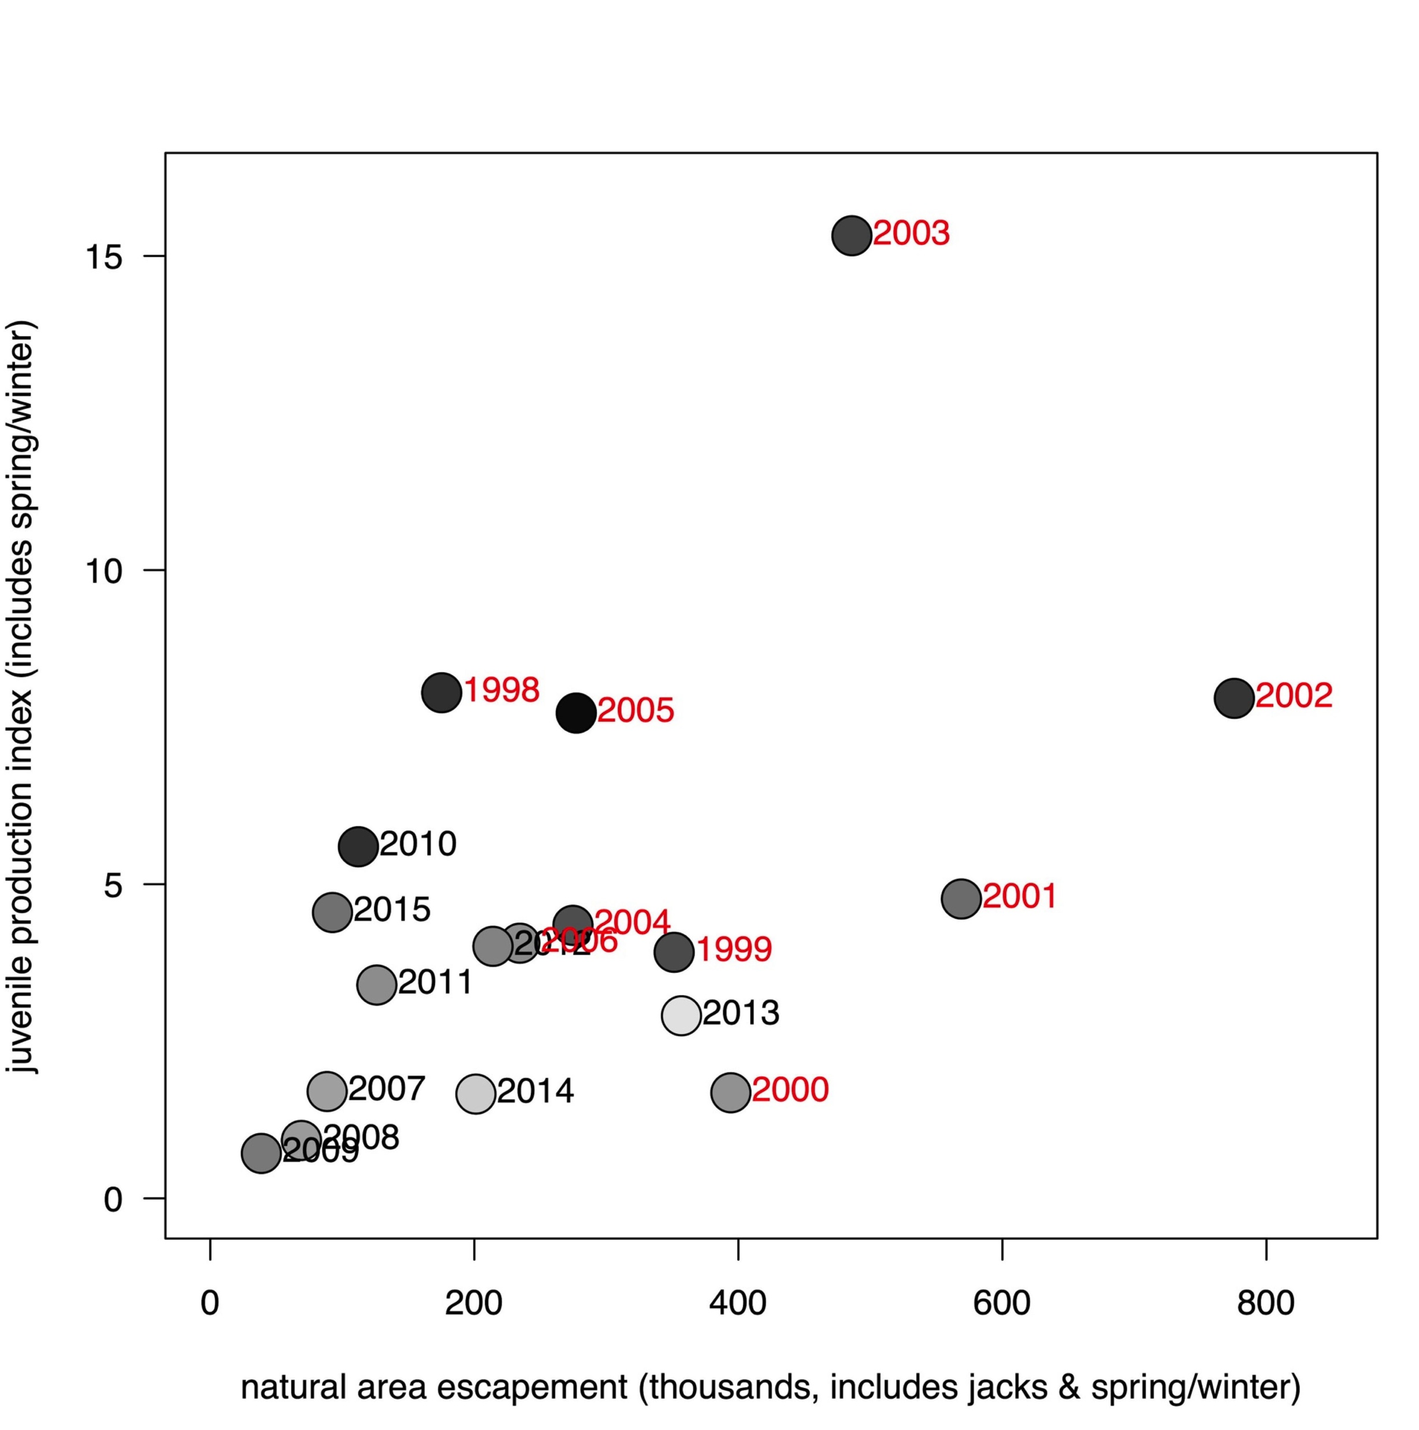
Limitations of years suited to SRFC cohort reconstructions or natural-origin SI calculations
Parent years in red lack suitable data for cohort reconstruction
or to estimate the proportion of escapement that was natural origin to do the SI adjustment
Notes:
BY 2016 missing from this figure because it was not available in original Munsch et al analysis through BY15
Note that BY 2005 pretty high juvenile production, but associated with very low SI in 2008, with Lindley et al 2009 pinning a lot of the blame for that on ocean conditions

Slide 16
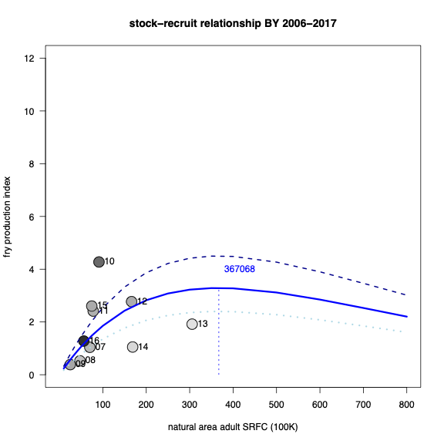
But, seems to be more to it than just years included
Munsch et al. fry index truncated to brood years 2006-2017 to match cohort reconstruction years
Notes:
Even truncated to the same years as CR, Munsch et al analysis seems to favor a somewhat B-H like Ricker, with a high Smp. Note BY 2016 by this analysis had mediocre production despite a lot of flow.

Slide 17
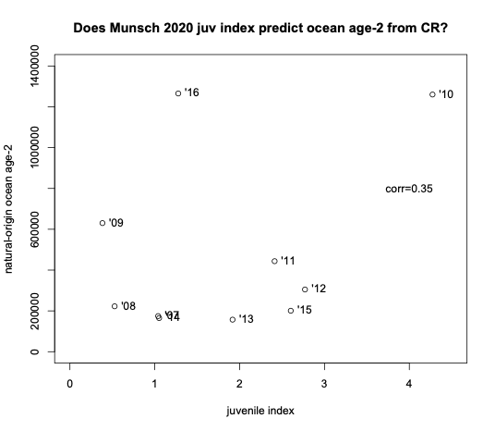
How well does Munsch et al. fry index predict CR natural-origin ocean abundance?
Notes:
So the Munsch et al fry index covers more years, and is correlated with the CR “gold standard” for years where both are applicable, but is the correlation “good enough”?
Asked Stu about using ocean indicators to improve predictive relationship, nothing too promising so far

Slide 18
Options for natural-area Spawner-Recruit relationship
Cohort reconstruction is “gold standard” for estimating recruits, but covers a limited range of years (and thus escapements and flows)
  Will never be able to apply prior to BY 2007
  Gap in CWT sampling of ocean harvest in early 2020 may slightly compromise several brood years that would have been subject to harvest then
  Lack of genetic sampling for returns of unmarked, PBT-only fry releases compromised analysis of BY 21-22 and may compromise future BY
  No telling when we’ll get another high escapement + high flow year (and then 4+ year lag to reconstruct the resulting cohort)
Munsch et al juvenile index covers a broad range of years, can be updated, and is peer-reviewed
  But may be reasonable to expect further density-dependence after juvenile stage
  And correlation to cohort reconstruction is modest (but nonzero) – could ocean covariates help?
Upper Sacramento / RBDD fry equivalents seems like a relatively secure data source spanning many years
  But may be reasonable to expect further density-dependence after juvenile stage
  Only a portion of the system (but a critical one experiencing recent shortfalls)
SI x prop. natural-origin escapement likely similar to (in years covered and broad/relative results) but inferior to (in data quality) cohort reconstruction
  But slightly less data-demanding (no scale ages needed) in terms of year coverage

Slide 19
C. Workgroup Tasks
1. Derivation of S_{MSY}
2. Conservation Objective
  November guidance: “develop options for an updated conservation objective based on total escapement (natural and hatchery areas combined) and based on an S_{MSY} based on natural-area spawners”
  natural area S_{MSY} as a starting point
  Add considerations of:
    Hatcheries?
    River harvest?
    Conservation/resilience/ecological and evolutionary factors?
3. Harvest Control Rule
4. Other Items, as appropriate

Slide 20
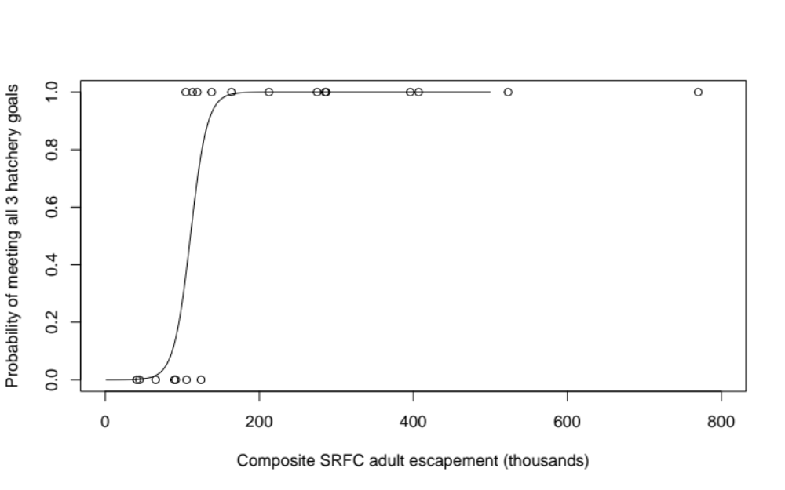
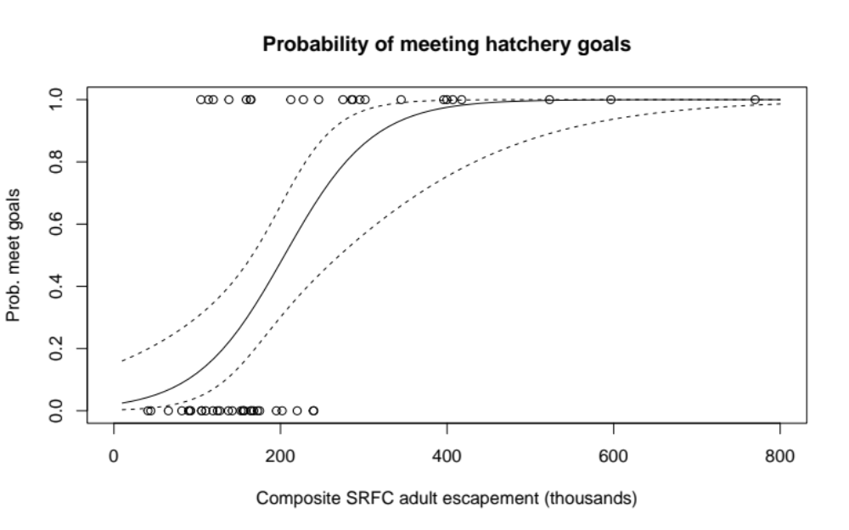
Probability of meeting hatchery goals
Return years 2002-2021
Return years 1970-2021
Satterthwaite (2023), goals as defined in Review Table B-3
Notes:
Main analysis in Satterthwaite 2023 was 2002-2021 to match years with natural production data. Very knife-edge response within those years, no ability to calculate confidence intervals. Longer timesries allowed confidence interval calculation and found a shallower relationship, but hatchery goals may have been different and release practices / stray rates surely were, so not clear how representative. Adding more recent data could be helpful.

Slide 21
Defining hatchery success
Based on spawner numbers or based on production?
“Mitigation” goals alone, or updated goals?
Which hatcheries?
  All 3 Sacramento Fall programs seem obvious to include
  But given “indicator stock” role for ”stock complex” what about
    Sacramento late-fall (Coleman late-fall program)?
    San Joaquin fall (Mokelumne, Merced)?
  And what about Feather River Spring program?
    Not in complex, but not actively managed
And how to combine with natural-area spawner considerations?

Slide 22
Determine total escapement likely to yield desired fraction of production and meet hatchery goals
Or just say,
S_{Y}=S_{MSY} from some other analysis
Fishery managers specify:
• Y: fraction of maximum natural production
• X: biological risk tolerance
(expressed as success probability)
• Z: forecast/implementation risk tolerance
(expressed as success probability)
R_{MAX}
Natural
Production:
Recruits (R)
Y x R_{MAX}
S_{Y}
S_{MAX}
Analysts quantify:
• Spawner-Recruit relationship
• Relationship between total SRFC adult spawners and escapement measured at other scales
• Outcome error
(forecast and implementation)
Natural-area spawners (S)
1.0
Probability that
S ≥ S_{Y}
and
H_{goals} met
S_{MSY}
X
Escapement Goal
Total SRFC adults
Satterthwaite (2023), Figure 2, neglecting forecast & harvest model error

Slide 23
Determine total escapement likely to achieve Natural-Area S_{MSY} and meet hatchery goals
1
Probability of achieving S_{MSY}
and hatchery goals
0
Total Escapement
Notes:
Can’t fill in the figure without more analyses, but can predict that low total escapement means a small chance of achieving natural-area Smsy and hatchery goals while a high total escapement is more likely to achieve this. Actually working this out quantitively might identify a point of diminishing returns, or there might be a specific probability the Council wants to target (or NS1 implies we must target)

Slide 24
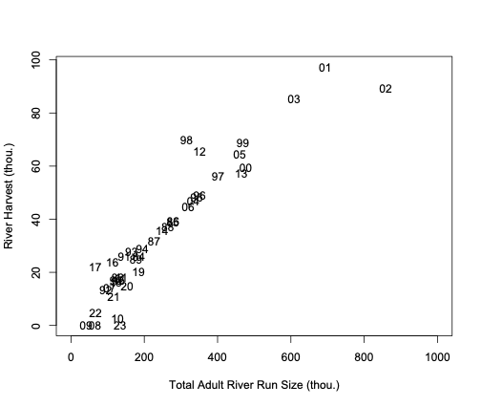
River harvest versus run size
Unconstrained linear regression
(although 0-intercept would make sense):
River Harvest = 1,407 + 0.13 x Run Size
p < 2x10⁻¹⁶
R²=0.88
Excluding years of zero harvest:
Minimum river harvest rate: 0.2% [2008]
(then 2% [‘10], 7% [‘22], overall 5/39 below 10%)
Maximum river harvest rate: 33% [2017]
(3/39 years above 20%)
Notes:
Data are from Pre-I Table II-1
Fit is almost suspiciously good – was river harvest ever simply backcalculated from escapement and assumed harvest rate?

Slide 25
Conservation/ecological considerations
NS1: The benefits of protection afforded to marine ecosystems are those resulting from maintaining viable populations (including those of unexploited species), maintaining adequate forage for all components of the ecosystem, maintaining evolutionary and ecological processes (e.g., disturbance regimes, hydrological processes, nutrient cycles), maintaining productive habitat, maintaining the evolutionary potential of species and ecosystems, and accommodating human use.
Viability criteria?
  For which subunits? Those identified by AFRP/CVPIA?
  https://www.noaa.gov/sites/default/files/legacy/document/2020/Oct/07354626391.pdf
Criteria spelled out under de minimis considerations in FMP?
  The potential for critically low natural spawner abundance, including considerations for substocks that may fall below crucial genetic thresholds;
  The status of co-mingled stocks;
How to ensure conservation of late-fall run, San Joaquin fall run
  (do have goals under AFRP)

Slide 26
C. Workgroup Tasks
1. Derivation of S_{MSY}
2. Conservation Objective
3. Harvest Control Rule
  November guidance “work towards modifying the current harvest control rule to account for potential updates to the S_{MSY} and in terms of an updated conservation objective”
  So defer until after S_{MSY}/conservation objective updated?
    Though we have discussed utility of parameterizing based on C.O. rather than S_{MSY}
    And may be good to understand effects of updated reference points
  Seems like we may want to revisit form of de minims as well
  Methods contained in Satterthwaite and Shelton (2023) would be valuable in analyzing costs/benefits of different rules
4. Other Items, as appropriate

Slide 27
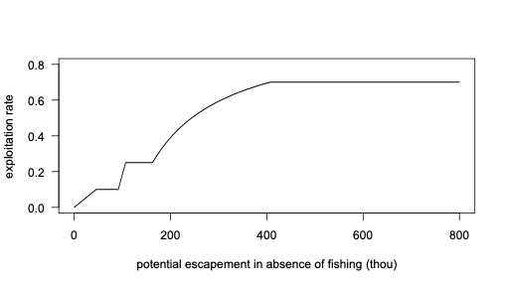
SRFC control rule as of 2024
Can’t intentionally exceed F_{ABC} (90% of F_{MSY} proxy)
Often target escapement equal to S_{MSY}
But at low abundance, can still have de minimis fisheries not expected to achieve S_{MSY}

Slide 28
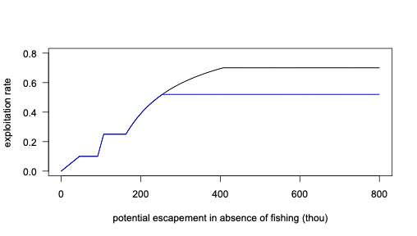
Presumed SRFC control rule as of 2025
Reflects new F_{MSY} = 0.58, leading to new F_{ABC} = 0.9*0.58=0.52
No effect of F_{MSY} change at low-moderate forecast
(black and blue overlap)
Notes:
If the forecast is less than 254,167 (i.e., 122/(1-0.52), the forecast expected to yield escapement of 122K if fishing at Fabc) there is no change in the output of the control rule, but F cannot increase above Fabc for higher forecasts. Note however that if a higher forecast is accurately capturing a higher true abundance, the harvest amount (F*abundance) still increases as abundance increases.

Slide 29
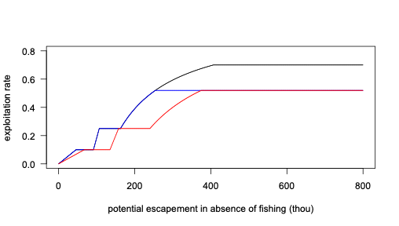
Totally hypothetical illustration of different S_{MSY}
Reflects new F_{MSY} = 0.58, leading to new F_{ABC} = 0.9*0.58=0.52
Purely hypothetical effect of also adopting S_{MSY}=180,000 and assuming
MSST is still 0.75*S_{MSY}
No effect of S_{MSY} change at high forecast
(blue and red overlap)
Notes:
Bottom line: Fmsy change has affected top end. Change in Smsy has potential to change low end, wouldn’t change high end (though changes where “high end” starts)
Hint for reading when there is overlap: Black will always be the highest allowable ER and red the lowest

Slide 30
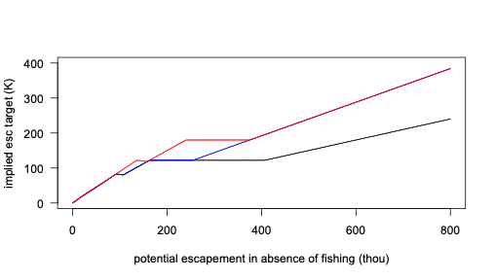
Implied target escapements
Control rule as of 2024
Incorporating new F_{MSY} and resultant F_{ABC}
Purely hypothetical effect of also adopting S_{MSY}=180,000
Notes:
These show the implied desired escapement as a function of abundance, assuming no error in any of the forecast or harvest planning models. Pretty similar at low abunances, diverge based on targeting Smsy at moderate abundances, and diverge based on Fabc at high abundance (where Smsy irrelevant so red and blue overlap). Note however the dependence of these results on complete lack of forecast or implementation error.
Hint for reading when there is overlap: Red will always be the highest escapement and black the lowest.

Slide 31
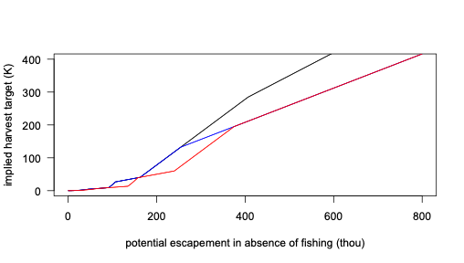
Implied target harvests
Control rule as of 2024
Incorporating new F_{MSY} and resultant F_{ABC}
Purely hypothetical effect of also adopting S_{MSY}=180,000
Notes:
These show the implied desired amount of harvest as a function of abundance, assuming no error in any of the forecast or harvest planning models.
So at high abundance, only Fabc matters, no difference between red and blue. At low abundance, only Smsy matters, no difference between blue and black. At intermediate abundances, both matter.
Hint for reading when there is overlap: Black will always be the highest allowable harvest and red the lowest

Slide 32
C. Workgroup Tasks
1. Derivation of S_{MSY}
2. Conservation Objective
3. Harvest Control Rule
4. Other Items, as appropriate
Notes:
Will has no additional tasks to add to our workload, but do we as a group think there are important additional tasks for us to take on?

Slide 33
D. Workgroup Discussion
1. Prioritization of tasks
  Seems like November Council guidance effectively prioritized S_{MSY} and conservation objective
    May have exhausted Spawner-Recruit analysis options for available data
    Satterthwaite (2023) approach to evaluating hatchery success ready to go, might merit proposal as topic for methodology review (but could use updated hatchery-specific escapement goals, expansion to rest of complex?)
    Satterthwaite (2023) also offers options for converting across scales (natural-area versus total) and perhaps defining “diminishing returns”
2. Potential data needs and availability
3. Estimated timeline/schedule for tasks
4. Potential 2025 salmon methodology review topics

Slide 34
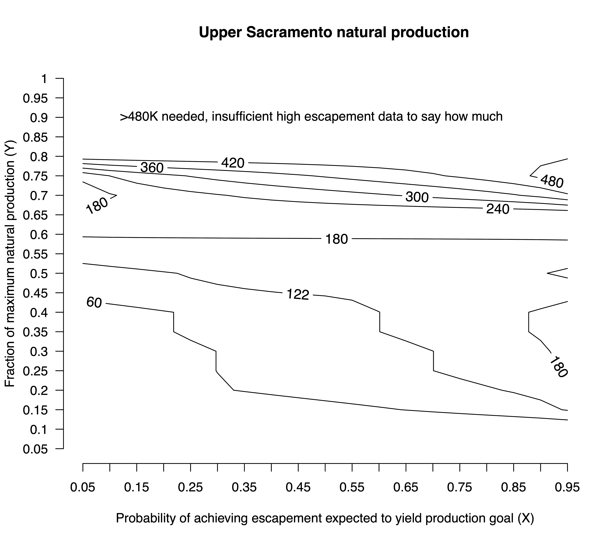
Determine total escapement likely to yield desired fraction of natural production
Satterthwaite (2023), Figure 5A
Notes:
A lot going on here
122K total spawners unlikely to achieve more than half of potential Upper Sac natural production
180K total spawners likely to achieve about 60% of potential Upper Sac natural production
Diminishing returns above 240-300K spawners
Very hard to get more that ~80% of potential Upper Sac natural production, may not be realistic goal
Note contours not as curvy as I expecred, reflects very few high escapement years and thus knife-edge logistic regressions

Slide 35
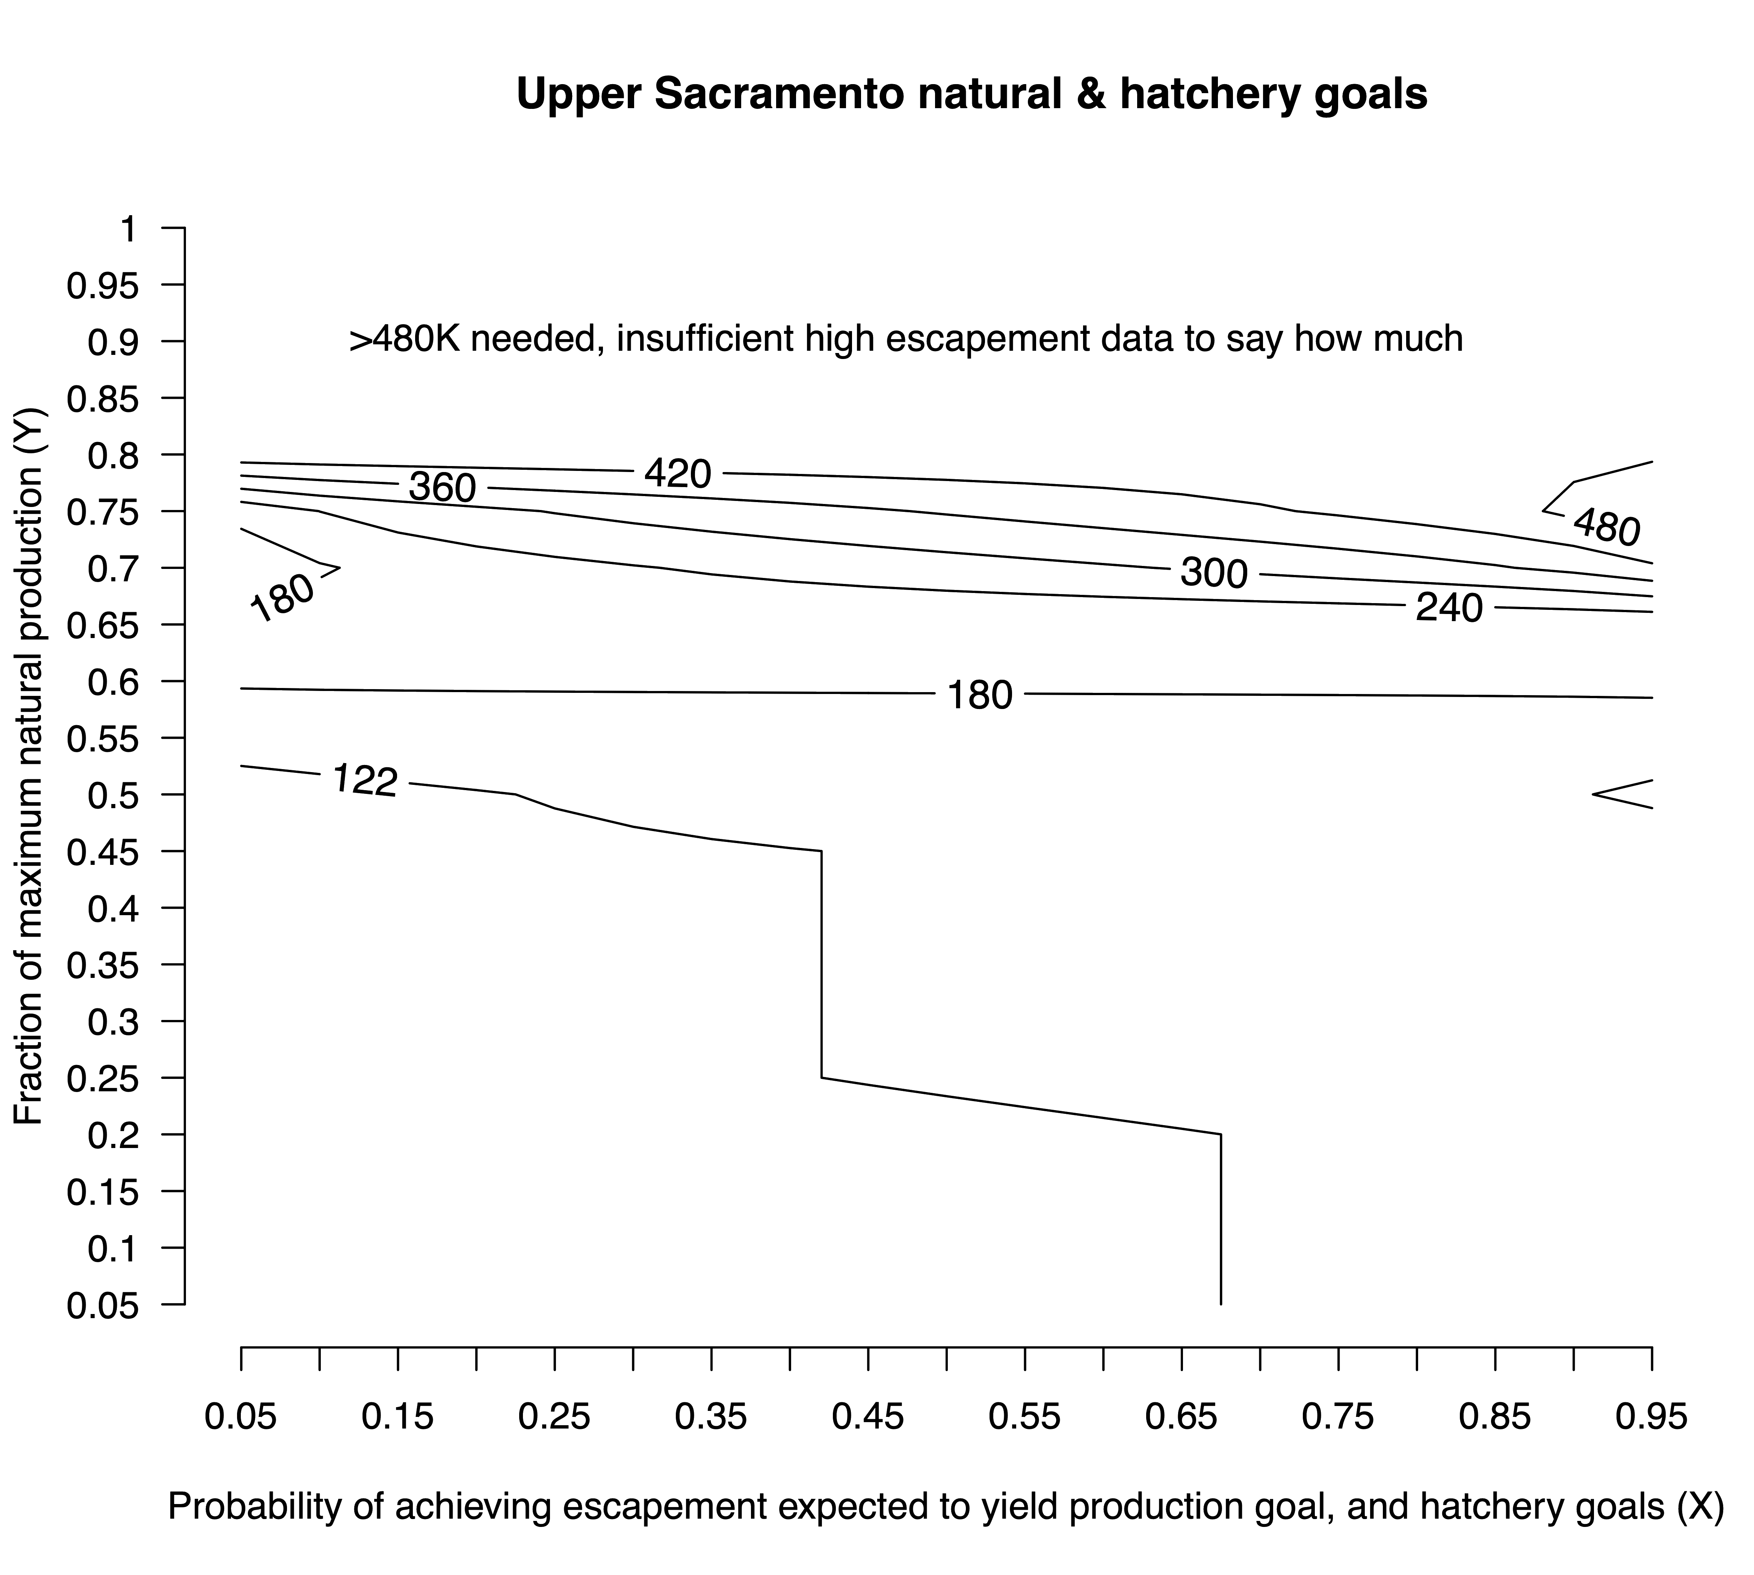
Determine total escapement likely to yield desired fraction of production and meet hatchery goals
Satterthwaite (2023), Figure 6A
Notes:
This looks a lot like the previous contour plot, but reflects that we cannot be highly confident in meeting the hatchery goals with only 122K spawners so the 122 contour doesn’t extend as far to the rifght, and the 60K contour is gone because 60K spawners is almost certainly not sufficient to meet hatchery goals

Slide 36
D. Workgroup Discussion
1. Prioritization of tasks
2. Potential data needs and availability
  Updated hatchery goals / definitions of success
  Data to perform cohort reconstructions for recent and future years
  Viability criteria and/or definition of subunits
  Modified control rule ideas?
  Means to evaluate costs/benefits (e.g. Satterthwaite and Shelton 2023)
3. Estimated timeline/schedule for tasks
4. Potential 2025 salmon methodology review topics

Slide 37
D. Workgroup Discussion
1. Prioritization of tasks
2. Potential data needs and availability
  Updated hatchery goals / definitions of success
  Data to perform cohort reconstructions for recent and future years
  Viability criteria and/or definition of subunits
  Modified control rule ideas?
  Means to evaluate costs/benefits (e.g. Satterthwaite and Shelton 2023)
3. Estimated timeline/schedule for tasks
  180K as interim conservation objective and/or S_{MSY}?
4. Potential 2025 salmon methodology review topics
Notes:
Will finds timelines hard to predict. How fast do we expect advances on any of the data or analytical (or really review of existing analytical methods) needs above? What can we do in the meantime?

Slide 38
D. Workgroup Discussion
1. Prioritization of tasks
2. Potential data needs and availability
3. Estimated timeline/schedule for tasks
4. Potential 2025 salmon methodology review topics

Slide 39
Deferred tasks that could have been informed by proposed review of Satterthwaite & Shelton (2023)
Evaluate forecast performance, compare performance of alternative methods, identify potential scope for improvement
Evaluate consequences for harvest and conservation metrics of changes to control rule
Potential incorporation of a forecast buffer into the control rule
  More objective and repeatable than status quo “escapement target” guidance
  Makes clear whether the goal is actually higher escapement versus concern about forecast error
Potential method for translating qualitative risk tables into quantitative effects on models

Slide 40
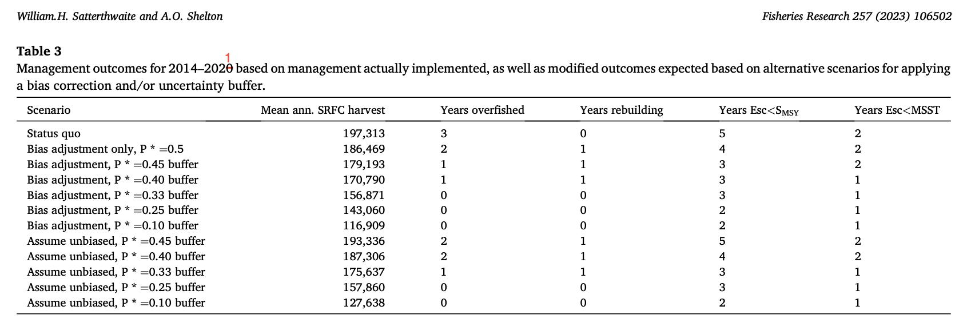
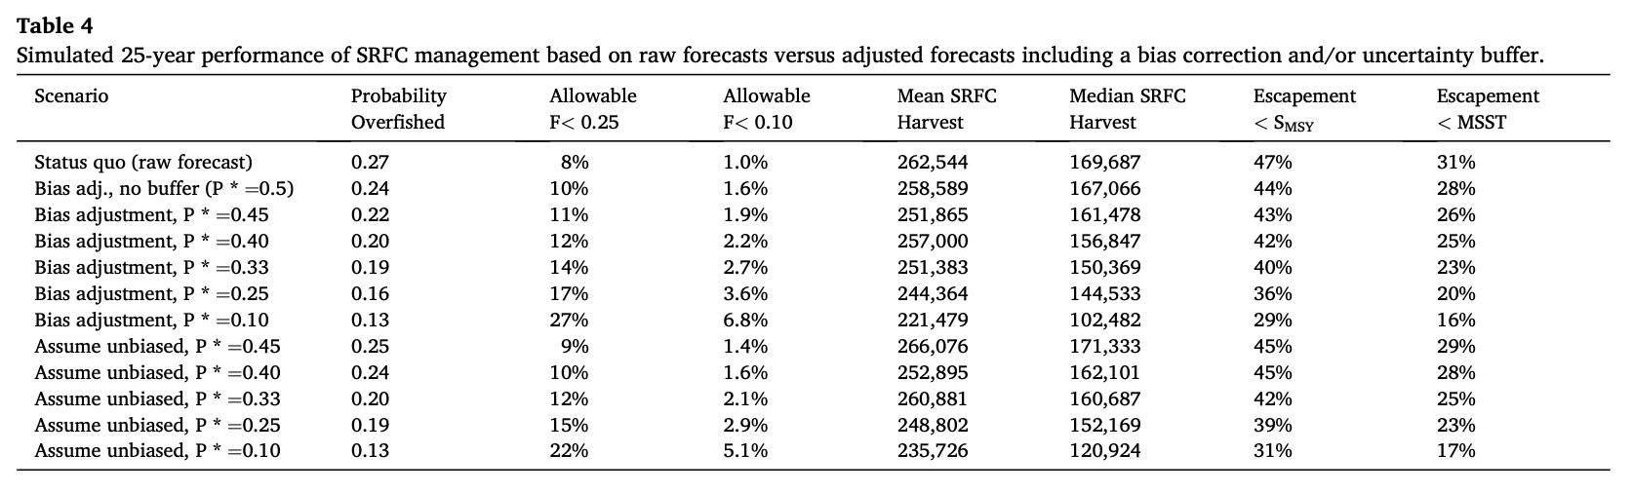

Slide 41
Deferred tasks that could have been informed by proposed review of Satterthwaite & Shelton (2023)
Evaluate forecast performance, compare performance of alternative methods, identify potential scope for improvement
Evaluate consequences for harvest and conservation metrics of changes to control rule
Potential incorporation of a forecast buffer into the control rule
  More objective and repeatable than status quo “escapement target” guidance
  Makes clear whether the goal is actually higher escapement versus concern about forecast error
Potential method for translating qualitative risk tables into quantitative advice, adjustment of models

Slide 42
D. Workgroup Discussion
1. Prioritization of tasks
2. Potential data needs and availability
3. Estimated timeline/schedule for tasks
4. Potential 2025 salmon methodology review topics
  Satterthwaite and Shelton 2023
    Address tasks around control rule and evaluating costs/benefits
    Address tasks around forecast performance
    Complement work on risk tables
  Satterthwaite 2023 (or some update/extension thereof)
    Address conversion between natural-area S_{MSY} and composite conservation objective
    Address evaluation of hatchery success
    Potential use of “diminishing returns” as proxy for S_{MSY} and/or conservation objective
  Do any of the spawner-recruit analyses completed so far merit review?
    Are we ready to propose the results of any of them as new S_{MSY}?

