Slide 1
Harvest Control Rule
SRWG presentation August 7, 2024
Will Satterthwaite, will.satterthwaite@noaa.gov

Slide 2
Key questions on HCR
What escapement(s) should be targeted?
Uncertainty buffers
De minimis considerations
Incorporation of environmental conditions

Slide 3
Key questions on HCR
What escapement(s) should be targeted?
  Uncertainty buffers
  De minimis considerations
  Incorporation of environmental conditions

Slide 4
What escapement(s) should control rule target
Arguments for S_{MSY}
  It’s the status quo
  If S_{MSY} reliably estimated, and if forecast and harvest models are error-free, targeting S_{MSY} would be expected to maximize average yield
Arguments for something else
  OY ecosystem and evolutionary considerations consistent with NS1
  Quality of recreational river fishing experience consistent with NS1
  Broodstock to support desired level of hatchery production
  Effects of uncertainty
Arguments for year-specific values
  Effects of uncertainty
  De minimis considerations
  Expected productivity for escaping spawners

Slide 5

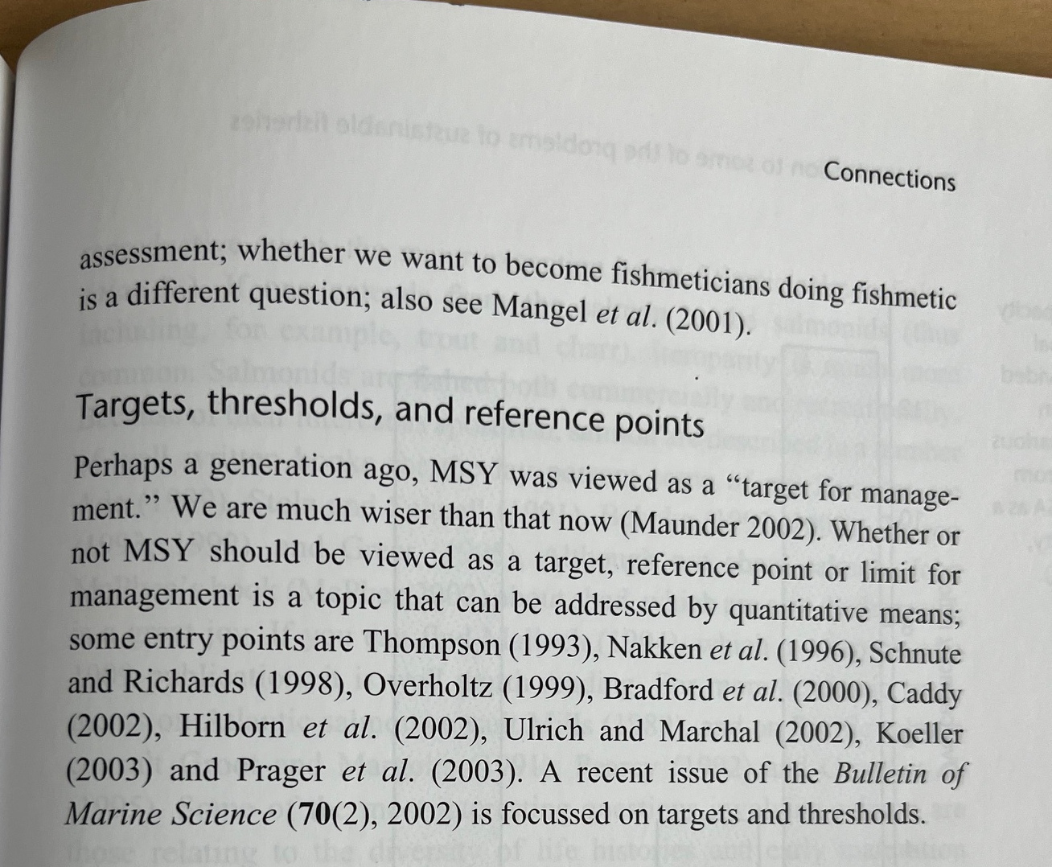

Slide 6
What escapement(s) should control rule target
Arguments for S_{MSY}
  It’s the status quo
  If S_{MSY} reliably estimated, and if forecast and harvest models are error-free, targeting S_{MSY} would be expected to maximize average yield
Arguments for something else
  OY ecosystem and evolutionary considerations consistent with NS1
  Quality of recreational river fishing experience consistent with NS1
  Broodstock to support desired level of hatchery production
  Effects of uncertainty
Arguments for year-specific values
  Effects of uncertainty
  De minimis considerations
  Expected productivity for escaping spawners

Slide 7
National Standard 1
OY is based on MSY as reduced [when expressed as harvest, equating to increased escapement] under paragraphs (e)(3)(iii)(A) and (B) of this section. The most important limitation on the specification of OY is that the choice of OY and the conservation and management measures proposed to achieve it must prevent overfishing.
In determining the greatest benefit to the Nation, the values that should be weighed and receive serious attention when considering the economic, social, or ecological factors used in reducing MSY, or its proxy, to obtain OY are:
  The benefits of food production …
  The benefits of recreational opportunities reflect the quality of both the recreational fishing experience and non-consumptive fishery uses …
  The benefits of protection afforded to marine ecosystems are those resulting from maintaining viable populations (including those of unexploited species), maintaining adequate forage for all components of the ecosystem, maintaining evolutionary and ecological processes (e.g., disturbance regimes, hydrological processes, nutrient cycles), maintaining productive habitat, maintaining the evolutionary potential of species and ecosystems, and accommodating human use.
Ecological factors. Examples include impacts on EC species, forage fish stocks, other fisheries, predator-prey or competitive interactions, marine mammals, threatened or endangered species, and birds. Species interactions that have not been explicitly taken into account when calculating MSY should be considered as relevant factors for setting OY below MSY. In addition, consideration should be given to managing forage stocks for higher biomass than Bmsy to enhance and protect the marine ecosystem. Also important are ecological or environmental conditions that stress marine organisms or their habitat, such as natural and manmade changes in wetlands or nursery grounds, and effects of pollutants on habitat and stocks.
Notes:
We discussed the NS1 aspects pretty thoroughly last meeting, but here they are again for the record.

Slide 8
What escapement(s) should control rule target
Arguments for S_{MSY}
  It’s the status quo
  If S_{MSY} reliably estimated, and if forecast and harvest models are error-free, targeting S_{MSY} would be expected to maximize average yield
Arguments for something else
  OY ecosystem and evolutionary considerations consistent with NS1
  Quality of recreational river fishing experience consistent with NS1
  Broodstock to support desired level of hatchery production
  Effects of uncertainty
Arguments for year-specific values
  Effects of uncertainty
  De minimis considerations
  Expected productivity for escaping spawners

Slide 9
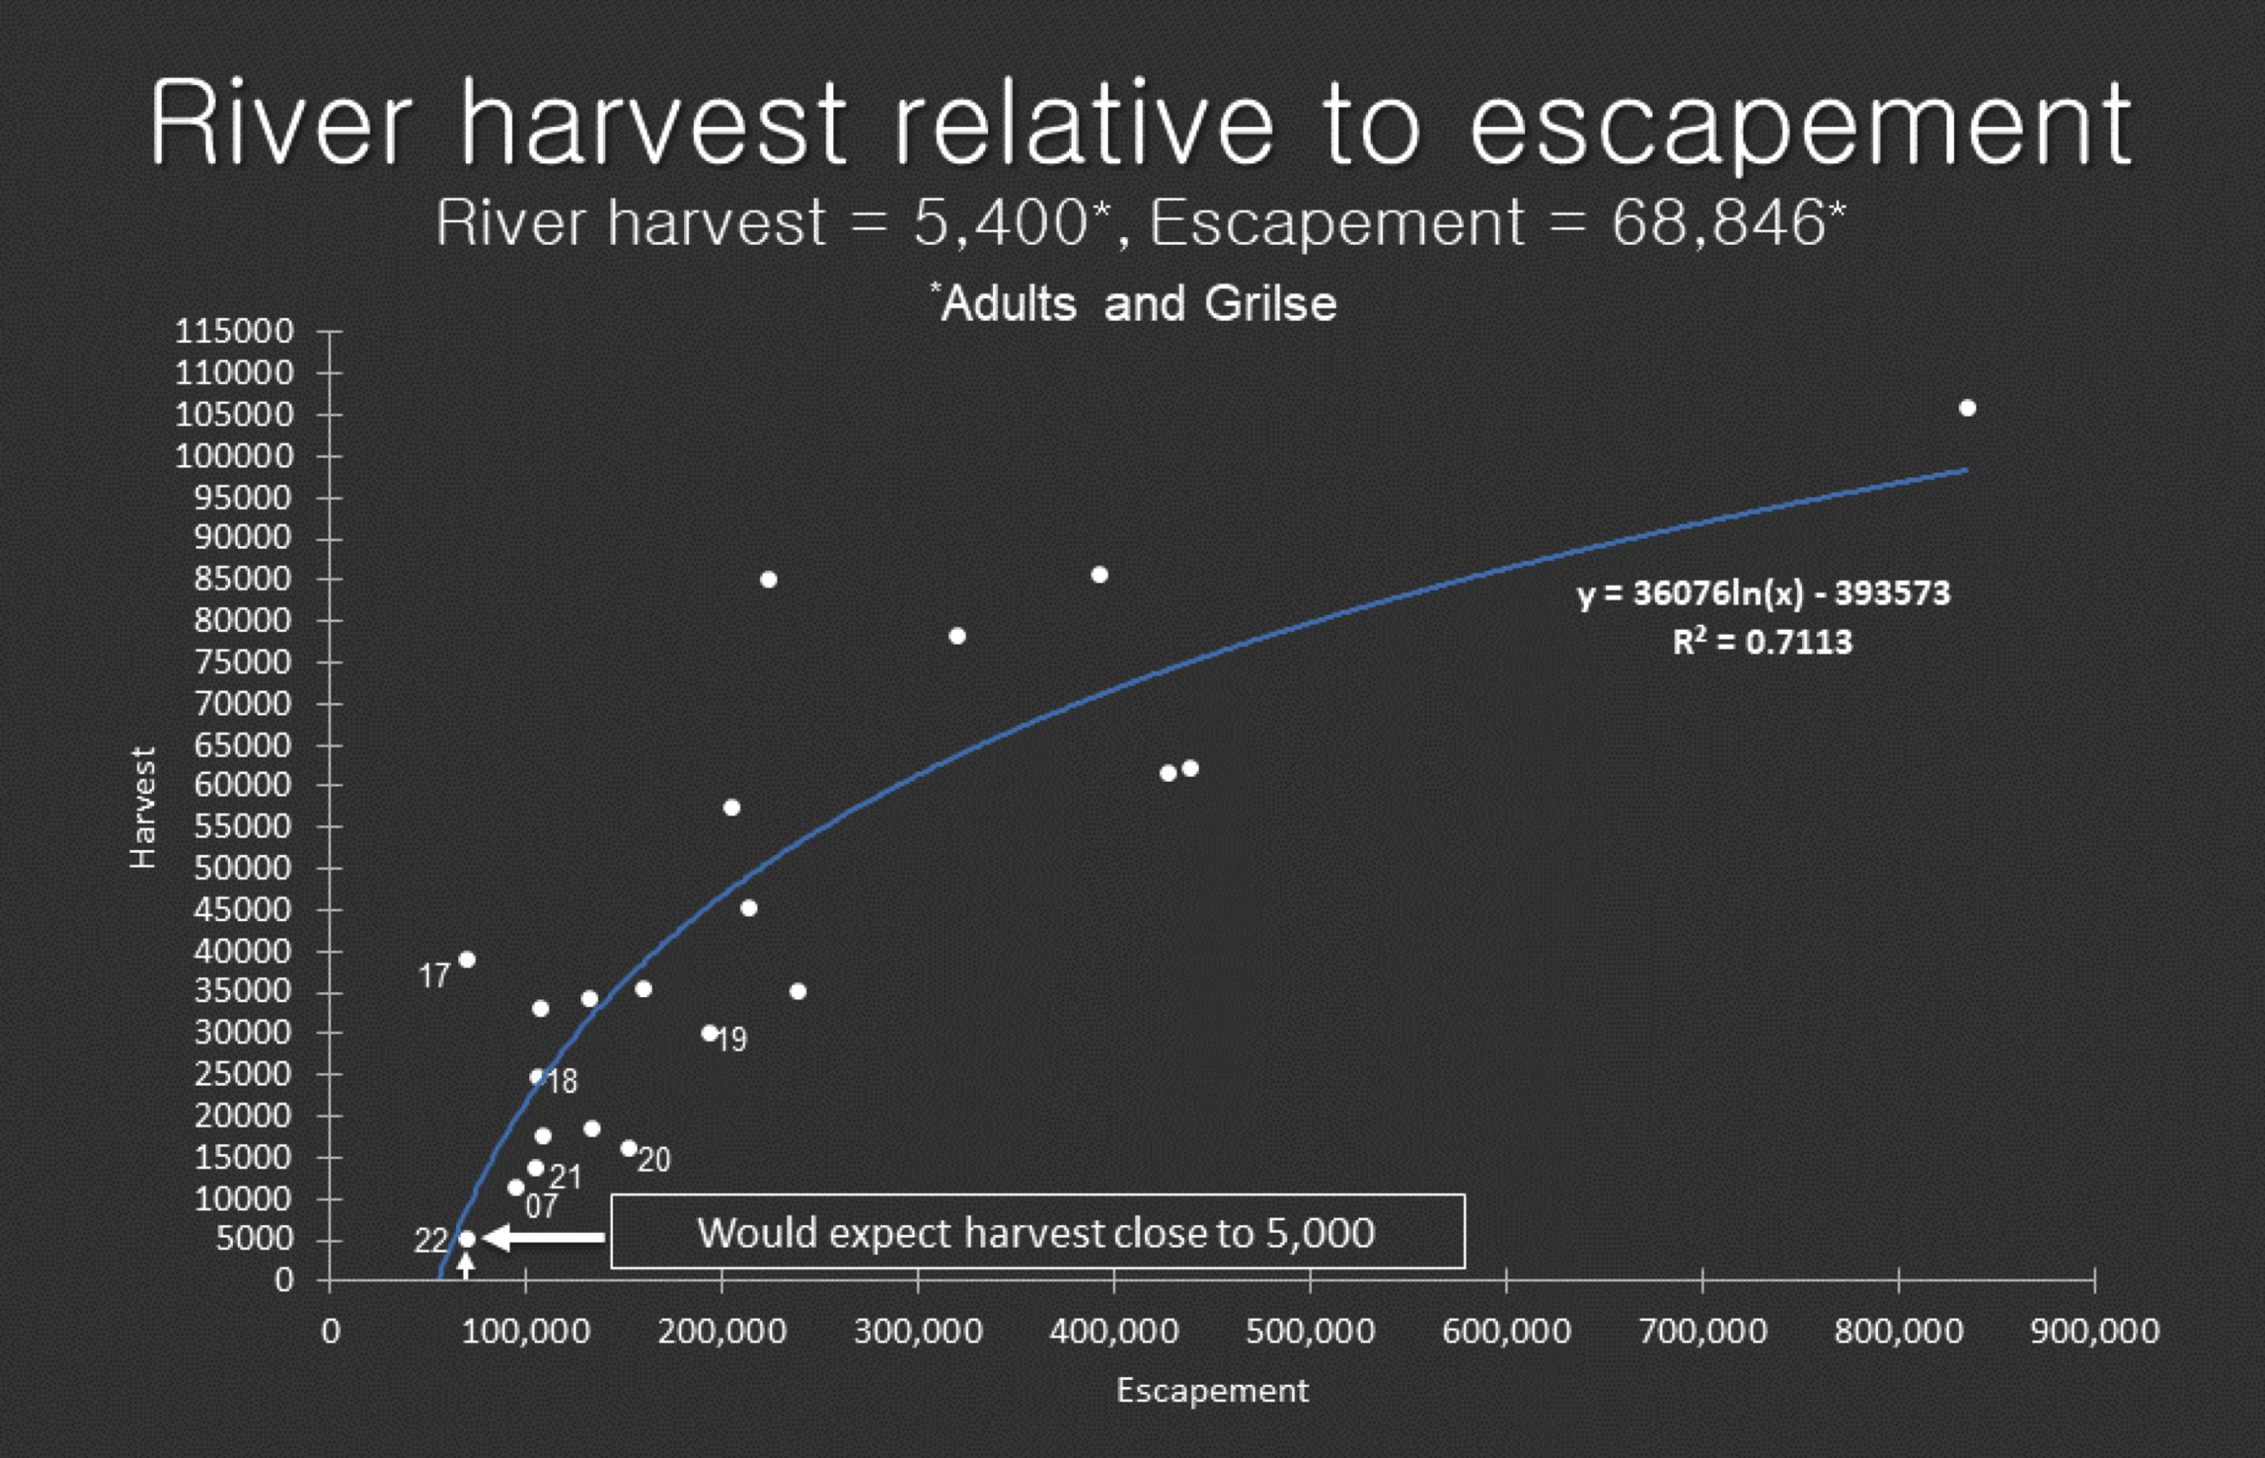
2022
Slide shown by Shawn Simkins during March 1, 2023 CDFW Salmon Information Meeting
Notes:
I would probably redo this analysis with total river run size (and probably adults only) rather than escapement as the x-axis, but the concept seems clear that river run size predicts river harvest reasonably well, so if there was a desired level of river harvest, we could determine the run size likely to provide it.

Slide 10
What escapement(s) should control rule target
Arguments for S_{MSY}
  It’s the status quo
  If S_{MSY} reliably estimated, and if forecast and harvest models are error-free, targeting S_{MSY} would be expected to maximize average yield
Arguments for something else
  OY ecosystem and evolutionary considerations consistent with NS1
  Quality of recreational river fishing experience consistent with NS1
  Broodstock to support desired level of hatchery production
  Effects of uncertainty
Arguments for year-specific values
  Effects of uncertainty
  De minimis considerations
  Expected productivity for escaping spawners

Slide 11
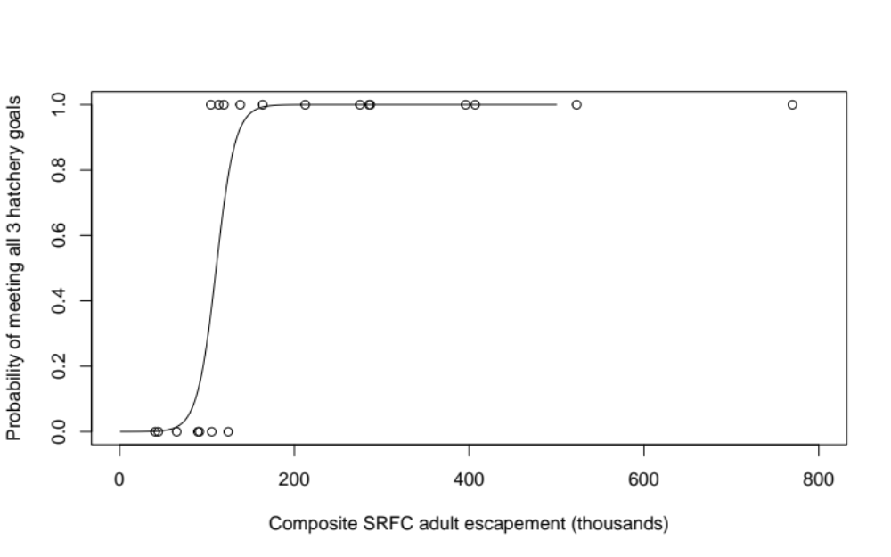
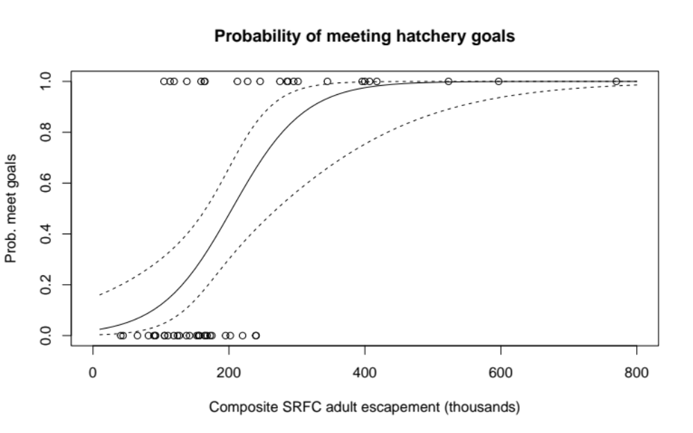
Probability of meeting hatchery goals (currently escapement-based)
Return years 2002-2021
Return years 1970-2021
Satterthwaite (2023), goals as defined in Review Table B-3
Notes:
Main analysis in Satterthwaite 2023 was 2002-2021 to match years with natural production data. Very knife-edge response within those years, no ability to calculate confidence intervals. Longer timesries allowed confidence interval calculation and found a shallower relationship, but hatchery goals may have been different and release practices / stray rates surely were, so not clear how representative. Adding more recent data could be helpful.
For hatchery question, Brett made suggestion to look at hatchery success in terms of meeting production goals rather than meeting escapement goals. And I think the suggestion was just meeting the “mitigation” aspect of the production goals. Is that what we agree is the best approach and if so who wants to find the data to do that analysis?

Slide 12
What escapement(s) should control rule target
Arguments for S_{MSY}
  It’s the status quo
  If S_{MSY} reliably estimated, and if forecast and harvest models are error-free, targeting S_{MSY} would be expected to maximize average yield
Arguments for something else
  OY ecosystem and evolutionary considerations consistent with NS1
  Quality of recreational river fishing experience consistent with NS1
  Broodstock to support desired level of hatchery production
  Effects of uncertainty
Arguments for year-specific values
  Effects of uncertainty
  De minimis considerations
  Expected productivity for escaping spawners
Notes:
One option, which seems somewhat consistent with recent approach of “targeting” 180K or the adjustment to recent CCC standard is to try to estimate the amount of recent bias, and adjust based on a point estimate of that ratio. That’s really an attempt to correct a bias, but does not reflect any “precautionary” buffer against uncertainty, in contrast with how we approach harvest limits for groundfish and coastal pelagic species.

Slide 13
What escapement(s) should control rule target
Arguments for S_{MSY}
  It’s the status quo
  If S_{MSY} reliably estimated, and if forecast and harvest models are error-free, targeting S_{MSY} would be expected to maximize average yield
Arguments for something else
  OY ecosystem and evolutionary considerations consistent with NS1
  Quality of recreational river fishing experience consistent with NS1
  Broodstock to support desired level of hatchery production
  Effects of uncertainty
Arguments for year-specific values
  Effects of uncertainty
  De minimis considerations
  Expected productivity for escaping spawners

Slide 14
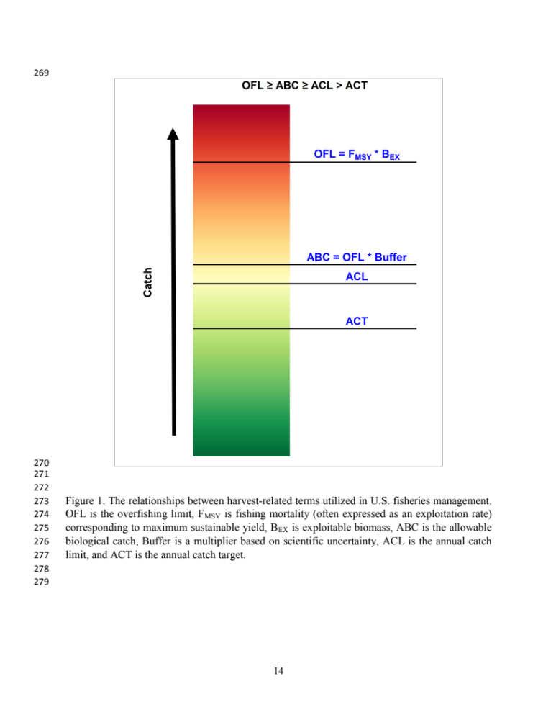
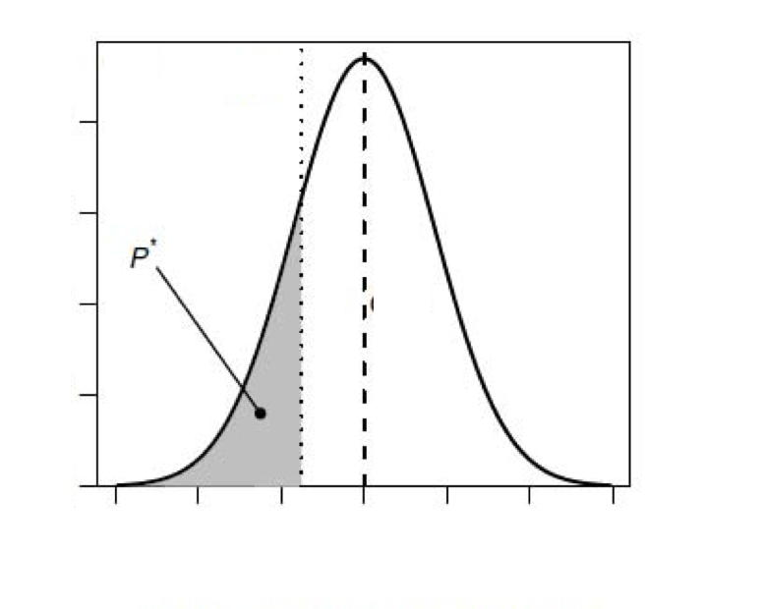
P*/σ approach for deriving ABC from OFL for groundfish and (most) CPS
OFL: maximum amount that can be caught without resulting in overfishing
Buffer = exp(z)
ABC: accounts for scientific uncertainty in the estimate of OFL
ACL & ACT: sector-specific allocations;
management uncertainty/implementation error; relevant ecological, economic, and social considerations
z
0
https://www.pcouncil.org/documents/2017/09/e9_att5_privitera-johnson_estofl_sept2017bb.pdf/
log (OFL_{true} / OFL_{assessed})
Notes:
Remember that for B>>Bmsy, OFL >> the harvest AMOUNT that corresponds to longterm MSY. I.e. RATE is sustainable, AMOUNT initially is not. But also remember that projections adjust OFL for future years to account for expected depletion, also in practice catch may be <<OFL or ABC. Not saying this is a problem per se, but remember it for later.

Slide 15
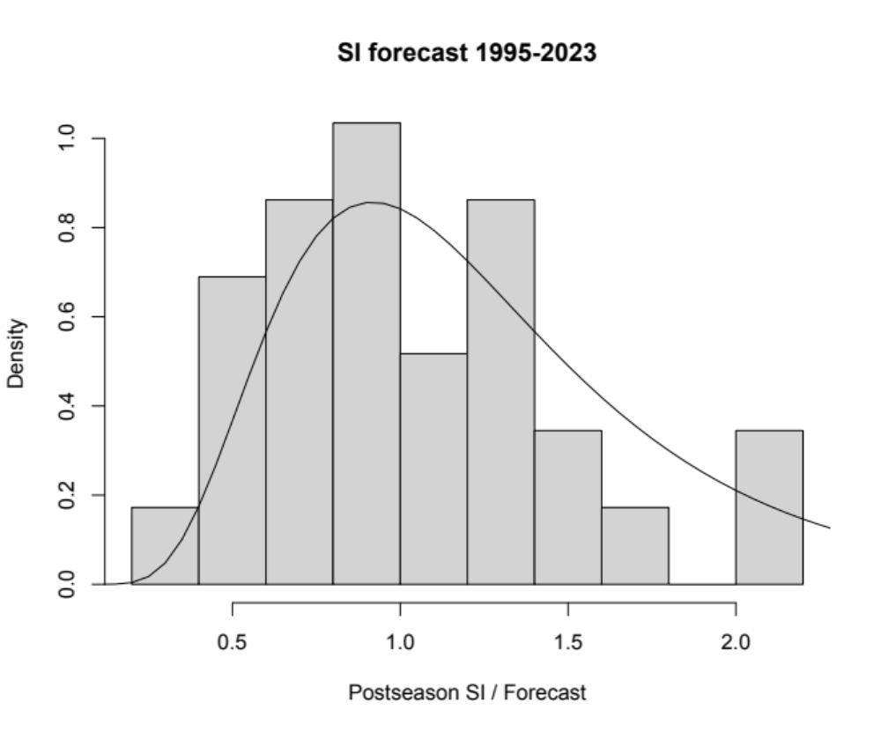
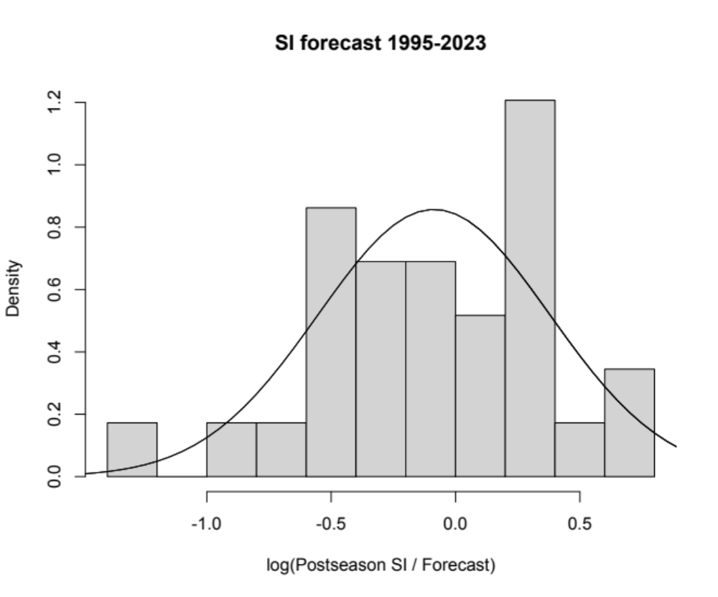
Fit a lognormal distribution describing current SI forecast model’s performance
Log-scale mean: -0.09
Median: 0.92
Log-scale σ: 0.47
CV: 0.49
45th %tile: 0.86
40th %tile: 0.81
25th %tile: 0.67
*In all cases, the 2023 SI forecast method was applied to the data that would have been available at the time.
Notes:
So, the current SI forecast approach appears to be biased toward over-forecasting (on median, the postseason estimate was only 92% of the preseason forecast).
Sigma (log-scale SD, approximately equal to the CV on the arithmetic scale) is pretty close to 0.5, the default sigma for category 1 groundfish assessmebts,
If we want the forecast to be too high no more than half the time, if past performance is representative of the future, we should multiply the forecast by 0.92 before applying the control rule.
The multipliers for lower risk tolerance (e.g. no more than a 45% or 40% chance the forecast is too high, comparable to common P* used for groundfish; or 25%, comparable to ICES approach for Atlantic salmon) get smaller the lower the risk tolerance. These are smaller (ad multipliers, representing larger reductions from the point estimate) than the buffers typically used for groundfish because of the added bias correction, i.e. we assume groundfish assessments are median unbiased but it looks like SI forecasts are biased.

Slide 16
What escapement(s) should control rule target
Arguments for S_{MSY}
  It’s the status quo
  If S_{MSY} reliably estimated, and if forecast and harvest models are error-free, targeting S_{MSY} would be expected to maximize average yield
Arguments for something else
  OY ecosystem and evolutionary considerations consistent with NS1
  Quality of recreational river fishing experience consistent with NS1
  Broodstock to support desired level of hatchery production
  Effects of uncertainty
Arguments for year-specific values
  Effects of uncertainty
  De minimis considerations
  Expected productivity for escaping spawners

Slide 17
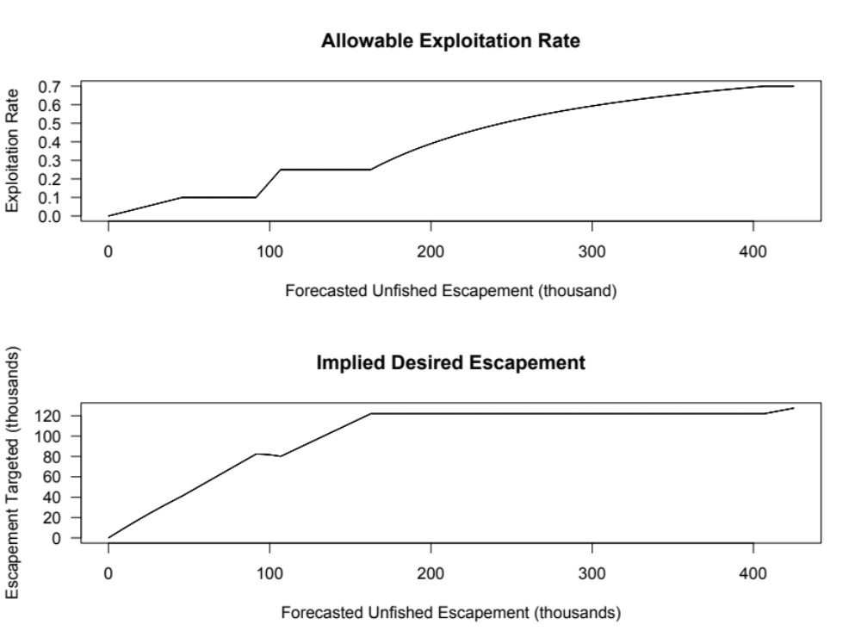
Extreme sensitivity to forecast error
Why break here?
Is this still “better than nothing”? For whom?
Huh?

Slide 18
What escapement(s) should control rule target
Arguments for S_{MSY}
  It’s the status quo
  If S_{MSY} reliably estimated, and if forecast and harvest models are error-free, targeting S_{MSY} would be expected to maximize average yield
Arguments for something else
  OY ecosystem and evolutionary considerations consistent with NS1
  Quality of recreational river fishing experience consistent with NS1
  Broodstock to support desired level of hatchery production
  Effects of uncertainty
Arguments for year-specific values
  Effects of uncertainty
  De minimis considerations
  Expected productivity for escaping spawners
Notes:
Don’t really have something fleshed out here. It seems like CCIEA/HC have come up with indicators with the potential to forecast conditions faced by the offspring of spawners we let escape this year. It might make sense to target something like SMP in years when that would result in a lot of production and a lot of future opportunity, versus something like SMSY in a year where that is not sacrificing much production. Current de minimis provisions provide some precedent for targeting escapement even less than SMSY even in some years when we think SMSY could be achieved. Could a similar logic allow for targeting escapement less than SMSY if we expect poor production? How to balance against risk of low productivity years and some production being better than (almost) none?

Slide 20
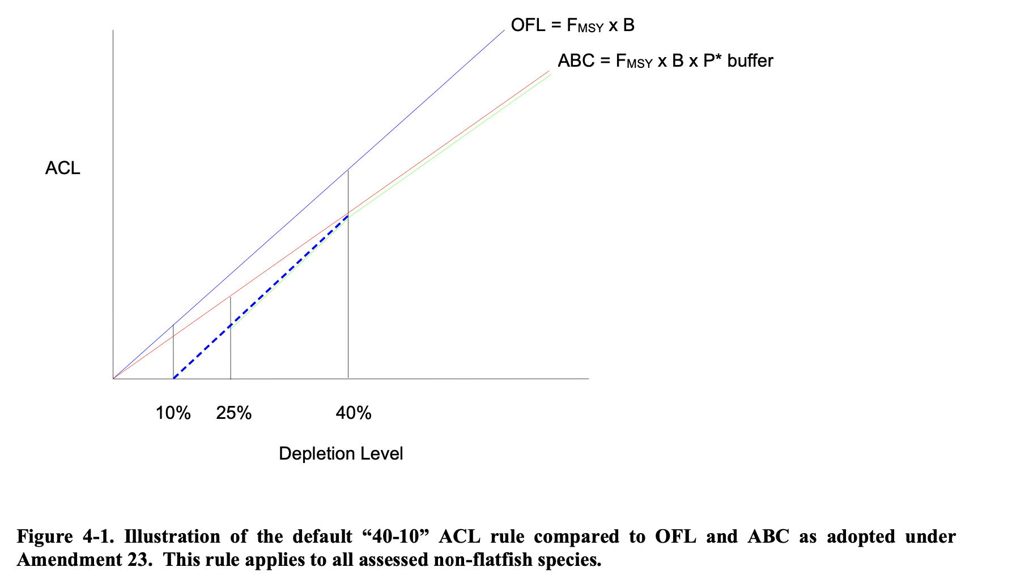
40-10 rule for deriving ACL from ABC for rockfish and roundfish
Notes:
The question has come up, is having a buffer for forecast error redundant with having a control rule that decreases allowable ER at low abundance? I would say no, they are addressing different problems. And similarly, groundfish has both an uncertainty buffer applied in deriving the ABC, and then a 40-10 control rule that reduces the ACL below the ABC at low abundance, so it’s a control rule applied to a buffered quantitty.

