Slide 1
Deep Seabed Hard Minerals Resources Act
30 U.S.C. §§ 1401 et seq
15 C.F.R § 970.100 – 970.2601 (Exploration Leases)
15 C.F.R § 971.100 – 971.1007 (Commercial Recover Permits)

Slide 2
Recent Activities
April 2025. Executive Order 14285 - Unleashing America’s Offshore Critical Minerals and Resources
January 2026. NOAA issued the final rule: Deep Seabed Mining: Revisions to Regulations for Exploration License and Commercial Recovery Permit Applications.
March 2026. A consolidated application—covering both an exploration license and a commercial recovery permit deemed by NOAA to be in substantial compliance with the Act. (The Metals Company USA – Application A and Application B)
March 2026. Two exploration license applications submitted to NOAA for polymetallic nodules (American Metals Resources & SeaX, Inc)

Slide 3
Select Definitions (Sec 1403)
(1) Commercial Recovery
(4) Deep Seabed
(5) Exploration
(12) Administrator

Slide 4
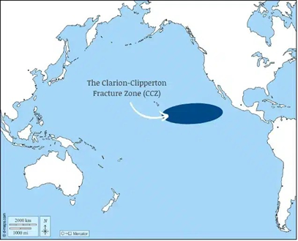
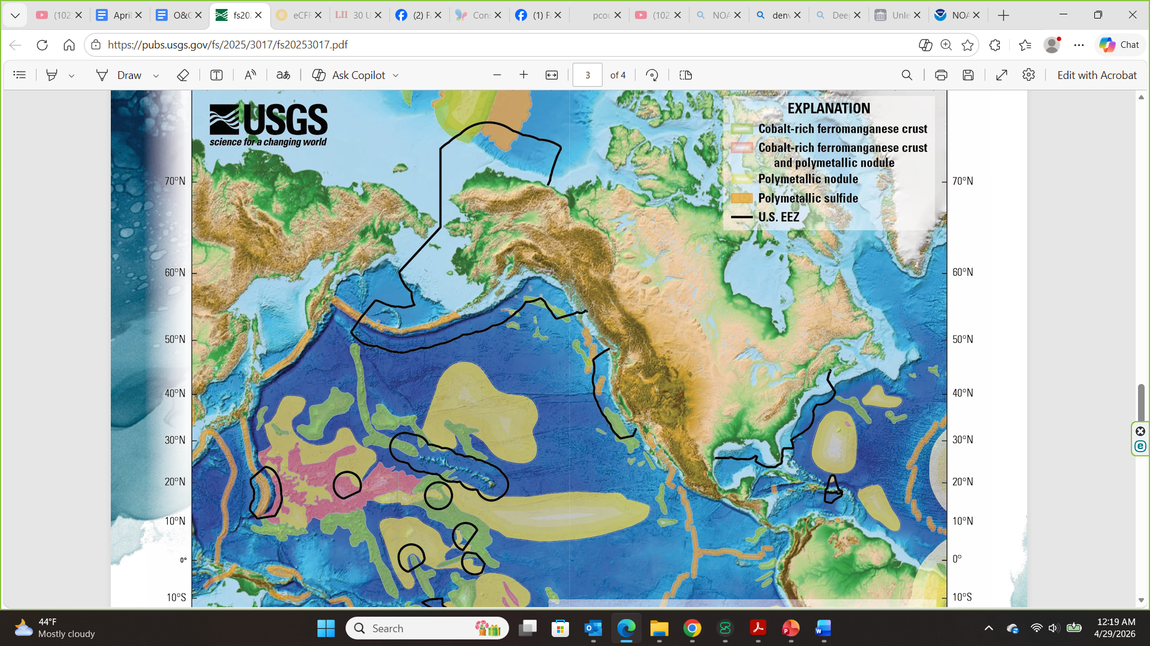
Clarion-Clipperton Fracture Zone (CCZ)

Slide 5
License/Permit T&Cs & Restrictions (Sec 1415)
No Significant Adverse Effect on the quality of the environment
Prior Consultations (Sec 1415(d))
  Prior to making a determination to issue, transfer, modify, or renew a license or permit under this section, the Administrator shall consult with any affected Regional Fishery Management Council established pursuant to section 1852 of title 16, if the activities undertaken pursuant to such license or permit could adversely affect any fishery within the Fishery Conservation Zone, or any anadromous species or Continental Shelf fishery resource subject to the exclusive management authority of the United States beyond such zone.

Slide 6
Other provisions that may be of interest
§ 1419. Protection of the environment
§ 1420. Conservation of natural resources
§ 1421. Prevention of interference with other uses of the high seas

