Slide 1
Pacific OCS Offshore Activities
Marine Planning Committee, Pacific Fishery Management Council
April 30, 2026

Slide 2
Transition to Marine Minerals Administration
The Department of the Interior announced on April 3, 2026, the start of a phased plan to establish the Marine Minerals Administration, bringing together the functions of the Bureau of Ocean Energy Management (BOEM) and the Bureau of Safety and Environmental Enforcement (BSEE).
What to Expect
Phased Transition: Internal alignment activities begin soon.
No Regulatory Rollbacks: Existing requirements remain in full effect.
New Website and Branding: The Marine Minerals Administration’s full digital presence will launch in the coming months.
The https://www.doi.gov/mma-reunification page will be updated regularly

Slide 3
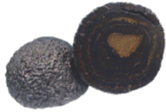

Topics: Overview of leasing processes and Pacific OCS activities
Conventional Energy
Seabed minerals
BOEM oversees prospecting and leasing activities on the federal seabed where critical minerals may be found.
Critical minerals are hard minerals that are in limited supply and that are essential to U.S. economic and national security.
Critical minerals include nickel, cobalt, lithium, manganese, and rare earth elements. The current list of 60 critical minerals is maintained by the U.S. Geological Survey (USGS).
Uses for critical minerals include consumer electronics, energy production, healthcare, transportation, and defense.
BOEM's Outer Continental Shelf (OCS) leasing and program development for oil and gas
National Program
Regional Leasing
Notes:
Critical Minerals - The Energy Act of 2020 defined critical minerals as those that are essential to the economic or national security of the United States; have a supply chain that is vulnerable to disruption; and serve an essential function in the manufacturing of a product, the absence of which would have significant consequences for the economic or national security of the U.S.

Slide 4
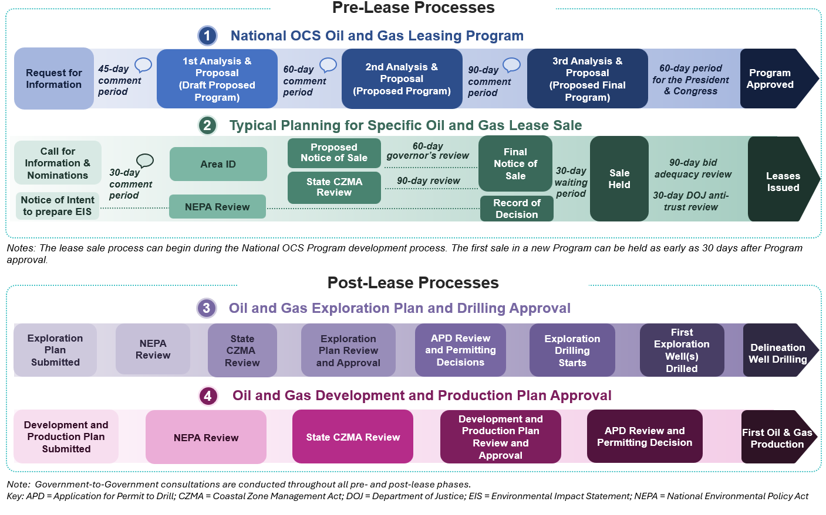
OCS Oil and Gas Leasing, Exploration, and Development Process
Notes:
OCSL Section 18 requires the Secretary to prepare an oil and gas leasing program that consists of a 5-year schedule of proposed lease sales that the Secretary determines best meets national energy needs.

Slide 5
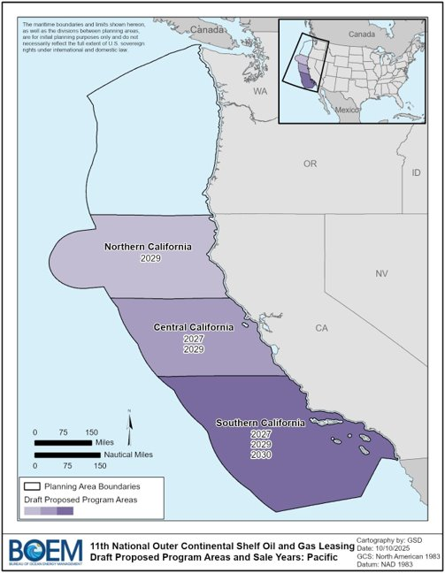
11th National OCS Oil & Gas Program Development
Request for Information (RFI)--published April 2025
    Requested information and comments from stakeholders regarding all 27 OCS planning areas.
  45-day comment period - closed June 2025
Draft Proposed Program – 1st Analysis & Proposal
    Presents analysis of all 27 OCS planning areas
    Presents the Secretary’s 1st Proposal, which reflects areas that remain under leasing consideration
  60-day Comment Period - closed Jan 2026
  1st Proposal Regional Sales in the Pacific Region
    Southern California – 2027, 2029, 2030
    Central California – 2027, 2029
    Northern California – 2029
Proposed Program – 2nd Analysis & Proposal
  Pending
Proposed Final Program – 3rd and Final Analysis & Proposal
Approval
Notes:
Section 18 of the Outer Continental Shelf (OCS) Lands Act, the Secretary of the Interior is responsible for approving a schedule of OCS oil and gas lease sales for a 5-year period.
For any specific lease sale to be held, it must be included in an approved National OCS Program. A lease sale cannot be added later to an existing National OCS Program without an act of Congress.
How frequent - ??
Given that the lease sales are proposed to occur in 2027, and the long lead time needed to prepare, BOEM must initiate the planning process before the National OCS Program has been finalized.
Should any portion of the Call areas remain in the approved National OCS Program, a final determination regarding the area will be made taking into consideration the information gathered from the Call, analysis undertaken during BOEM’s environmental review, and consultations required under the National Environmental Policy Act, and in accordance with other requirements of applicable laws, regulations, and departmental procedures.

Slide 6
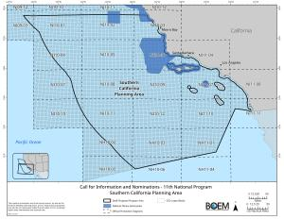
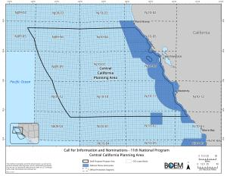
California Oil and Gas Leasing Activities
Call for Information and Nominations
Comment period closed on Feb 26, 2026.
Southern California Call: Covers potential lease sales offshore in the Southern California planning area.
Central California Call: Covers potential lease sales offshore in the Central California planning area.
Programmatic Environmental Impact Statement (PEIS)
Notice of Intent to prepare a programmatic environmental impact statement announced on February 26, 2026
Public scoping period opened on February 27, 2026
Comment period closed March 30, 2026
Comments received are publicly available at https://www.regulations.gov, Docket BOEM-2025-0681.
First sale is tentatively scheduled for 2027 (Draft Proposed Program – 1st Analysis & Proposal)
Notes:
Pursuant to the July 14, 2008, Presidential Memorandum issued in accordance with section 12(a) of the OCS Lands Act, any national marine sanctuary that was designated as of July 14, 2008, is withdrawn from oil and gas leasing for a time without specific expiration. Any NMS created or expanded after that date is not withdrawn from oil and gas leasing per se.
Rules and regulations governing the designation and management of a specific national marine sanctuary may also restrict or prohibit certain activities within that sanctuary.

Slide 7
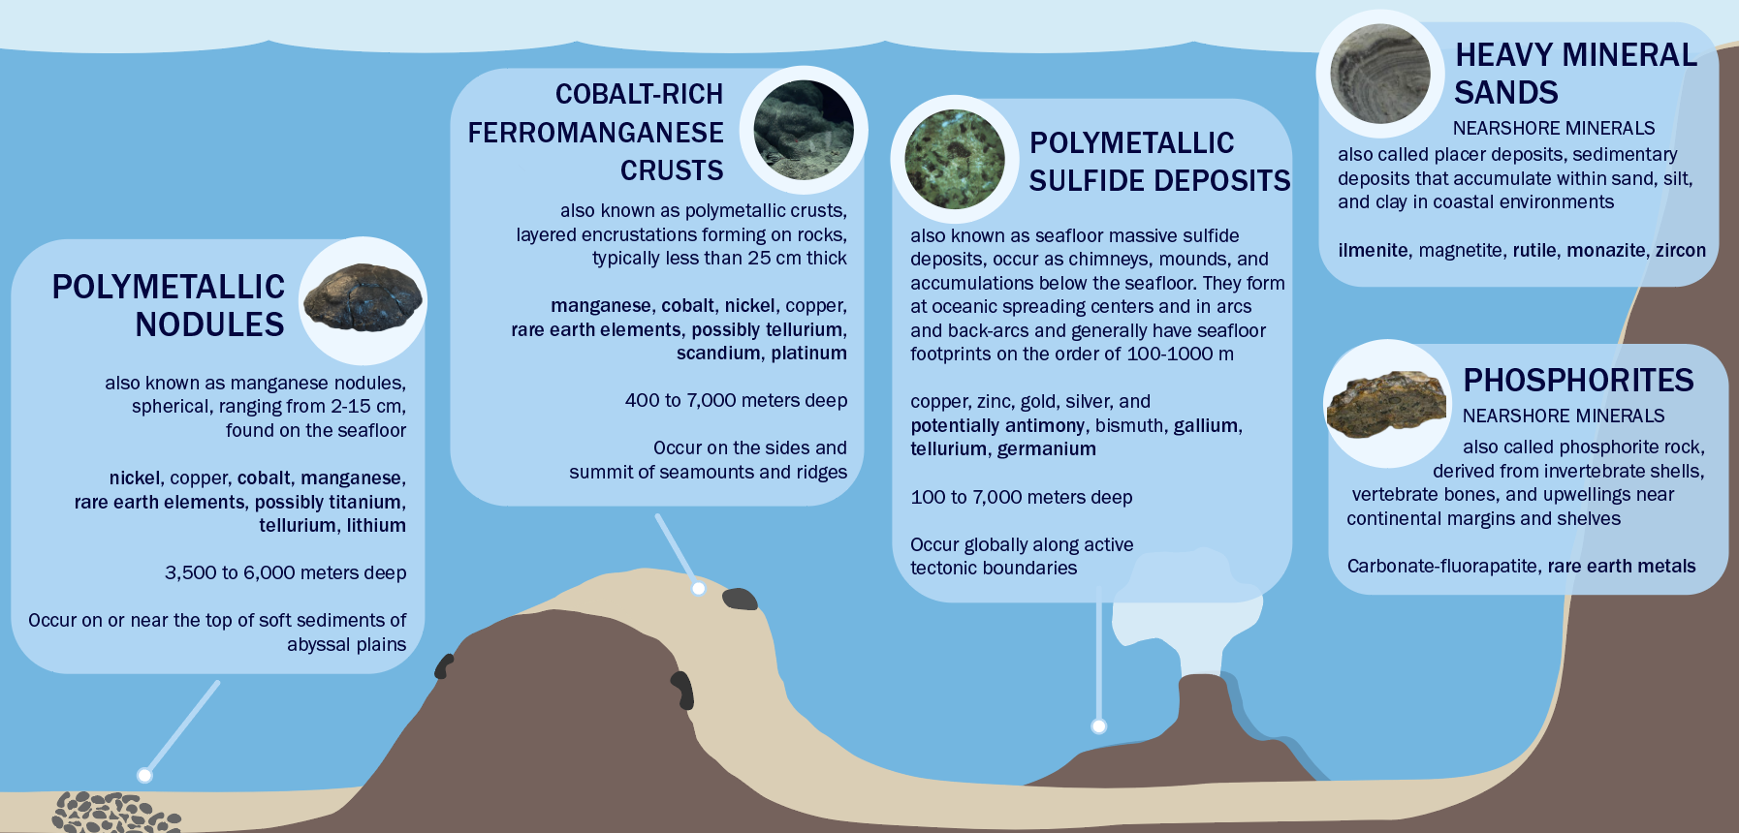
Seabed Minerals
Seabed minerals are mineral deposits that may contain critical minerals
(e.g., nickel, cobalt, manganese, and rare earth elements).

Slide 8
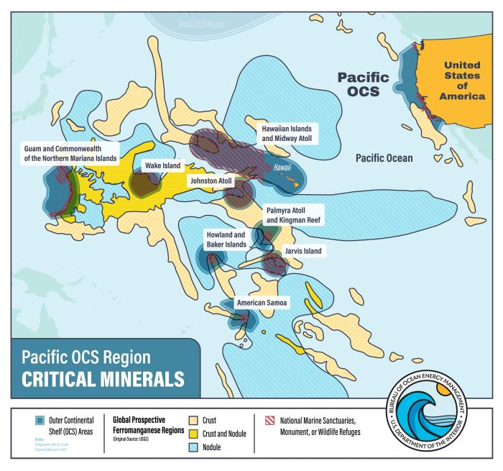
OCS Seabed Minerals
Prospective Maps
  Developed from USGS models indicating areas where minerals are likely to occur based on available data
  Central and Western Pacific are most prospective areas in US EEZ. However, maps do not indicate confirmed mineral presence or viable economic potential
Pacific Region Activities
  American Samoa
  Commonwealth of The Northern Mariana Islands (CNMI)

Slide 9
BOEM Regulatory Pathway for OCS Mineral Leasing (CNMI and American Samoa)
Request for Information and Interest (RFI)
(Published in the Federal Register)
Identification of areas to be considered for leasing
National Environmental Policy Act (NEPA) review on areas
for lease sale
Proposed Leasing Notice (Published in the Federal Register)
Leasing Notice (Published in the Federal Register)
Competitive Lease Sale
Request may include indications of interest
in the leasing and/or specific information and comments
Size sufficiently large to include potentially minable OCS mineral ore bodies
Sale procedures, lease stipulations, payments, and other terms and conditions
Published 60 days prior to Leasing Notice
Bidding mechanism, auction details, and other terms and conditions
Published at least 30 days prior to Lease Sale
Conducted on areas for potential leasing
Territorial engagement occurs throughout the process
Current step in the process: CNMI American Samoa

Slide 10
Authorized Activities on a Lease and Additional Approvals
Authorized Activities on a Lease (30 CFR 582):
  Conduct Preliminary Activities (582.21(d))
      Perform bathymetric, geological, geophysical, mapping, and other surveys to support development of a comprehensive Delineation, Testing, or Mining Plan(s)
  Submit Plan(s) (582.21(b) and (c)) for Technical and Environmental Reviews and Receive BOEM Approval Prior to Conducting Activities
  Plans include:
Delineation Plan
Activities to locate leased OCS minerals, characterize the quantity and quality of the minerals, and generate other information needed for the development of a comprehensive Testing or Mining Plan.
Testing Plan
For any of the following activities:
To collect more information to develop a detailed Mining Plan,
To prepare feasibility studies,
Pilot program(s) to evaluate processing techniques or technology or mining equipment,
To determine environmental effects by a pilot test mining operation.
Mining Plan
Comprehensive detailed descriptions, illustrations, and explanations of the proposed OCS mineral development, production, and processing activities and lessee's proposed plan of operation.

Slide 11
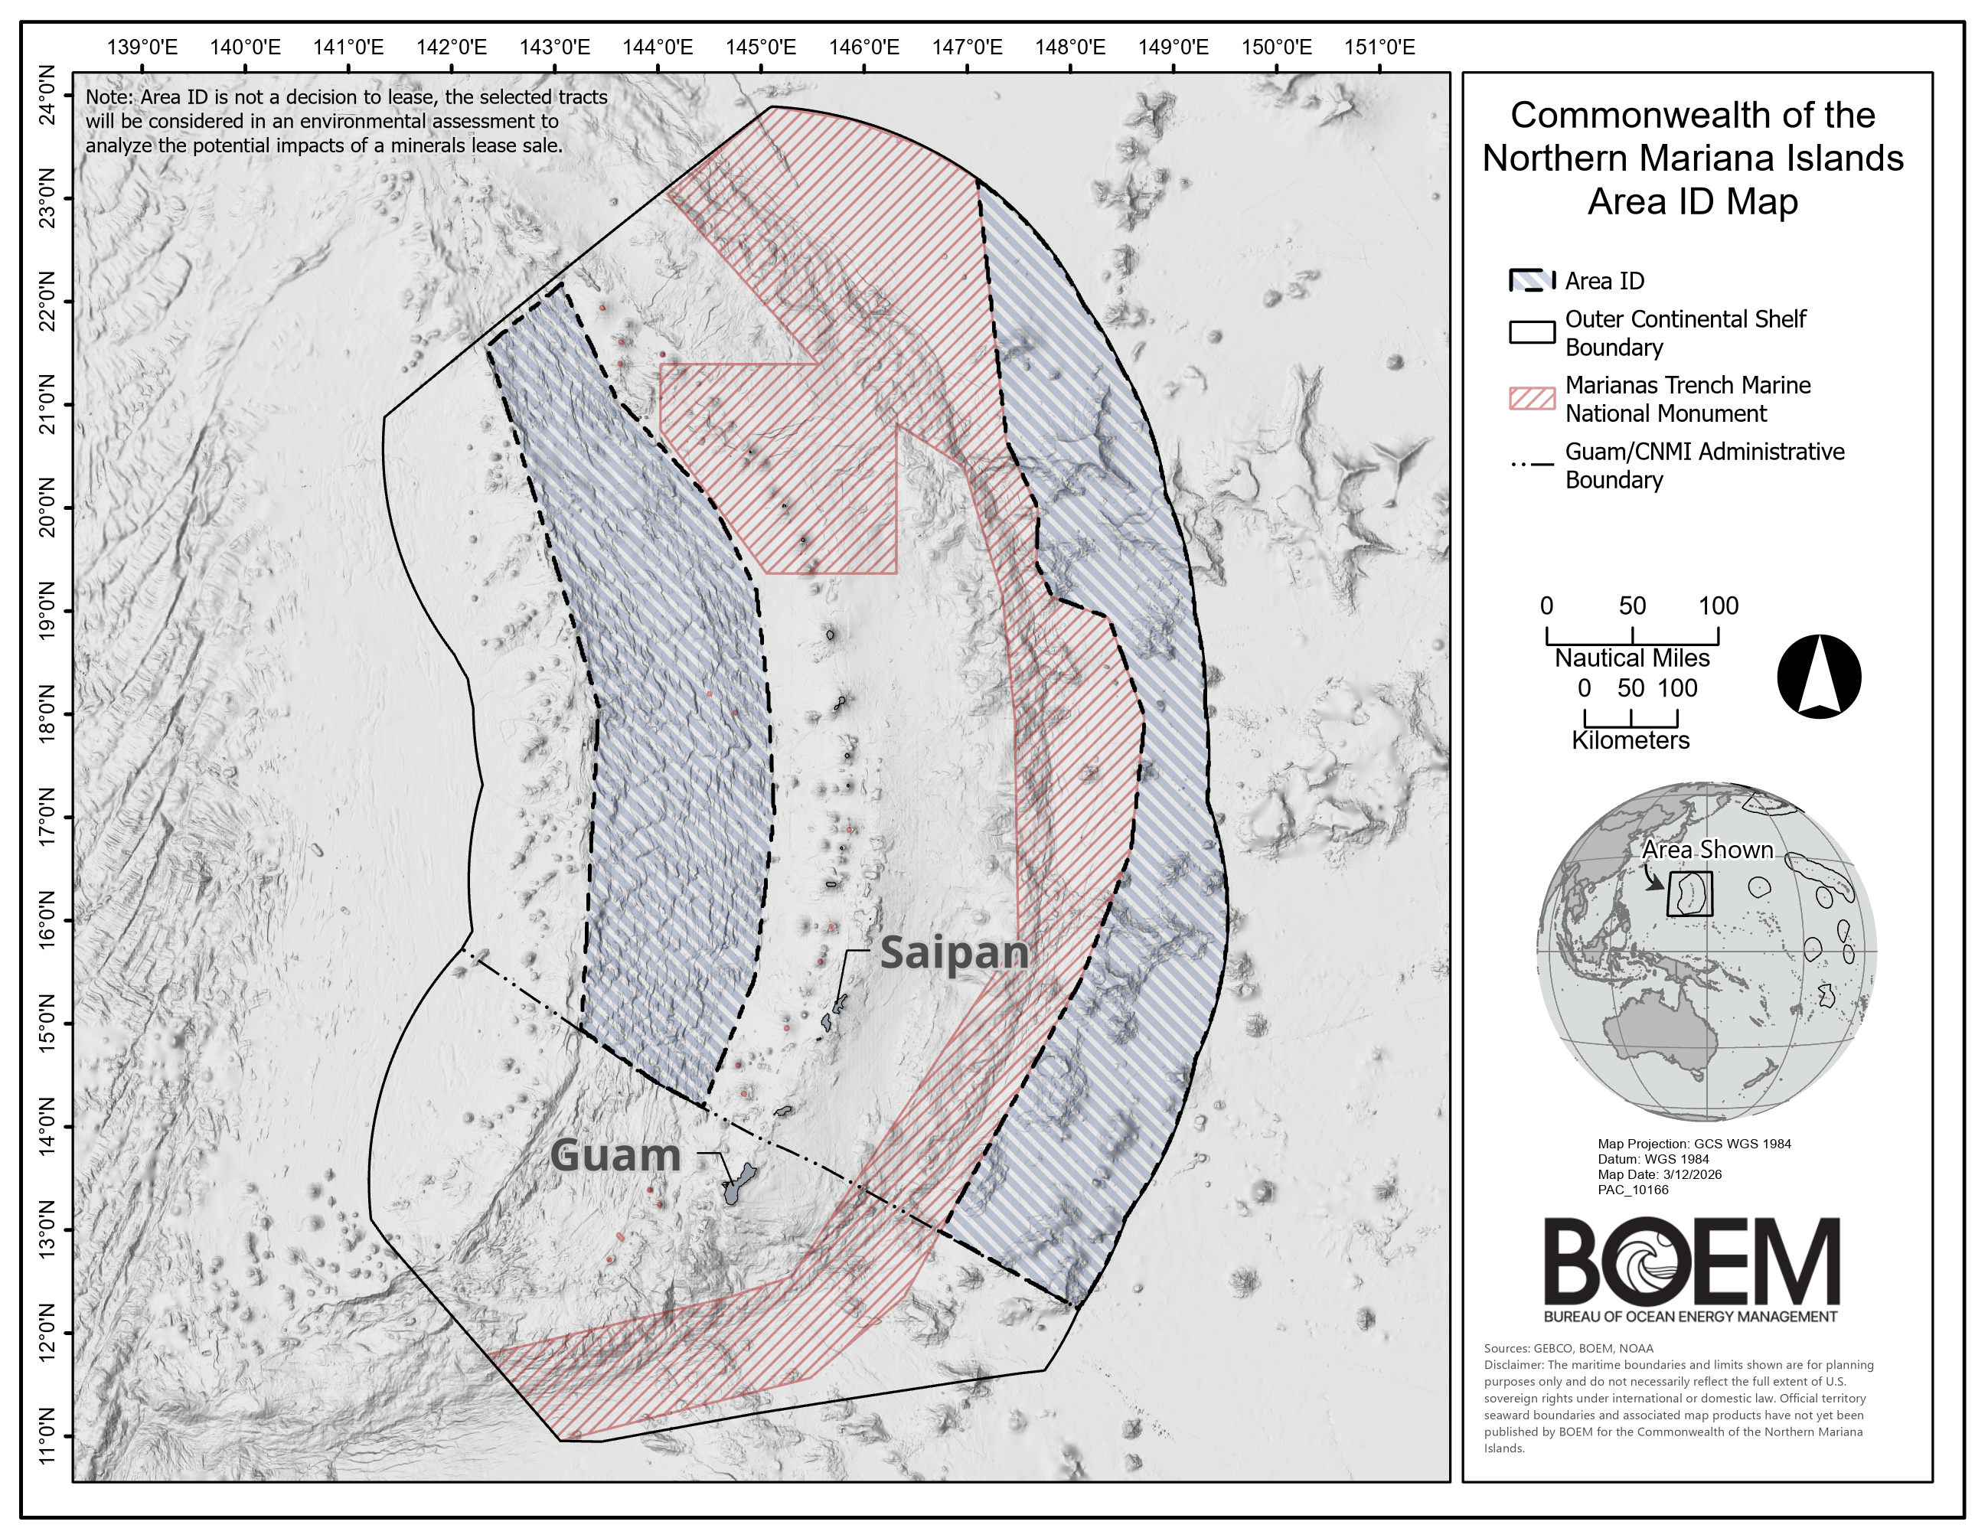
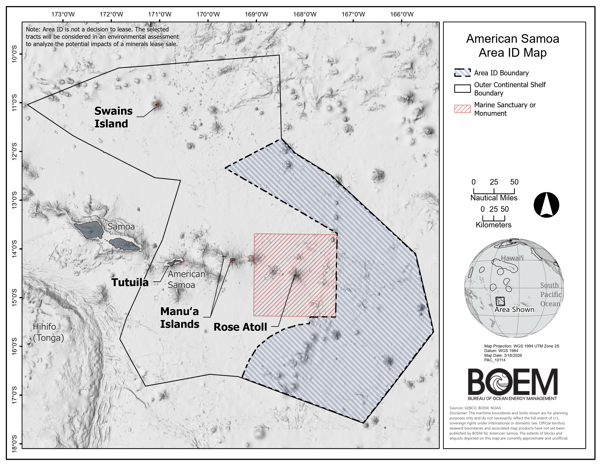
American Samoa and CNMI Status: Determined areas for environmental assessment for possible leasing (Area Identification)
CNMI
Area Identification (Area ID) posted on March 18, 2026
Additional information: https://www.boem.gov/cnmi
American Samoa
Area Identification (Area ID) posted on November 10, 2025
Additional information: https://www.boem.gov/american-samoa

Slide 12
Potential Next Steps
California Oil and Gas
  Area Identification
  Continue work on Programmatic Environmental Impact Statement
OCS Minerals in the Pacific Territories
  Continue Environmental Assessment of areas identified for potential leasing
  Proposed Leasing Notice
BOEM funded studies to continue to collect data and information to inform future decisions

Slide 13
Necy Sumait | Necy.Sumait@boem.gov

