Slide 1
SRFC cohort reconstruction -preliminary results
Will Satterthwaite & Emily Chen
Will.Satterthwaite@noaa.gov & emily-chen@berkeley.edu
SRFC WG meeting June 26, 2024

Slide 2
Council Guidance:
(2) Task the workgroup with evaluating the draft cohort reconstruction that is underway for Sacramento fall Chinook and determine if it will provide substantial improvement and accuracy over current forecasting and modeling methodologies.

Slide 3
Cohort analysis
Cohort progression through time
Things we can observe or sample
age-specific escapement
In-river spawners
Hatchery returns
In-river harvest
Total
abundance
S3
S4
maturation
S2
N1
N2
N3
N4
mortality
F2
F3
F4
M1
M2
M3
M4
Notes:
Age-specific data informs maturation

Slide 4
Cohort Reconstruction
Things we can observe or sample
Hatchery returns
In-river spawners
In-river harvest
Ocean fishery landed harvest of tagged fish
S2
S3
S4
maturation
N1
N2
N3
N4
Total
abundance
Things we want to know
Impacts of fisheries on stocks of interest
Maturation rates
Early life survival
Subadult natural mortality rates – typically assume
F2
F3
F4
M1
M2
M3
M4
mortality

Slide 5
Cohort Reconstruction
Hatchery fish – Brood Year 1998-2016
CWT recovered from spawning grounds, hatcheries, in-river fisheries, ocean fisheries
Natural-origin fish – Brood Year 2008-2016
Unmarked scales aged from spawning grounds by CDFW
Age composition adjusted using Kimura Chikuni bias correction
Natural-origin spawning age-composition
Unmarked natural-origin fish_{a} = Unmarked fish_{a} - unmarked hatchery fish_{a}
Fishery impact assumed to be the same as hatchery cohorts

Slide 6
Preliminary cohort reconstruction outputs
Run Year | SI (postseason estimate) | Potential escapement absent* fishing | Sept 1 ocean abundance | Potential escapement fully unfished
2011 | 207 | 199 | 317 | 205
2012 | 628 | 492 | 878 | 516
2013 | 869 | 665 | 1422 | 746
2014 | 551 | 451 | 828 | 592
2015 | 255 | 206 | 376 | 299
2016 | 205 | 172 | 256 | 212
2017 | 137 | 110 | 184 | 132
2018 | 220 | 174 | 292 | 205
2019 | 507 | 481 | 983 | 540
Abundances are in thousands
*absent fishing means no fishing in current year, but still reflects reductions resulting from ocean fisheries in previous years
Notes:
Directions of difference are not surprising (potential escapement over-estimated by SI because it doesn’t account for natural mortality or fish that don’t mature, also mis-attributes harvest of other natural stocks to SI; ocean abundance under-estimated by SI because it does not account for fish remaining in the ocean for another year nor for nonlanded fishing mortality)
Magnitudes of differences may be larger than expected
Note the distinction between potential escapement if just no fishing this year versus if also accounting for fishing on these corhorts when they were younger

Slide 7
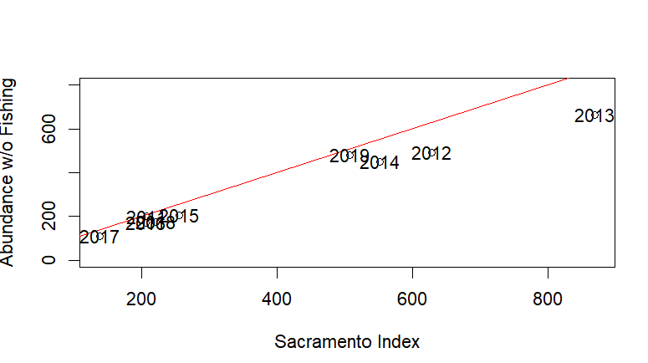
SI over-estimates potential escapement
Run Year | SI (postseason estimate) | Potential escapement absent* fishing | Comparison
2011 | 207 | 199 | 104%
2012 | 628 | 492 | 128%
2013 | 869 | 665 | 131%
2014 | 551 | 451 | 122%
2015 | 255 | 206 | 124%
2016 | 205 | 172 | 119%
2017 | 137 | 110 | 125%
2018 | 220 | 174 | 126%
2019 | 507 | 481 | 105%
More unlikely to achieve target escapement

Slide 8
SI over-estimates potential escapement
Run Year | SI (postseason estimate) | Potential escapement absent* fishing | Comparison
2011 | 207 | 199 | 104%
2012 | 628 | 492 | 128%
2013 | 869 | 665 | 131%
2014 | 551 | 451 | 122%
2015 | 255 | 206 | 124%
2016 | 205 | 172 | 119%
2017 | 137 | 110 | 125%
2018 | 220 | 174 | 126%
2019 | 507 | 481 | 105%
SI vs Potential Escapement
SI includes age-3 fish that wouldn’t have matured
SI ocean harvest component south of Point Arena includes other natural-origin stocks (e.g., San Joaquin fall, CCC, CVSC, SONCC)
This confounds expansion used for ocean-harvest north of Point Arena
Notes:
Contributes to under-achievement of expected escapement?
But exploitation rate calculations also affected – net result unclear

Slide 9
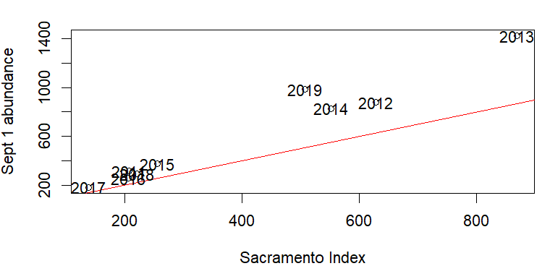
SI under-estimates ocean abundance
Run Year | SI (postseason estimate) | Sept 1 ocean abundance | Comparison
2011 | 207 | 317 | 65%
2012 | 628 | 878 | 71%
2013 | 869 | 1422 | 61%
2014 | 551 | 828 | 67%
2015 | 255 | 376 | 68%
2016 | 205 | 256 | 80%
2017 | 137 | 184 | 74%
2018 | 220 | 292 | 75%
2019 | 507 | 983 | 52%
Could lead to setting in-season quotas too low?
Implications for SRKW abundance threshold
Notes:
Quotas could be set too low, assuming unbiased forecasts

Slide 10
SI under-estimates ocean abundance
Run Year | SI (postseason estimate) | Sept 1 ocean abundance | Comparison
2011 | 207 | 317 | 65%
2012 | 628 | 878 | 71%
2013 | 869 | 1422 | 61%
2014 | 551 | 828 | 67%
2015 | 255 | 376 | 68%
2016 | 205 | 256 | 80%
2017 | 137 | 184 | 74%
2018 | 220 | 292 | 75%
2019 | 507 | 983 | 52%
SI vs Sept 1 abundance
Sept 1 includes fish that ultimately become natural mortalities
SI doesn’t include non-landed mortalities
Could lead to setting in-season quotas too low?
Implications for SRKW abundance threshold
Notes:
Quotas could be set too low, assuming unbiased forecasts.
Implications for SRKW abundance threshold

Slide 11
Fishing mortality accumulates across years
Run Year | Potential escapement absent* fishing | Potential escapement fully unfished | Comparison
2011 | 199 | 205 | 97%
2012 | 492 | 516 | 95%
2013 | 665 | 746 | 89%
2014 | 451 | 592 | 76%
2015 | 206 | 299 | 69%
2016 | 172 | 212 | 81%
2017 | 110 | 132 | 83%
2018 | 174 | 205 | 85%
2019 | 481 | 540 | 89%
Single-year Exploitation Rate calculations may not be capturing the full picture
Notes:
If age-2 fishing mortality is relatively high, and/or age-3 maturation rate for the relevant cohort unusually low, a single year ER may really fail to capture the cumulative impact of fishing on the population. Would be useful to partition effect of age-2 fishing versus depleted age-4

Slide 12
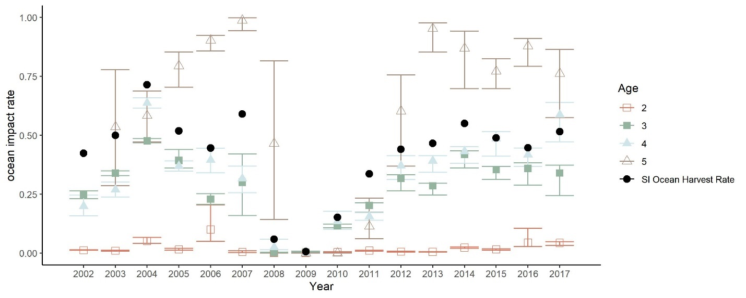
SI-derived Ocean Harvest Rate vs age-specific impact rates
Ocean Harvest is greater than impact of primary ages harvested (age 3 and 4)

Slide 13
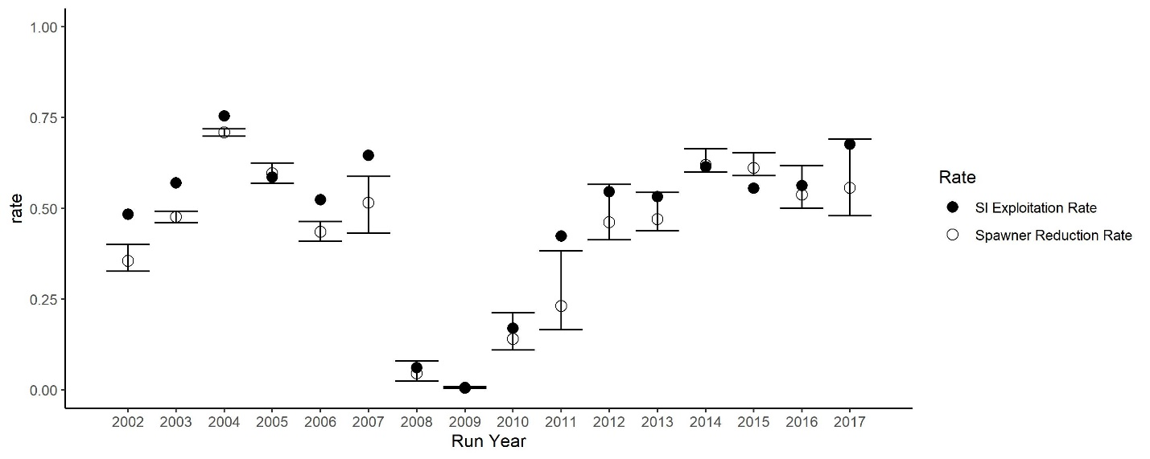
SI-derived Exploitation Rate often greater than SRR

Slide 14
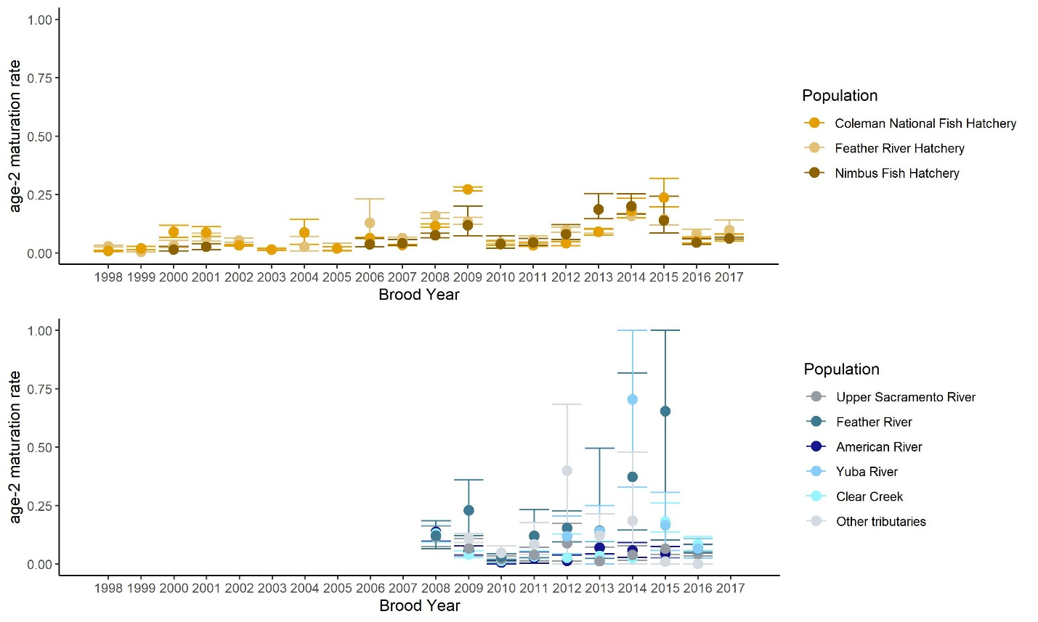
Age 2 maturation rates
Increasing in hatchery populations but not natural-origin, although time series for natural-origin is shorter

Slide 15
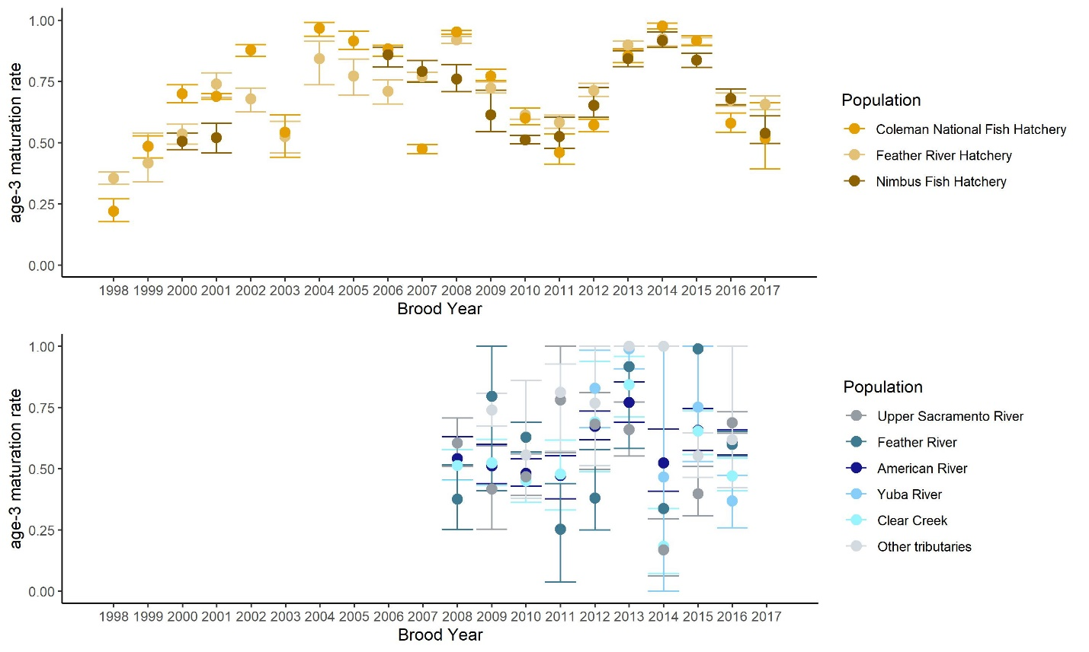
Age 3 maturation rates
Lots of year-to-year variation in age-3 maturation rates.
Also an increase in age-3 hatchery maturation rates over time

Slide 16
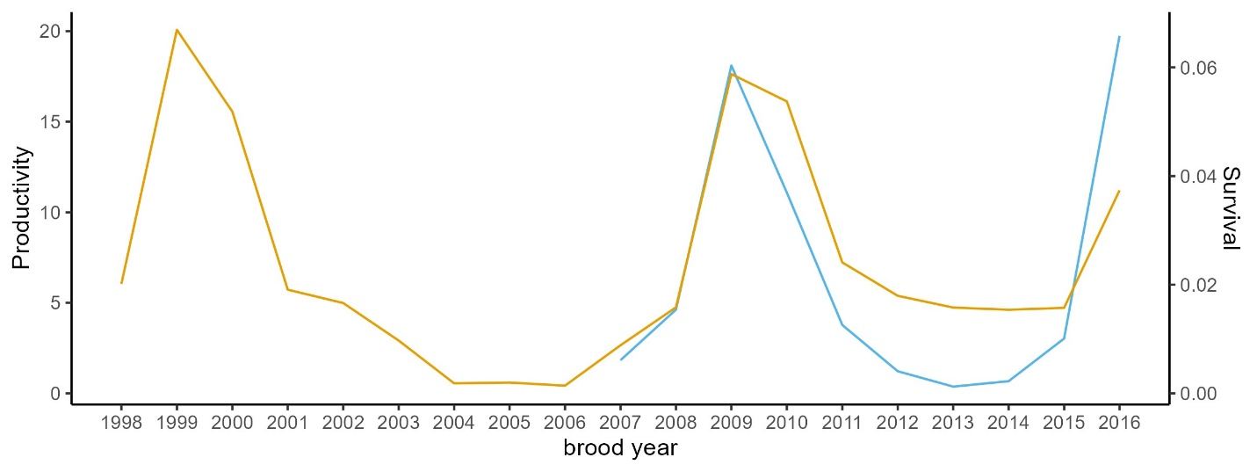
Outmigration production (NO) and survival (HO)
corr = 0.84
Year-1 survival (i.e., from release to age-2) of hatchery cohorts (gold) and productivity (age-2 recruits per spawner) of natural-origin broods (blue).
*note different axis (points in years not directly comparable)

