Slide 1
Fisheries Ecosystem Plan Initiative 4
Sacramento River Fall Chinook Ad-Hoc Workgroup Presentation
June 25, 2024

Slide 2
Initiative 4
Also known as the Ecosystem and Climate Information for Species, Fisheries, and FMPs
Goals:
review the incorporation of climate and ecosystem information into the Council’s harvest-setting and fisheries management processes,
determine the need and appropriate timing for additional, FMP-specific ecosystem and climate information, and
where there is a need for additional ecosystem and climate information, develop clear pathways for it to be used in the setting of scientific uncertainty, harvest policy, and specific management actions.
https://www.pcouncil.org/actions/ecosystem-and-climate-information-for-species-fisheries-and-fmps/

Slide 3
Initiative 4 - Timeline
Discussions began in 2022
Detailed workplan in March 2023
Draft risk tables presented in Sept 2023
Reviewed by SSC in Nov 2023
EWG presented an update in March and received direction from the Council based on the HC report
https://www.pcouncil.org/actions/ecosystem-and-climate-information-for-species-fisheries-and-fmps/

Slide 4
https://www.pcouncil.org/documents/2023/08/f-1-a-ewg-report-1-with-edit.pdf/

Slide 5
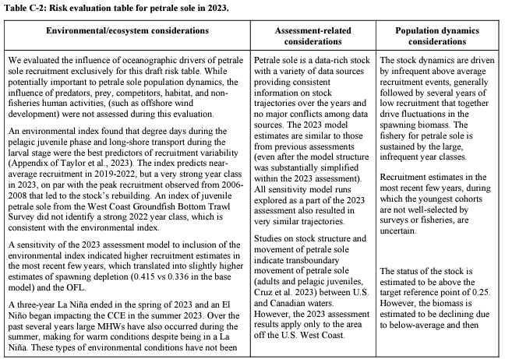
https://www.pcouncil.org/documents/2023/08/f-1-a-supplemental-ewg-report-2-risk-evaluation-tables-for-petrale-sole-and-sablefish.pdf/

Slide 6
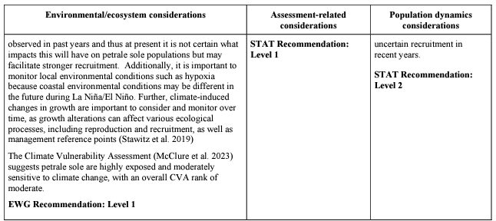
https://www.pcouncil.org/documents/2023/08/f-1-a-supplemental-ewg-report-2-risk-evaluation-tables-for-petrale-sole-and-sablefish.pdf/

Slide 7
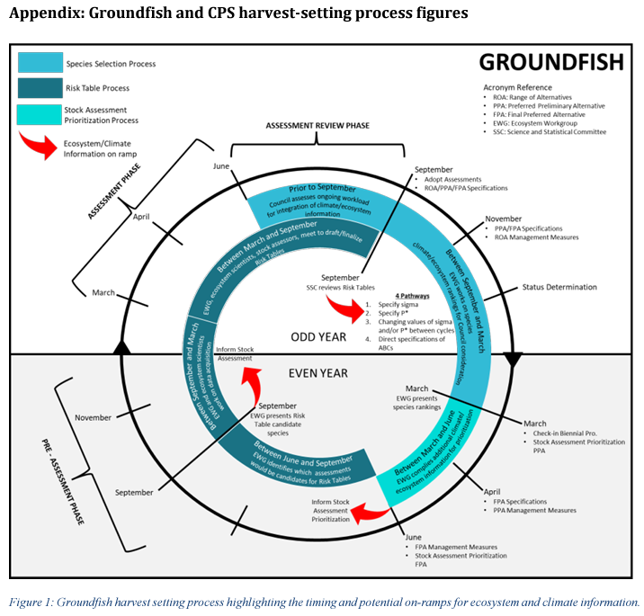
https://www.pcouncil.org/documents/2024/02/agenda-item-h-2-a-supplemental-ewg-report-1-initiative-4.pdf/

Slide 8
March Council Direction
Task the EWG to work with NMFS ecosystem, groundfish, and other science center staff to further explore development of a methodological framework for risk tables and apply ti to groundfish, as described in Agenda Item H.2.a Supplemental EWG Report 2, item 1.
Include in this a retrospective analysis of how risk tables would have impacted decision making in past groundfish assessments if they had been used in the manner currently envisioned.
If sablefish and Petrale sole are approved for assessment in 2025 or the risktables are approved for use without a new assessment; update, finalize, and include their risk tables to be considered as a part of those stock assessments and the 2027-2028 harvest specifications process.
Task the EWG to work with NMFS and the appropriate advisory bodies to broaden the application of risk tables to the Salmon FMP as described in Agenda Item H.2.a Supplemental HC Report 1.
Delay Council development of risk table for data-limited species or groups or other FMP species until a later date.
https://www.pcouncil.org/documents/2024/03/h-2-motion-in-writing-march-2024.pdf/

Slide 9
March HC Report
As noted in our March 2023 comments, the HC continues to support work to develop ecosystem on-ramps for Sacramento and Klamath River fall Chinook salmon. Sacramento fall Chinook salmon are recommended because of their overall vulnerability to changing freshwater climate conditions. The HC and other advisory bodies have suggested Klamath River fall Chinook salmon because of substantial impending changes to freshwater habitat/ecosystem due to dam removal, combined with data streams that will include pre-, during, and post-dam-removal periods. Also, currently, there are necessary changes of monitoring of spawners in the system, which supports the need for an alternate approach.
Since stop light tables for both Klamath and Sacramento fall Chinook salmon have been developed, these tables could be refined, e.g. by weighting indicators or inclusion of additional indicators such as the habitat compression index, into numerical risk tables for integration into salmon management. This work could be facilitated by the efforts of the existing working groups reviewing conservation objectives for Sacramento and Klamath River fall Chinook salmon runs. Members of the HC could also work with the Integrated Ecosystem Assessment Team, the Scientific and Statistical Committee, or the Ecosystem Workgroup to determine how best to accomplish this.
https://www.pcouncil.org/documents/2024/03/agenda-item-h-2-a-supplemental-hc-report-1-habitat-committee-report-on-fishery-ecosystem-plan-initiative-4-progress-review.pdf/

Slide 10
https://www.pcouncil.org/documents/2023/08/f-1-a-ewg-report-1-with-edit.pdf/

Slide 11
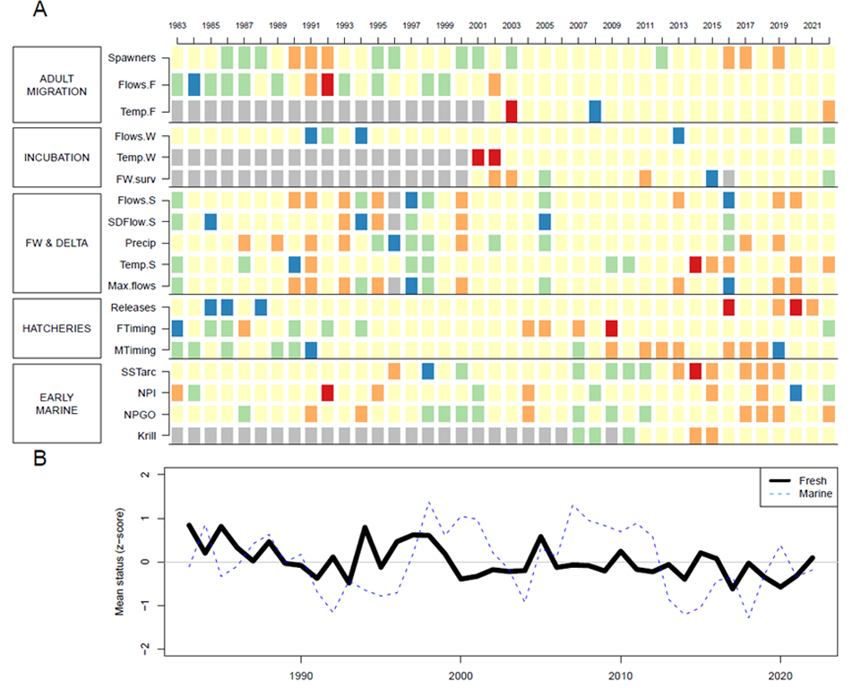
https://www.pcouncil.org/documents/2024/02/agenda-item-h-1-a-cciea-team-report-1-2023-2024-california-current-ecosystem-status-report-electronic-only.pdf/

Slide 12
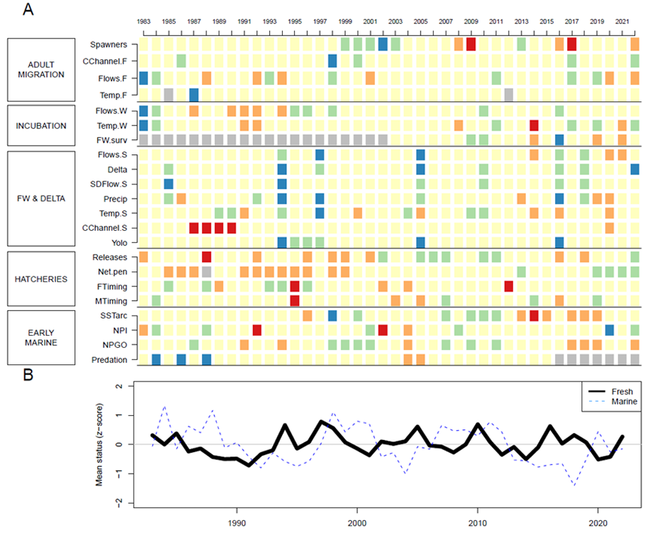
https://www.pcouncil.org/documents/2024/02/agenda-item-h-1-a-cciea-team-report-1-2023-2024-california-current-ecosystem-status-report-electronic-only.pdf/

Slide 13
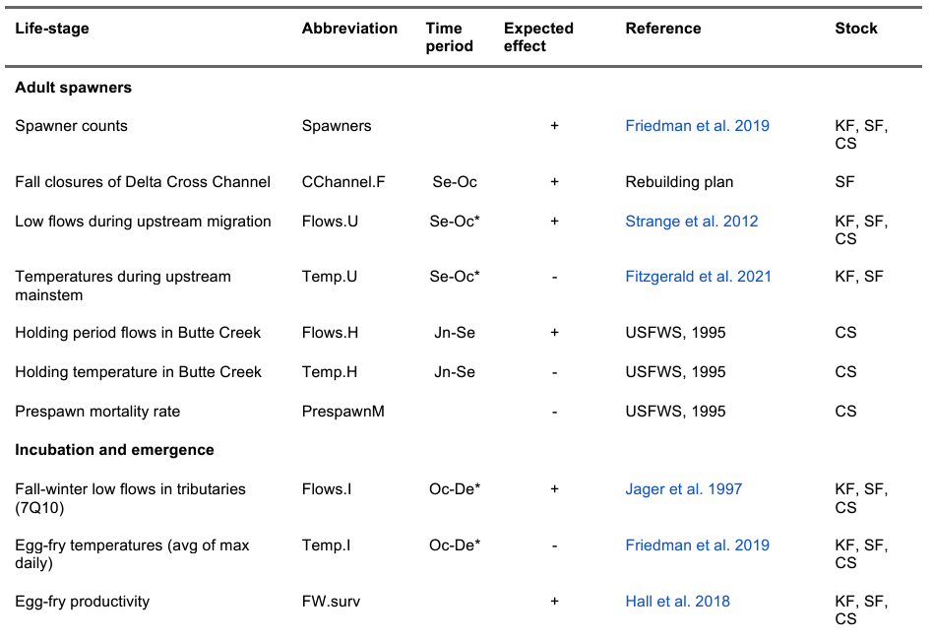
https://www.pcouncil.org/documents/2024/02/agenda-item-h-1-a-cciea-team-report-1-2023-2024-california-current-ecosystem-status-report-electronic-only.pdf/

Slide 14
Discussion
How could risk tables, stop light tables, or other approaches be used to improve use of ecosystem information in Sacramento and Klamath River fall Chinook?
Next steps?
SSC-ES
Salmon Methodology
Timeline?
September Briefing Book

