Slide 1
SRFC conservation objective and reference points – next steps Part 2: Exploitation
Will Satterthwaite
Will.Satterthwaite@noaa.gov
SRFC WG meeting June 25, 2024

Slide 2
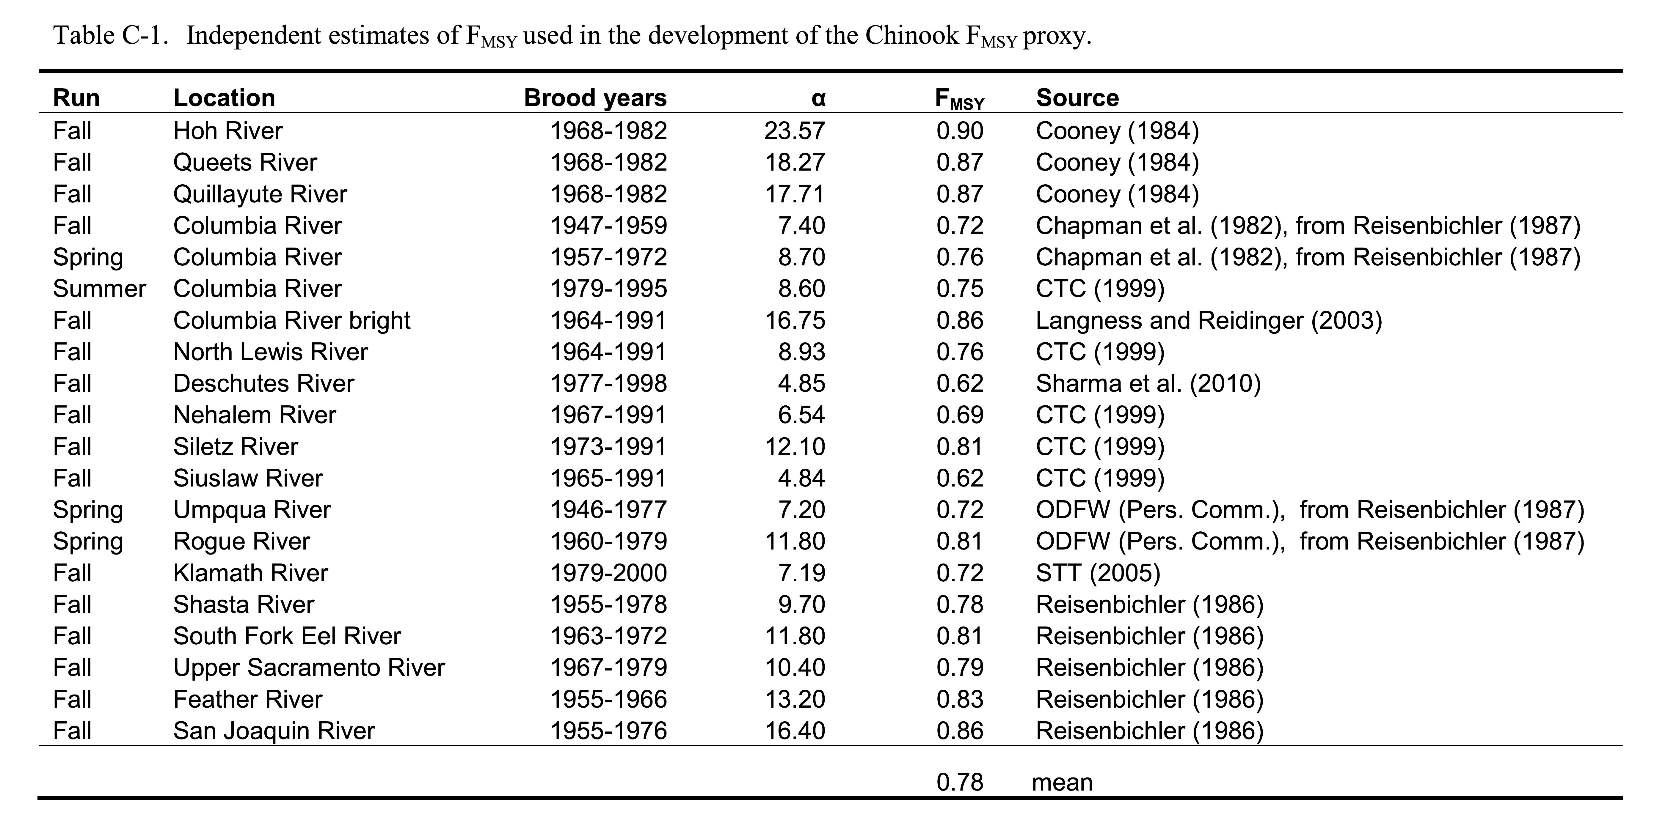
F_{MSY} – current bar for BSIA:
PFMC/NMFS 2011
Appendix C
More recent work
ODFW (2014) estimated F_{MSY}=0.54 for Rogue River Fall Chinook, endorsed by STT and SSC
KRFC WG (2024) fit updated spawner-recruit analysis for Klamath River Fall Chinook
alpha=4.7 implies F_{MSY}=0.61
Other examples might turn up in literature review
Updated set of representative S-R relationships could inform S_{MSY}/S_{MAX} ratio calculation suggested by STT

Slide 3
For brood years prior to late 1970s, lack of CWT data means harvest assumptions lack empirical support, and these pre-date a “regime shift”
Siuslaw, Columbia River Bright, North Lewis River on the edge of majority of data pre/post
More recent analysis available for Klamath River
Notes:
Siuslaw right on the edge in terms of majority of brood years being pre/post late 1970s. At least it is geographically closer to Sacramento than Columbia stocks that started one brood year earlier.

Slide 4
Stock | Brood Years | Citation | alpha | beta | S_{MSY} | S_{MAX} | R_{MSY} | R_{MAX} | Y_{MSY} | Y_{MAX} | F_{MSY} | S_{MSY}/S_{MAX} | R_{MSY}/R_{MAX} | Y_{MAX}/Y_{MSY}
Rogue River Fall Chinook | 1980-2004 | ODFW 2014 | 3.93* at mean flow and survival | 0.0000156 | 35,655 or 34,992 | 64,103 | 80,343 or ? | 92,677 or ? | 44,688 or ? | 28,575 or ? | 0.56 or 0.54 | 0.56 or 0.55 | 0.87 or ? | 0.64 or ?
Klamath River Fall Chinook | 2001-2017 | KRFC WG 2024 | 4.70 | 0.0000274 | 22,221 or 25,300 | 36,496 | 56,812 | 63,103 | 34,591 | 26,607 | 0.61 | 0.61 | 0.90 | 0.77
Columbia Upriver Summer Chinook | 1979-1995 | CTC 1999 | 8.5987 | 0.000062 | 12,146 | 16,129 | 49,183 | 51,021 | 37,038 | 34,892 | 0.75 | 0.75 | 0.96 | 0.94
Siletz River Fall Chinook | 1973-1991 | CTC 1999 | 12.10 | 0.000273 | 2,980 | 3,663 | 15,984 | 16,305 | 13,004 | 12,642 | 0.81 | 0.81 | 0.98 | 0.97
Siuslaw River Fall Chinook | 1965-1991 | CTC 1999 | 4.840 | 0.000044 | 14,024 | 22,727 | 36,621 | 40,467 | 22,597 | 17,739 | 0.62 | 0.62 | 0.90 | 0.79
Deschutes River Fall Chinook | 1977-1998 | Sharma et al. 2010 (pers comm.) | 4.85 | 0.0001357 | 4,553 | 7,372 | 11,908 | 13,153 | 7,354 | 5,781 | 0.62 | 0.62 | 0.91 | 0.79
Notes:
I cannot exactly reproduce the ODFW (2014) numbers, this may reflect a different handling of covariates (e.g. it may not be expected to have both equal to the mean simultaneously), and/or rounding, and/or not using Scheurell’s exact solution, and/or they may have been presenting Bayesian posterior estimates for the reference points. They reported Smsy of 34,992 and Fmsy of 0.54. Smsy/Smax based on their Smsy would be 0.55.
For KRFC, I also have small divergence in Smsy (they did not report Fmsy). Could be rounding issue or exact solution issue, Rich says he used an iterative method.
For Deschutes, Rishi calculated Smsy of 4,532 which is technically not identical to what I got but close enough it does not surprise me at all, could be rounding, could be use of an “optimizer” rather than the exact solution.
That said, recalculating based on their reported alpha and beta is probably most consistent with how proxy was developed in 2011.

Slide 5
 | F_{MSY} | S_{MSY}/S_{MAX} | R_{MSY}/R_{MAX} | Y_{MAX}/Y_{MSY}
Mean | 0.66 | 0.66 | 0.92 | 0.82
Median | 0.62 | 0.62 | 0.91 | 0.79

