Slide 1
SRFC conservation objective and reference points – next steps
Part 1: Escapement
Will Satterthwaite
Will.Satterthwaite@noaa.gov
SRFC WG meeting June 25, 2024

Slide 2
CO & S_{MSY} – current bar for BSIA:
Accurate description of current S_{MSY} reference point and conservation objective as recommended by the SSC (2022):
122,000-180,000 natural and hatchery adult spawners (122,000 is the MSY proxy adopted 1984). This The upper end of this objective is intended to provide adequate escapement of natural and hatchery production based on the sum of previous hatchery goals and reports of average fall Chinook escapements for various parts of the Sacramento Basin (which are inconsistent with current estimates for those years) during various reference periods (PFMC 1984). The lower end of the objective and SMSY are based on a reduction from the average Upper Sacramento escapement, meant to be used until “problems caused by the Red Bluff Diversion Dam are rectified” (p. 3-19, PFMC 1984). for Sacramento and San Joaquin fall and late-fall stocks based on habitat conditions and average run-sizes as follows: Sacramento River 1953-1960; San Joaquin River 1972-1977 (ASETF 1979; PFMC 1984; SRFCRT 1994). The objective is less than the an estimated basin capacity of 2405,000 fall-run spawners (Hallock 1977), but greater than the 118,000 spawners for maximum production yield estimated for natural areas in the Upper Sacramento alone, based on data from 1954-1963 on a basin by basin basis before Oroville and Nimbus Dams (Reisenbichler 1986).
Notes:
None of the options I present today are the theoretical ideal I would pursue if we had more and better data and infinite time and resources.
Given that, I think it is important to remember where the bar is currently set in terms of BSIA for SRFC management measures.

Slide 3
S_{MSY}/conservation objective options
Based on total escapement
Based on natural-area escapement
Based on natural-origin escapement
Maximize sustainable yield
  Direct derivation
  Based on proxy ratio applied to S_{MAX}
Maximize production
Optimize production
Unit conversions

Slide 4
S_{MSY}/conservation objective options
Based on total escapement
Based on natural-area escapement
Based on natural-origin escapement
Maximize sustainable yield
  Direct derivation
  Based on proxy ratio applied to S_{MAX}
Maximize production
Optimize production
Unit conversions

Slide 5
Total escapement, directly MSY-based
Spawners: Total adult spawners in natural and hatchery areas combined, regardless of origin
Recruits: SI three years later
Covariates: None (for now?)
Brood years: 1984-2020, easy to update
MSY calculation assumes:
Spawners only source of recruits (?)
Recruits only source of harvest
Unfished recruits only source of spawners

Slide 6
R²=-0.15
negative proportion of variance explained – worse fit than just using mean
Notes:
It may seem counter-intuitive that the “best fit” fits worse than the mean, but the fitting of the Ricker takes place in log space, and there’s really not much reason to expect a clean functional relationship here
R^2 is probably not the best metric to use here, but Steve of STT and Marc of Council asked about metrics of fit and this is a familiar one
Might fit better restricted to more recent data or with some kind of covariate, but overall not very promising

Slide 7
Total escapement, directly MSY-based
Spawners: Total adult spawners in natural and hatchery areas combined, regardless of origin
Recruits: SI three years later
Covariates: None (for now?)
Brood years: 2001-2020, matches KRFC update start year, maybe more representative of current conditions
MSY calculation assumes:
Spawners only source of recruits (?)
Recruits only source of harvest
Unfished recruits only source of spawners

Slide 8
R²=-0.31 even worse than before!
negative proportion of variance explained – worse fit than just using mean
Notes:
Restricting data range to 2001+ did not help fi, note loss of high recruitments at intermediate escapements, fairly high recruitments at high escapements remain but overall unexpected U-shape

Slide 9
Total escapement, directly MSY-based
Spawners: Total adult spawners in natural and hatchery areas combined, regardless of origin
Recruits: SI three years later
Covariates: None (for now?)
Brood years: 2005-2020, starting brood year corresponds to 2008 “collapse” return year
MSY calculation assumes:
Spawners only source of recruits (?)
Recruits only source of harvest
Unfished recruits only source of spawners

Slide 10
R²=0.12
Notes:
Restricting things to BY 2005 onward still has fairly poor fit, leads to loss of high escapement and high recruitment data, also has some strong environmental confounding I’ll discuss later.
Kind of impressive and kind of worrying how much 4 brood years can change fit

Slide 11
S_{MSY}/conservation objective options
Based on total escapement
Based on natural-area escapement
Based on natural-origin escapement
Maximize sustainable yield
  Direct derivation
  Based on proxy ratio applied to S_{MAX}
Maximize production
Optimize production
Unit conversions

Slide 12
Natural-area escapement, production-based
Spawners: Female spawners above RBDD, regardless of origin
Recruits: Natural-origin fry equivalents passing RBDD next year
Covariates: None (for now?)
Brood years: 2002-2020, easy to update assuming continued USFWS reports
MSY calculation assumes:
Spawners only source of recruits
Recruits only source of harvest
Unfished recruits only source of spawners

Slide 13
S_{MSY}/conservation objective options
Based on total escapement
Based on natural-area escapement
Based on natural-origin escapement
Maximize sustainable yield
  Direct derivation
  Based on proxy ratio applied to S_{MAX}
Maximize production
Optimize production
Unit conversions

Slide 14
• R²=0.57, not bad for ecological data!
• Fit in Satterthwaite (2023), an update to the analysis in PFMC (2019)
Notes:
Pretty good fit but suffers from lack of data at high escapement

Slide 15
S_{MSY}/conservation objective options
Based on total escapement
Based on natural-area escapement
Based on natural-origin escapement
Maximize sustainable yield
  Direct derivation
  Based on proxy ratio applied to S_{MAX}
Maximize production
Optimize production
Unit conversions

Slide 16
Subjectively, diminishing returns set in about here???
• Fit in Satterthwaite (2023), an update to the analysis in PFMC (2019)
Notes:
Subjectively, we might identify a point of diminishing returns. Could be based on ratios/fractions of maximum like those put forward in Hilborn’s Pretty Good Yield paper.
And units still an issue compared to existing measures and harvest model.

Slide 17
S_{MSY}/conservation objective options
Based on total escapement
Based on natural-area escapement
Based on natural-origin escapement
Maximize sustainable yield
  Direct derivation
  Based on proxy ratio applied to S_{MAX}
Maximize production
Optimize production
Unit conversions

Slide 18
Determine total escapement likely to yield desired fraction of natural production
Fishery managers specify:
• Y: fraction of maximum natural production
• X: biological risk tolerance
(expressed as success probability)
• Z: forecast/implementation risk tolerance
(expressed as success probability)
R_{MAX}
Natural
Production:
Recruits (R)
Y x R_{MAX}
S_{Y}
S_{MAX}
Analysts quantify:
• Spawner-Recruit relationship
• Relationship between total SRFC adult spawners and escapement measured at other scales
• Outcome error
(forecast and implementation)
Natural-area spawners (S)
1.0
Probability that
S ≥ S_{Y}
and
H_{goals} met
X
Escapement Goal
Total SRFC adults
Satterthwaite (2023), Figure 2, neglecting hatcheries and model error

Slide 19
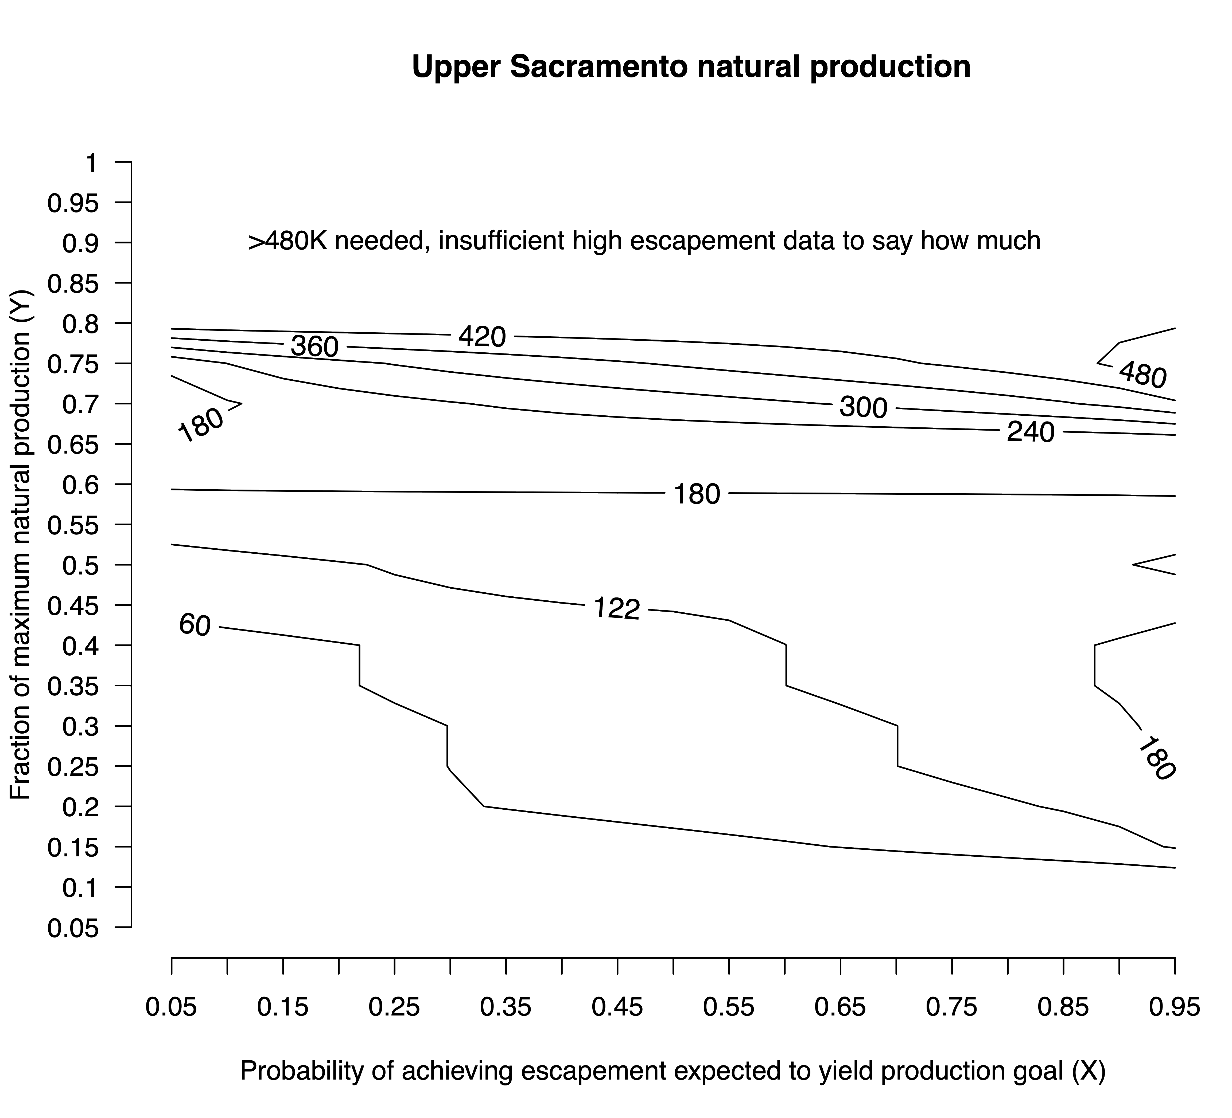
Determine total escapement likely to yield desired fraction of natural production
Satterthwaite (2023), Figure 5A
Notes:
A lot going on here
122K total spawners unlikely to achieve more than half of potential Upper Sac natural production
180K total spawners likely to achieve about 60% of potential Upper Sac natural production
Diminishing returns above 240-300K spawners
Very hard to get more that ~80% of potential Upper Sac natural production, may not be realistic goal
Note contours not as curvy as I expecred, reflects very few high escapement years and thus knife-edge logistic regressions

Slide 20
Determine total escapement likely to yield desired fraction of production and meet hatchery goals
Fishery managers specify:
• Y: fraction of maximum natural production
• X: biological risk tolerance
(expressed as success probability)
• Z: forecast/implementation risk tolerance
(expressed as success probability)
R_{MAX}
Natural
Production:
Recruits (R)
Y x R_{MAX}
S_{Y}
S_{MAX}
Analysts quantify:
• Spawner-Recruit relationship
• Relationship between total SRFC adult spawners and escapement measured at other scales
• Outcome error
(forecast and implementation)
Natural-area spawners (S)
1.0
Probability that
S ≥ S_{Y}
and
H_{goals} met
X
Escapement Goal
Total SRFC adults
Satterthwaite (2023), Figure 2, neglecting forecast & harvest model error

Slide 21
Probability of meeting hatchery goals
Return years 2002-2021
Return years 1970-2021
Satterthwaite (2023), goals as defined in Review Table B-3
Notes:
Main analysis in Satterthwaite 2023 was 2002-2021 to match years with natural production data. Very knife-edge response within those years, no ability to calculate confidence intervals. Longer timesries allowed confidence interval calculation and found a shallower relationship, but hatchery goals may have been different and release practices / stray rates surely were, so not clear how representative. Adding more recent data could be helpful.

Slide 22
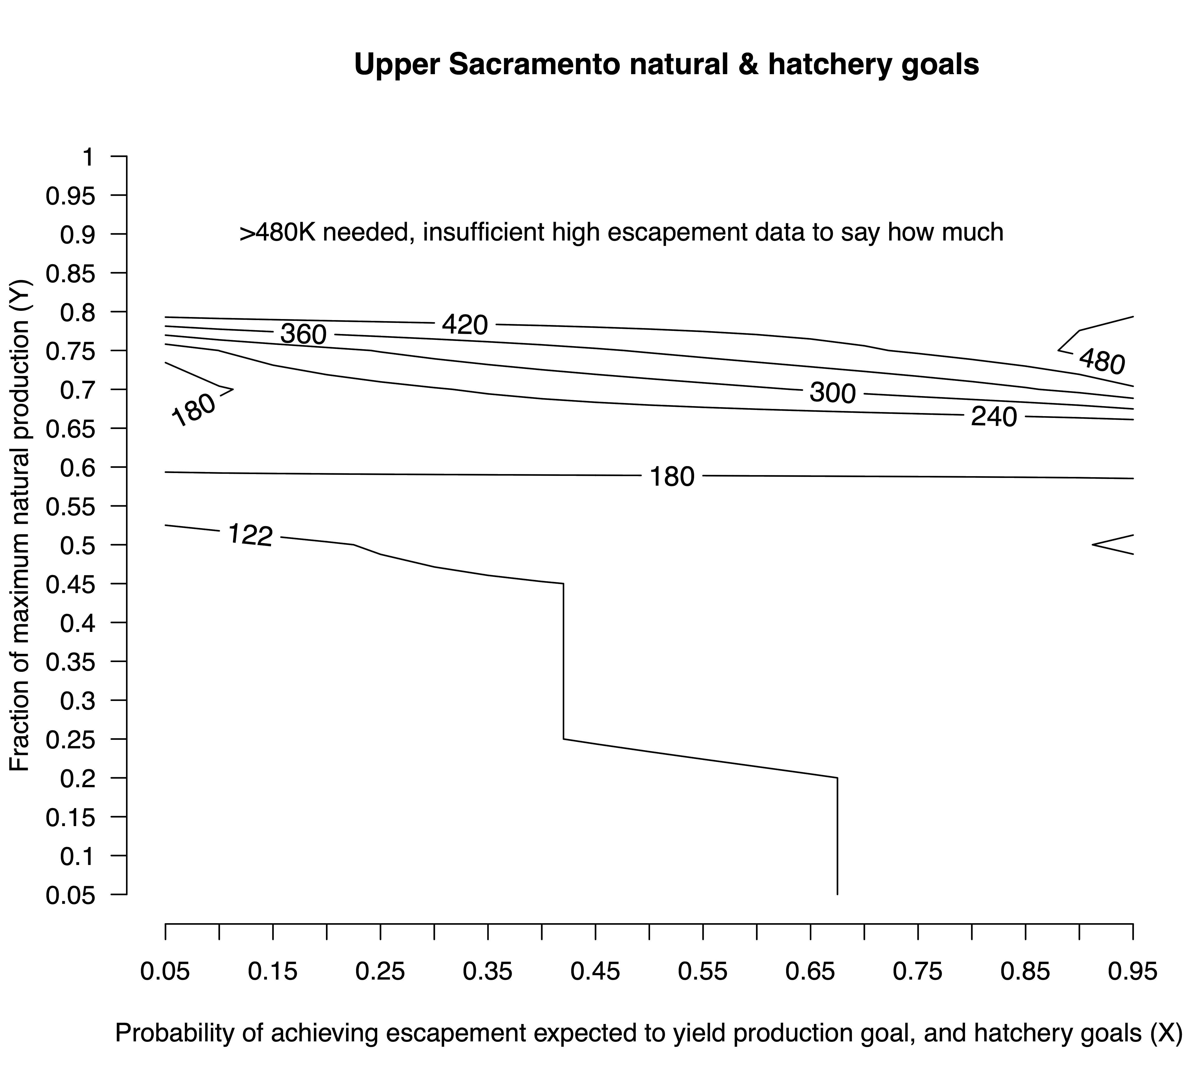
Determine total escapement likely to yield desired fraction of production and meet hatchery goals
Satterthwaite (2023), Figure 6A
Notes:
This looks a lot like the previous contour plot, but reflects that we cannot be highly confident in meeting the hatchery goals with only 122K spawners so the 122 contour doesn’t extend as far to the rifght, and the 60K contour is gone because 60K spawners is almost certainly not sufficient to meet hatchery goals

Slide 23
S_{MSY}/conservation objective options
Based on total escapement
Based on natural-area escapement
Based on natural-origin escapement
Maximize sustainable yield
  Direct derivation
  Based on proxy ratio applied to S_{MAX}
Maximize production
Optimize production
Unit conversions

Slide 24
Natural-area escapement, production-based
Spawners: Natural area adults, regardless of origin
Recruits: SI 3 years later x proportion of escapement that was natural-origin
Covariates: None (for now?)
Brood years: 2007-2017, updating depends on future CWT recovery reports and adequate marking/tagging/sampling of future hatchery releases
MSY calculation assumes:
Spawners only source of recruits
Recruits only source of harvest
Unfished recruits only source of spawners

Slide 25
R²=0.12
Not much variance explained, also problematic range of escapements and flows

Slide 26
Notes:
Here, the same data are re-piotted, but labeled by parent year and with the darkness of the shading of each point showing the flow during outmigration (darker – more flow)

Slide 27
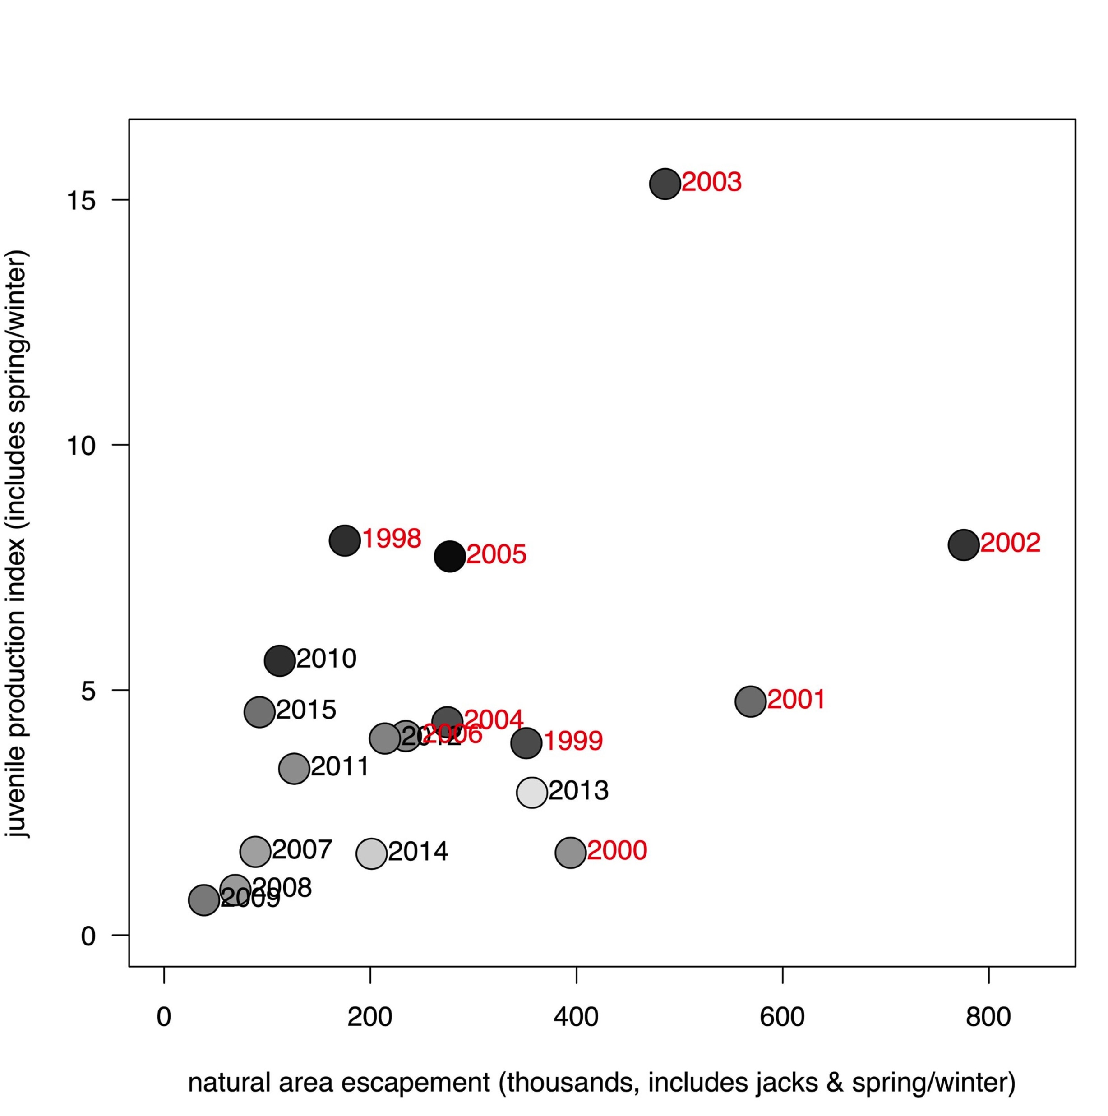
Limitations of years suited to SRFC cohort reconstructions or natural-origin SI calculations
Parent years in red lack suitable data for cohort reconstruction
Unmarked fry releases may compromise ability to reconstruct natural cohorts going forward unless new genetic sampling programs are implemented at the required scale

Slide 28
Natural-area escapement, production-based
Spawners: Natural area fall, spring, and winter escapement (incl. jacks)
Recruits: Natural-origin juvenile index from Munsch et al. (2020)
Covariates: Flow during outmigration
Brood years: 2002-2020, hard to update
MSY calculation assumes:
Spawners only source of recruits
Recruits only source of harvest
Unfished recruits only source of spawners

Slide 29
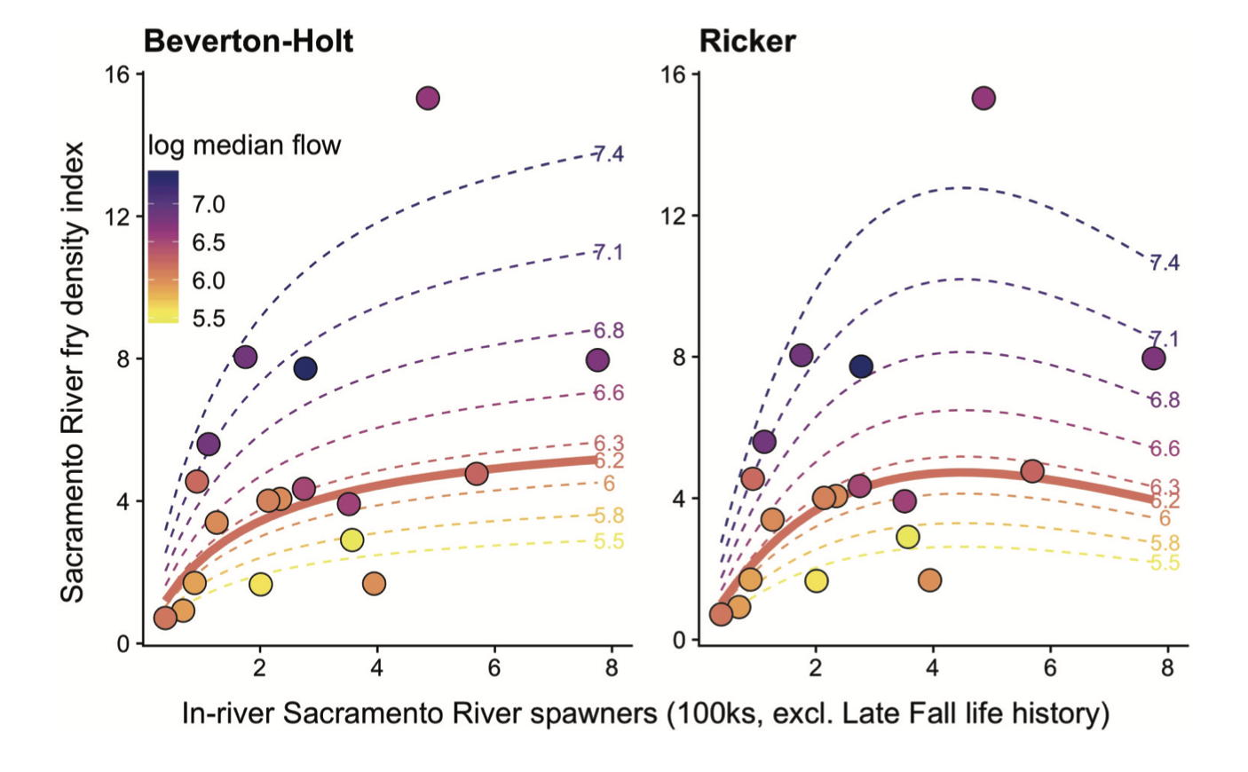
Notes:
Didn’t calculate R^2 yet, and would be hard to compare to models without environmental covariates, but visually the fit is pretty good
In my SFEWS paper, I did all the necessary calculations to convert to a total escapement goal as described for the Upper Sacramento relationship

Slide 30
S_{MSY}/conservation objective options
Based on total escapement
Based on natural-area escapement
Based on natural-origin escapement
Maximize sustainable yield
  Direct derivation
  Based on proxy ratio applied to S_{MAX}
Maximize production
Optimize production
Unit conversions
Notes:
Discuss how to get at this during the afternoon

Slide 31
S_{MSY}/conservation objective options
Based on total escapement
Based on natural-area escapement
Based on natural-origin escapement
Maximize sustainable yield
  Direct derivation
  Based on proxy ratio applied to S_{MAX}
Maximize production
Optimize production
Unit conversions
Notes:
Ideas? Easier to implement for conservation objective than for Smsy?

Slide 32
S_{MSY}/conservation objective options
Based on total escapement
Based on natural-area escapement
Based on natural-origin escapement
Maximize sustainable yield
  Direct derivation
  Based on proxy ratio applied to S_{MAX}
Maximize production
Optimize production
Unit conversions

Slide 33
Converting across scales for escapement objectives
Probability-based approach (Satterthwaite 2023)
Historical mean or median ratios (Satterthwaite 2022)
Log-proportion model (PFMC 2007, Appendix D)
  Used when planning de minimis fisheries on KRFC
  Proportions not constrained to sum to 1.0, may not apply to all tributaries simultaneously
Linear regression

Slide 34
Regression approach to escapement conversions
R²=0.81
Nonlinear fit likely better
R²=0.97

