Slide 1
June 2024 Council Guidance to SRWG
Will Satterthwaite
Will.Satterthwaite@noaa.gov
SRFC WG meeting June 25, 2024

Slide 2
Council Guidance:
(1) Future work should reflect that Maximum Sustainable Yield serves as the basis of salmon fishery management (as modified per the National Standard 1 Guidelines to achieve Optimum Yield), and not Maximum Sustainable Production, as described in Agenda Item E.1.a, Supplemental STT Report, June 2024.

Slide 3
STT recommendations (part 1):
the STT agrees that there is a potential inconsistency between managing for optimum yield (OY) based on maximum sustainable yield (MSY) per the National Standard 1 guidelines, versus managing for maximum sustainable production (MSP) per the fishery management plan (FMP).
In practice, SRFC have not been managed to maximize natural production and thus the STT recommends refocusing on management measures that are based on MSY but take into account other factors to achieve OY, consistent with the National Standard 1 guidelines.

Slide 4
STT recommendations (part 2):
the STT recommends that the Workgroup pay particular attention to the treatment of hatchery and natural-origin escapement in the stock-recruit analysis
giving thought to the right metrics will be necessary when choosing how hatchery fish will be treated in developing a new SRFC conservation objective
STT recommends caution if considerations are given to SRFC fishery management goals that are in terms of natural-origin fish
not aware of other management strategies that consist of objectives based on natural-origin fish only, where the composite stock is comprised of a large percentage of hatchery-origin fish
implementation of a natural-origin fish conservation objective could be difficult for SRFC in the absence of mass marking.
Estimates of the hatchery and natural fraction of escapement are routinely made by the California Department of Fish and Wildlife, but are not available in time to inform the preseason fishery planning process shortly after spawning ends.

Slide 5
STT recommendations (part 3):
In Section 4.2.3 the Workgroup noted logical inconsistencies in estimating F_{MSY} and S_{MSY} from a stock-recruitment relationship where the natural-origin spawners are not the only source of natural area production (and thus the “stock” and “recruit” components are not in the same units).
However, the escapement that results in Maximum Sustainable Production (MSP) can be estimated under this scenario.
The STT is supportive of identifying a reasonable ratio between S_{MSY} and S_{MSP} (S_{MAX}) to inform a data-based estimate of S_{MSY}.
Plot twist: for a Ricker, S_{MSY}/S_{MAX}=F_{MSY} (SAC 2011, p. 101)
The STT is less supportive of development of a proxy based on escapement maximizing production- because of the inconsistencies with National Standard 1 identified previously.

Slide 6
National Standard 1
OY is based on MSY as reduced [when expressed as harvest, equating to increased escapement] under paragraphs (e)(3)(iii)(A) and (B) of this section. The most important limitation on the specification of OY is that the choice of OY and the conservation and management measures proposed to achieve it must prevent overfishing.
In determining the greatest benefit to the Nation, the values that should be weighed and receive serious attention when considering the economic, social, or ecological factors used in reducing MSY, or its proxy, to obtain OY are:
The benefits of food production …
The benefits of recreational opportunities reflect the quality of both the recreational fishing experience and non-consumptive fishery uses …
The benefits of protection afforded to marine ecosystems are those resulting from maintaining viable populations (including those of unexploited species), maintaining adequate forage for all components of the ecosystem, maintaining evolutionary and ecological processes (e.g., disturbance regimes, hydrological processes, nutrient cycles), maintaining productive habitat, maintaining the evolutionary potential of species and ecosystems, and accommodating human use.
Ecological factors. Examples include impacts on EC species, forage fish stocks, other fisheries, predator-prey or competitive interactions, marine mammals, threatened or endangered species, and birds. Species interactions that have not been explicitly taken into account when calculating MSY should be considered as relevant factors for setting OY below MSY. In addition, consideration should be given to managing forage stocks for higher biomass than Bmsy to enhance and protect the marine ecosystem. Also important are ecological or environmental conditions that stress marine organisms or their habitat, such as natural and manmade changes in wetlands or nursery grounds, and effects of pollutants on habitat and stocks.

Slide 7
SSC recommendations:
The SSC recommends the S_{MSY}, F_{MSY}, conservation objective, and other reference points for SRFC be developed for natural-origin fish only.
The approaches used to derive salmon harvest reference points (e.g., S_{MSY}, F_{MSY}) were developed for natural-origin salmon populations.
The SSC emphasizes the need to disentangle production and yield of natural-origin and hatchery-origin fish to reduce the risk of overharvest of the natural-origin component.
Reference points from a spawner-recruitment relationship for the natural-origin fish would support management and could reduce risk of listing under the Endangered Species Act.
The SSC encourages moving toward natural-origin reference points while acknowledging that data limitations may restrict the speed at which they can be developed.
In the interim, some updates can be completed in a short period of time.
The SSC recommends that the currently used proxy value for F_{MSY} be updated using recent data from other Chinook stocks that are representative of the SRFC stock under current conditions.
The SSC also recommends that S_{MSY} and the CO be updated using one of the indirect approaches proposed by the WG.
Some of the preferred approaches may be suitable for a salmon methodology review

Slide 8
SAS report:
The SAS noted this is the first report from the SRWG and they do not have any specific recommendations to provide at this stage. However, the SAS discussed several items they hope will be considered as work proceeds.
Hatcheries
Role in sustaining fish stocks
Broodstock needs
Habitat
Water management
Parentage-Based Tagging
Sacramento River Winter Chinook
a conservation objective that considers fish returning to both natural areas and fish returning to hatcheries may be the most appropriate
the SAS would like the SRWG to strongly consider moving forward with a “natural area” component that consists of a natural/hatchery aggregate rather than parsing the two apart.

Slide 9
Council Guidance :
(2) Task the workgroup with evaluating the draft cohort reconstruction that is underway for Sacramento fall Chinook and determine if it will provide substantial improvement and accuracy over current forecasting and modeling methodologies.

Slide 10
SSC recommendations:
An age-based cohort re-construction for hatchery and natural fish, as is currently done for Klamath River fall Chinook, should be the goal.
The SSC encourages moving toward natural-origin reference points while acknowledging that data limitations may restrict the speed at which they can be developed.
The SSC recommends the S_{MSY}, F_{MSY}, conservation objective, and other reference points for SRFC be developed for natural-origin fish only.
The approaches used to derive salmon harvest reference points (e.g., S_{MSY}, F_{MSY}) were developed for natural-origin salmon populations.
The SSC emphasizes the need to disentangle production and yield of natural-origin and hatchery-origin fish to reduce the risk of overharvest of the natural-origin component.
Reference points from a spawner-recruitment relationship for the natural-origin fish would support management and could reduce risk of listing under the Endangered Species Act.

Slide 11
STT recommendations:
The STT supports the idea of developing a cohort reconstruction for Sacramento River fall Chinook ... We understand that this would require a great deal of effort and the inclusion of scientists outside of the Workgroup. We also understand that due to data limitations, this effort would only provide information for a limited range of years, and confine the range of abundances to generally lower levels. However, development of a cohort reconstruction would provide a foundation for soundly managing the population into the future.
the Workgroup report states that the Sacramento Index (SI) forecast had over-forecasted the postseason estimate in seven of the last ten years. While this factually correct, there is more nuance to the SI forecast performance. The existing forecast method has been in place since 2014. Forecast skill has increased over the years since the adoption of the current forecast method. From 2014 to 2017, the SI was over predicted in each year. Since 2017, forecasts can be characterized as being over forecast by a modest amount in two years, very close to observed in three years, and under predicted in two years. A plot of forecast performance for SRFC (and other key Chinook stocks) can be found in Figure II-4 of the 2024 Preseason Report I.
The STT recommends not modifying the preseason abundance forecast until a formal cohort reconstruction is developed.

Slide 12
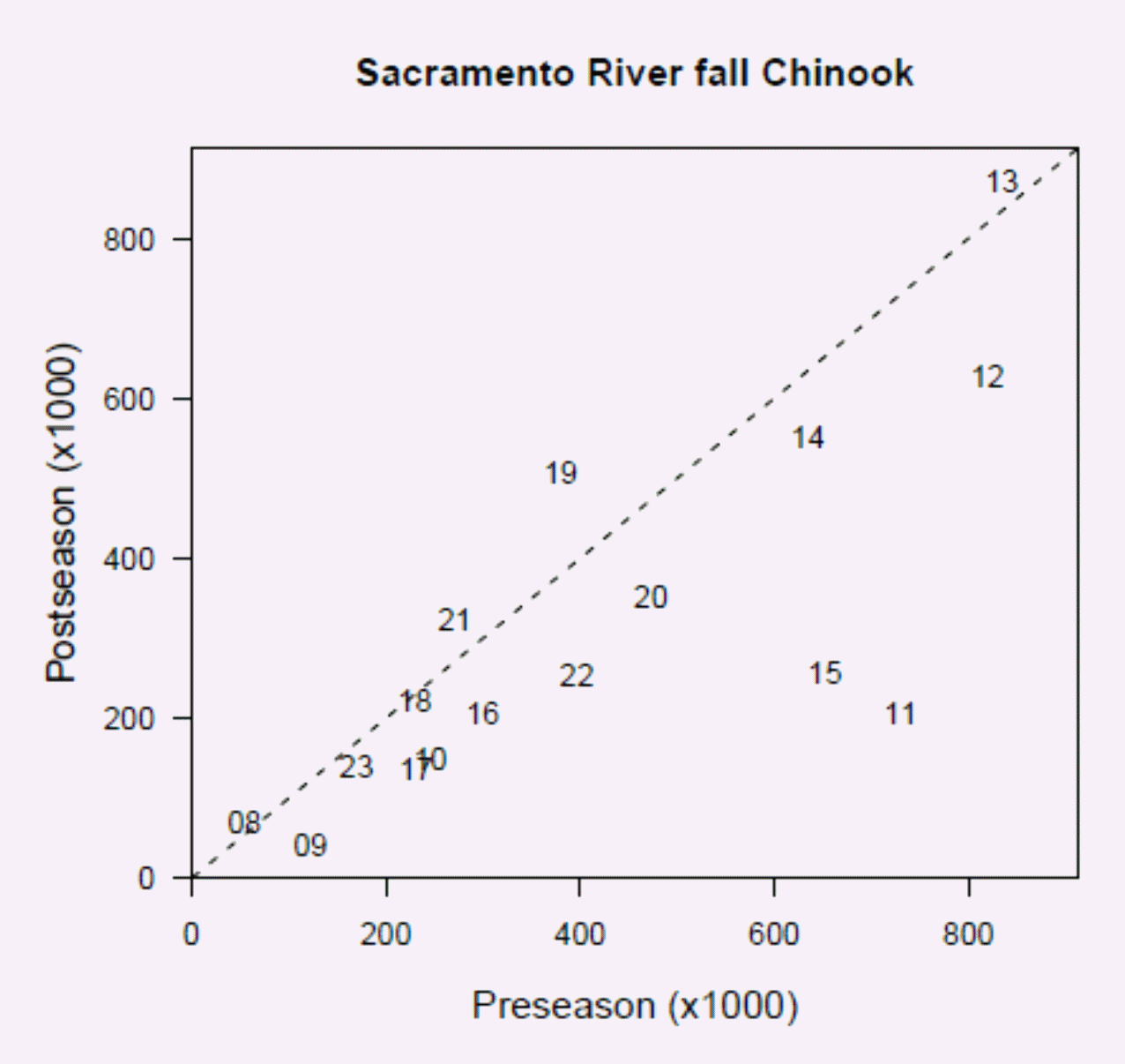
SI forecast accuracy
2023 forecast: 169,767
Control rule ER: 28%
Did not trigger ”de minimis” considerations
2023 postseason estimate: 139,487
over-forecast by 21%
Control rule ER: 25%
Would trigger “de minimis” considerations:
The potential for critically low natural spawner abundance, including considerations for substocks that may fall below crucial genetic thresholds;
Spawner abundance levels in recent years;
The status of co-mingled stocks;
Indicators of marine and freshwater environmental conditions;
Minimal needs for Tribal fisheries;
Whether the stock is currently in an approaching an overfished condition;
Whether the stock is currently overfished;
Other considerations as appropriate.
PFMC Preseason Report I (2024, Figure II-4)
Notes:
We can agree to disagree on whether a 21% over-forecast is “very close” (STT report description), but it had practical consequences even if the ER output by the control not very different (e.g. it seems we were taken a little bit by surprise by the really low Upper Sacramento escapement in 2023, and/or just how bad wild spring run returns are).

Slide 13
SI forecast accuracy
2022 forecast: 396,458
Control rule ER: 69%
ER to achieve 180K guidance: 55%
2022 postseason estimate: 251,191
over-forecast by 58%
Control rule ER: 51%
ER to achieve 180K guidance: 28%
PFMC Preseason Report I (2024, Figure II-3)
Notes:
We can agree to disagree on whether a 58% over-forecast is a “modest amount” (STT report description), but it had practical consequences

Slide 14
SI forecast accuracy
2019 forecast: 379,362
Control rule ER: 68%
ER to achieve 160K guidance: 58%
ER expected in Pre-III: 57.8%
Postseason ER estimate: 68%
2019 postseason estimate: 505,535
under-forecast by 25%
Control rule ER: 70%
ER to achieve 160K guidance: 68%
SRWC may have been constraining
PFMC Preseason Report I (2024, Figure II-3)
Notes:
We can agree to disagree on how significant a 25% under-forecast is. Practical consequences unclear, may have been constraining given the guidance to target 160K escapement, but winter run was constraining also, and realized ER does not appear to have been highly constrained by preseason ER target.

Slide 15
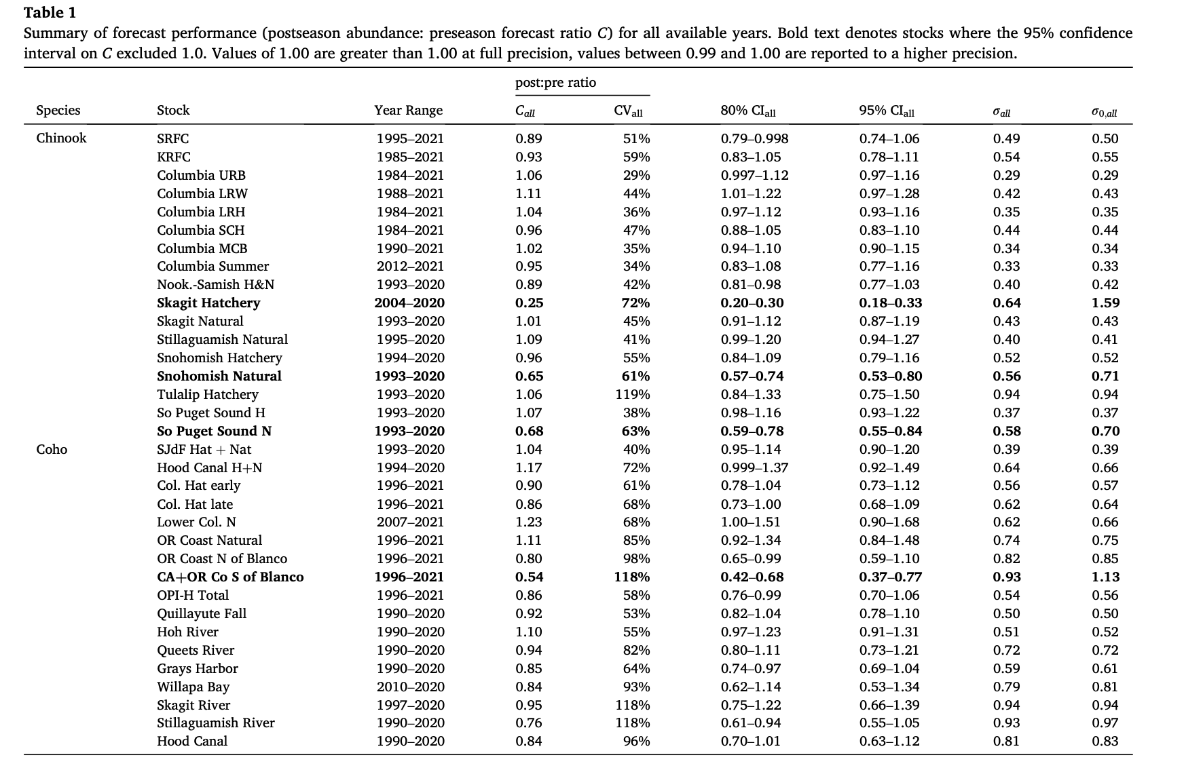
SI forecast accuracy – how does it compare?
Satterthwaite and Shelton (2023, Table 1)
Notes:
Bias tied for 4th worst Chinook stock where the worst 3 (bold) are really bad, SI has 11% bias toward over-forecasting based on median of fitted lognormal distribution to how the current model would have performed if applied in 1995-2021
CV/imprecision middle of the pack

