Slide 1
Klamath River Dam Removal Update
Agenda Item C.3.a Supplemental Presentation 1 March 2024
Jim Simondet
NOAA Fisheries
Klamath Branch Supervisor
West Coast Region – California Coastal Office

Slide 2
Presentation Overview
Dam Removal Activities Update
Look-Ahead Project Timeline
Water Quality, Sediment Evacuation and Restoration Update
Hatchery Update
Monitoring Update
On the Horizon
Notes:
Focus on Chinook Touch on coho

Slide 3
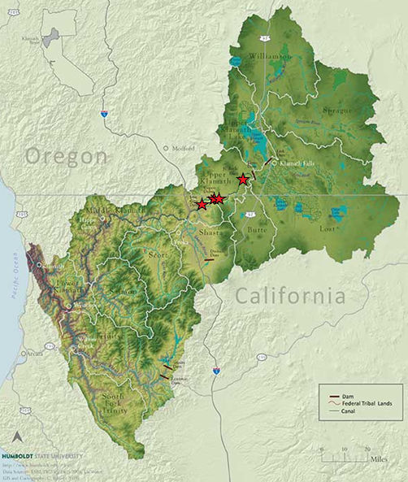
Klamath Dam Removal Recap
Removal of four dams
Opening of ~ 400 miles of anadromous habitat (Chinook, steelhead, lamprey; 70 miles of habitat for listed coho)
Restoring riverine function
Short-term Impacts
Interconnected Restoration Activities
Construction of Fall Creek Hatchery to offset loss of Iron Gate Hatchery
Notes:
Upside down watershed added water diversions climate change removed ag and hatcheries

Slide 4
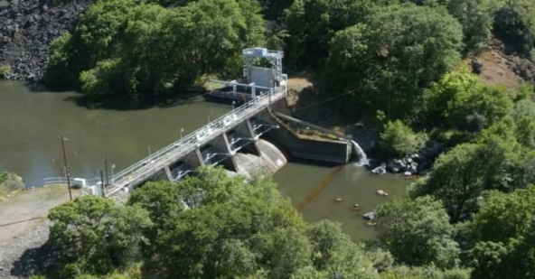
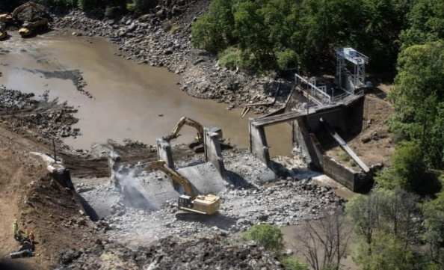
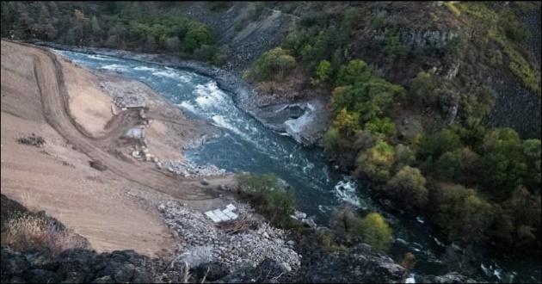
Activities Completed To Date
Copco No. 2 Dam Removal
Date | Description
March – Early December 2023 | Demolished portions of Iron Gate Hatchery (IGH) Began construction of Fall Creek Hatchery (FCH) Completed Fall Creek culvert replacement for fish passage Copco No. 2 Dam Removal completed
Late December 2023 | Fish transfer from IGH to FCH 243 overwintering juvenile coho relocation on Klamath River
January 2024 | Low-level outlets opened at remaining dams Reservoir-stored sediment evacuation begins
February 2024 | Approx. 800k Chinook fry released at FCH

Slide 5
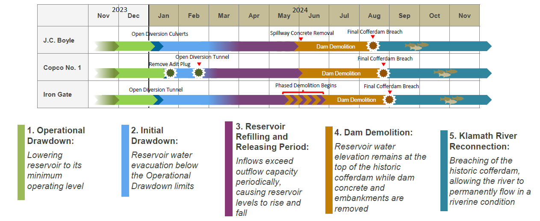
Look-Ahead Project Timeline
Volitional Fish Passage

Slide 6
Iron Gate Low Level Outlet

Slide 7
Copco No. 1 Low Level Adit Tunnel

Slide 8
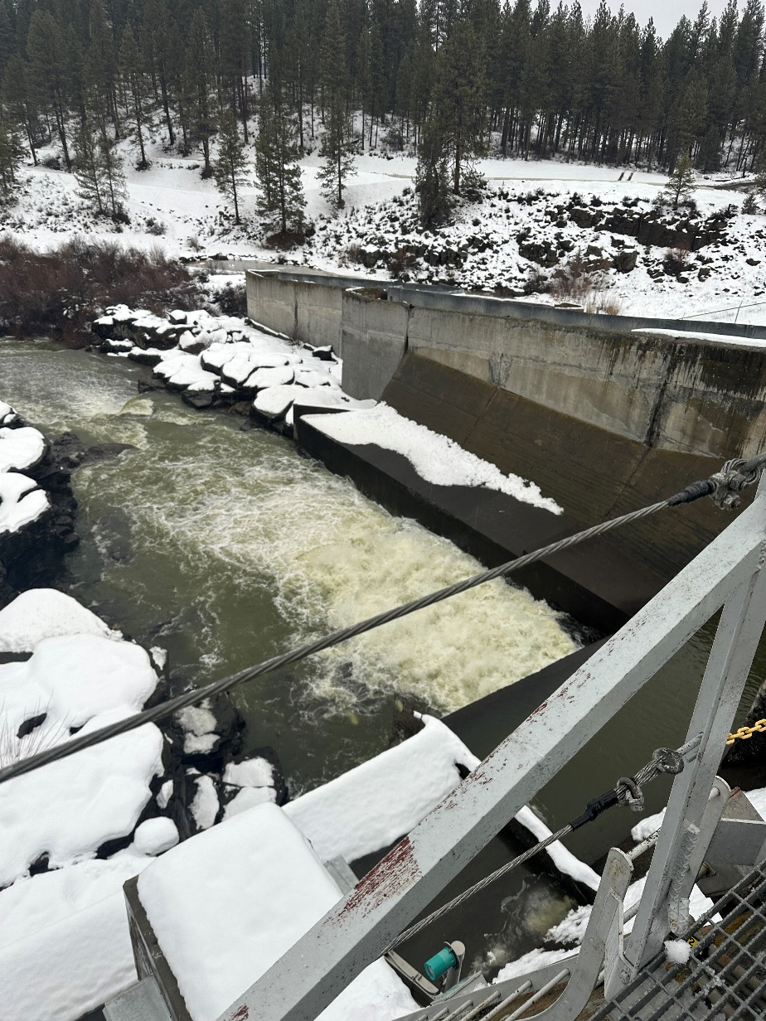
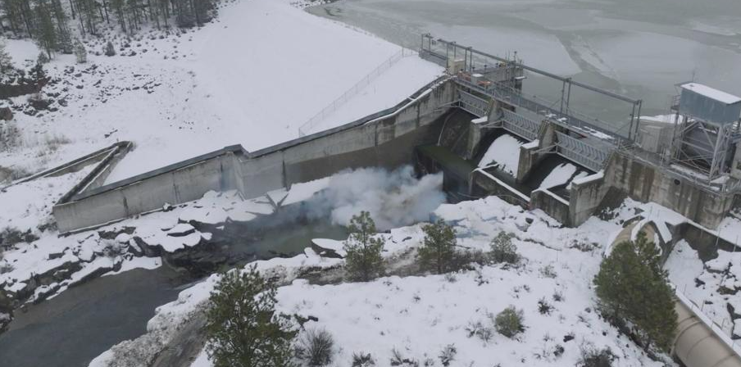
J.C Boyle Stoplog Blasting

Slide 9
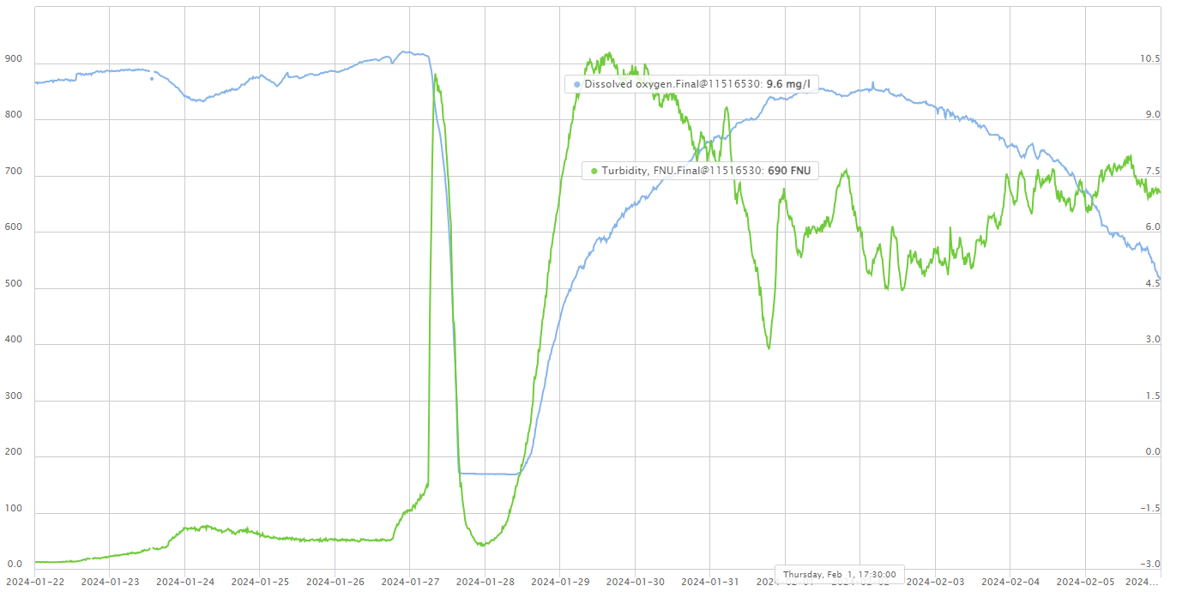
Water Quality
Dam Removal activities began in January 2023
DO < 0 mg/l occurred resulting from flushing dead algae/organics. DO recovered within 24-48 hrs
Turbidity and DO below Iron Gate within range analyzed under NMFS BiOp
Majority of observed fish mortality-non-native reservoir species
Reservoir drawdown/sediment evacuation timed to reduce exposure to salmonids.
Turbidity (FNU)
DO (mg/l)

Slide 10
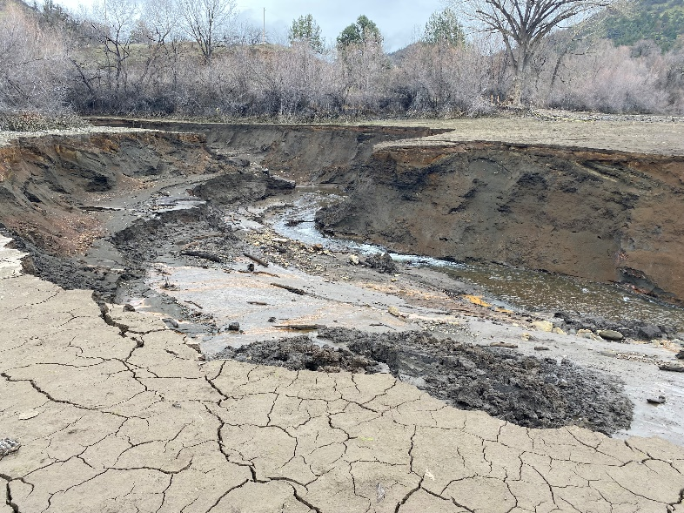
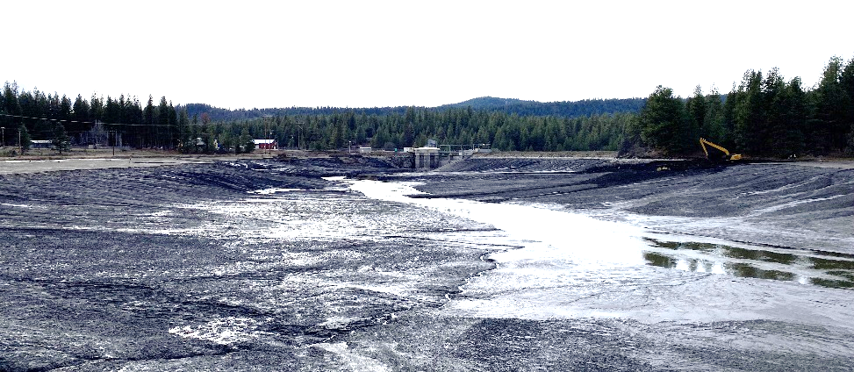
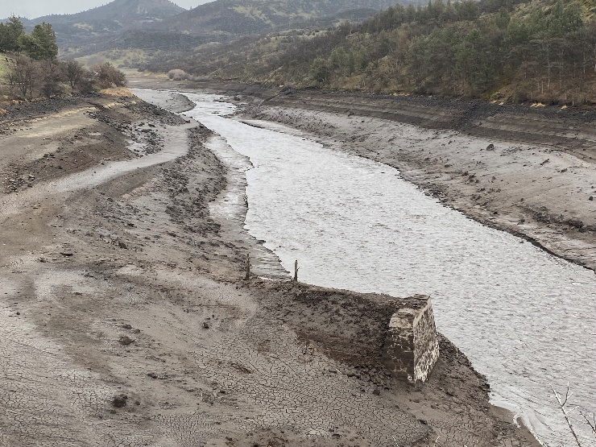
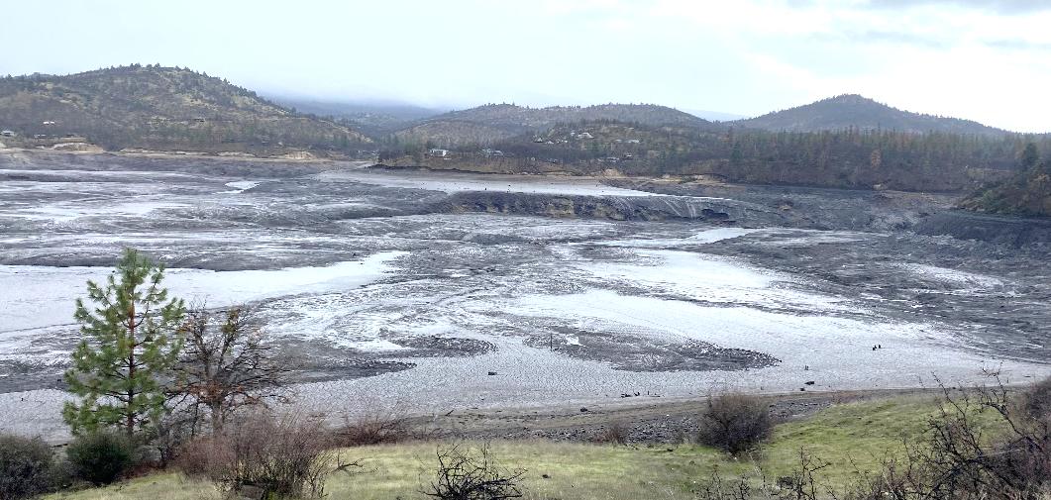
Sediment Evacuation
Iron Gate Tributaries
Former J.C Boyle Reservoir
Various sediment evacuation techniques being implemented (mechanical, flow)
Upper basin flow release strategies planned to support sediment evacuation
Buoys deployed in Crescent City to evaluate potential sediment disposition
Former Iron Gate Reservoir
Former Copco No. 1 Reservoir

Slide 11
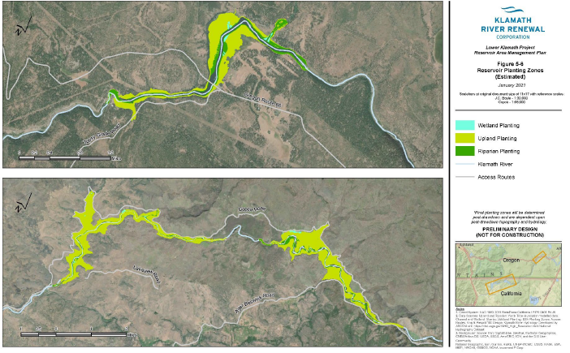
Restoration and Revegetation
KRRC began seeding upper portions of the reservoirs, seedlings already sprouting
Design team advancing restoration designs from 60-100% as they evaluate conditions as they appear
Reviewing current field conditions for fish passage and conducting drone monitoring
Terrestrial and wildlife protection protocols being implemented to help with stranded wildlife

Slide 12
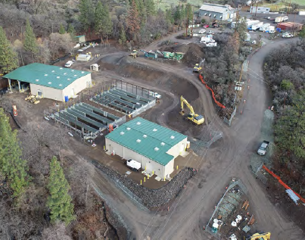
Hatchery Update
Iron Gate Hatchery (IGH) decommissioned in December 2023
Approx. 4.1 million Fall Run Chinook transferred from IGH to Fall Creek Hatchery on 12/6/23
Approx. 127,000 coho eggs transferred from IGH to FCH between 12/6 – 12/18
FCH fish are growing quickly and are healthy

Slide 13
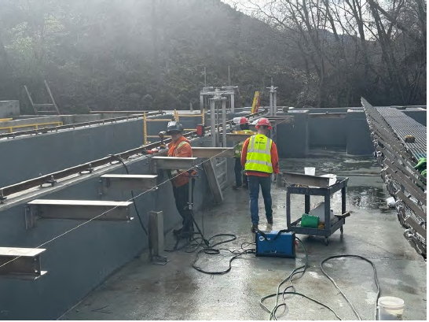
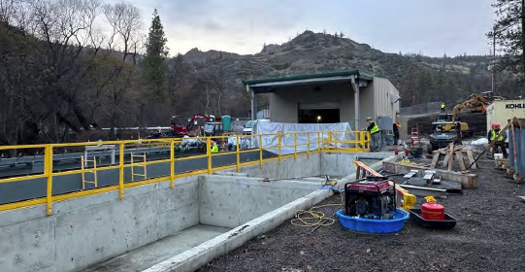
Fall Creek Hatchery Release 2024
Adult Holding Fish Crowder
KRFC Production Goal- 3.25 million; 4.1 million actual
Approx. 830k untagged fry released in late February (high mortality-presumed gas bubble disease)
Approx. 420k untagged fry to be released March/April
Approx. 1.75 million Chinook smolts, 25% Ad-CWT, release window May 1 – June 15
Approx. 250,000 Chinook yearlings, 100% Ad-CWT, release window Oct 15- Nov 20
Approx. 75,000 coho yearlings, 100% Ad-CWT, release window Mar 15- May 1
Spawning Building and Settling Ponds

Slide 14
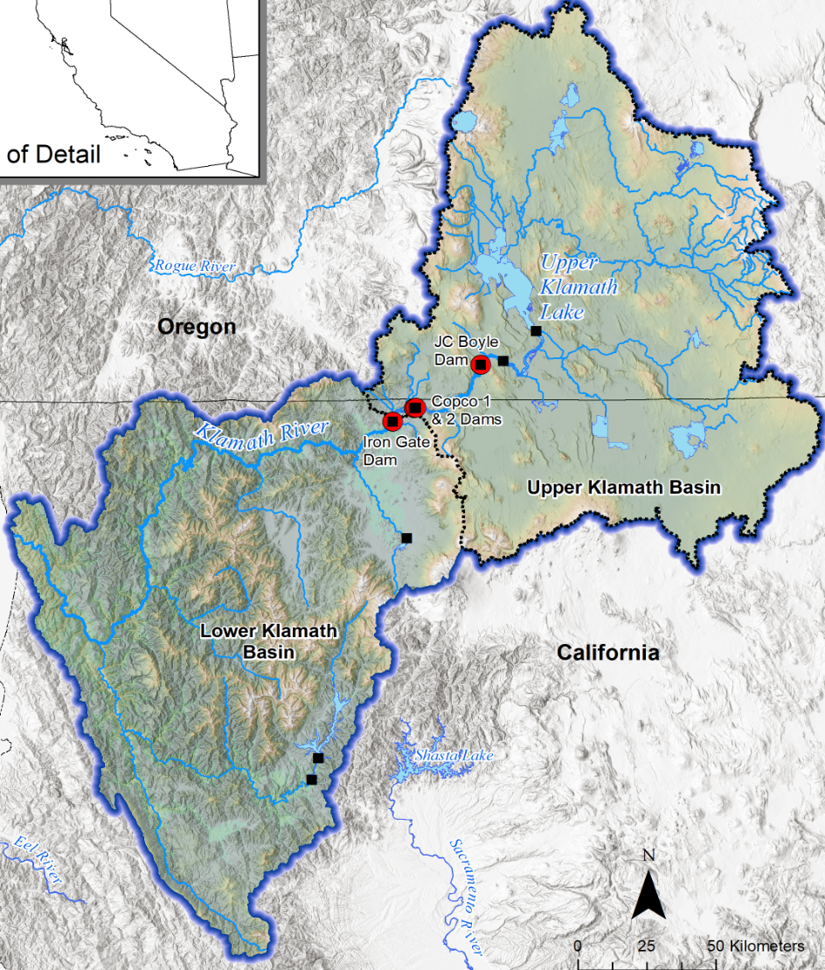
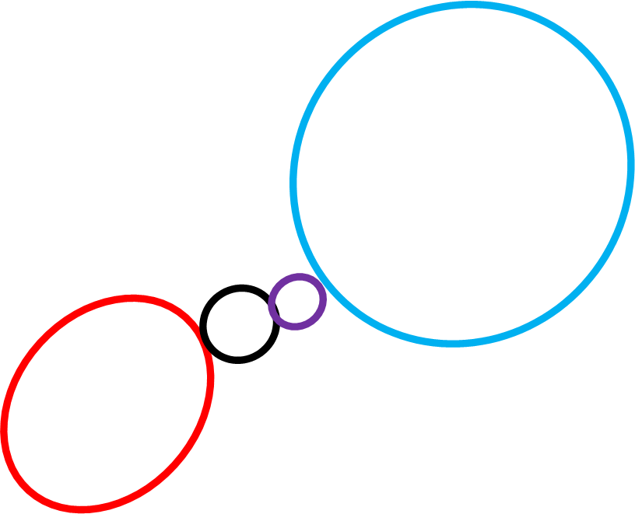
Monitoring Update
Current and Future Monitoring efforts for adult Chinook
Carcass and redd counts – mainstem Klamath, lower and mid Klamath tributaries (red), Iron Gate to Wingate Bar (black), and 4 tributaries in the Reservoir Reach (purple)
Data Gaps (blue)
Klamath Mainstem from Iron Gate to Keno Dam
Remaining high-priority tributaries in reservoir reach
Upper basin tributaries above upper Klamath Lake

Slide 15
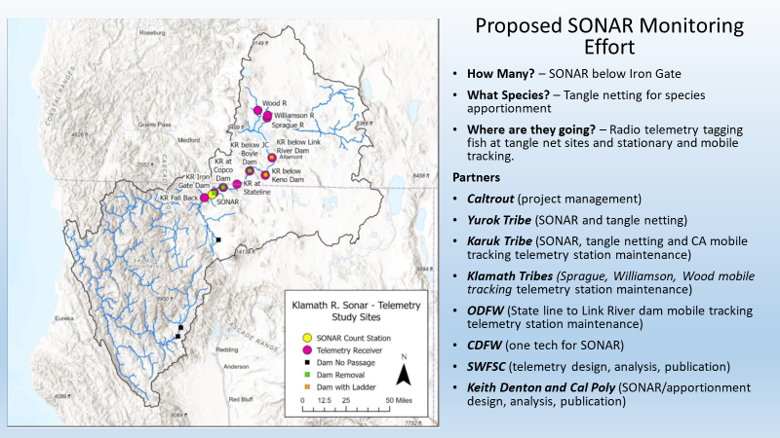

Slide 16
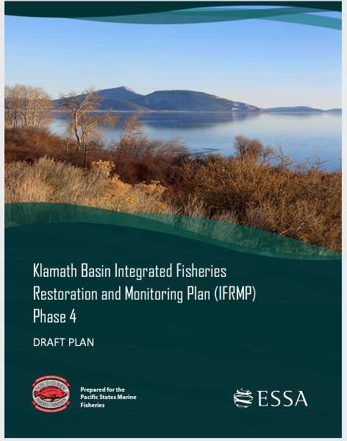
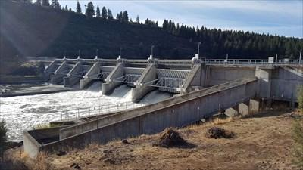
On the Horizon
Dam Demolition
Restoration Activities
Reintroduction
Reconsultation with Bureau Reclamation on Water Operations (Fall 2024)
Keno Operations and Passage
Notes:
Monitoring?

