Slide 1

Economic Analysis for Groundfish Closures in Northern California
Agenda Item E.5.b
Supplemental Public Presentation 1
November 2023
Ben Scuderi,
Lead Economist & Senior Analyst
Larry Phillips,
Pacific Fisheries Policy Dir.
Notes:
Larry Phillips representing American Sportfishing Association
Ben Scuderi (Southwick Associates) couldn’t be here.
I will be presenting a summary “Economic Analysis for Groundfish Closures in Northern California”

Slide 2
INTRODUCTION
Southwick Associates was asked by ASA to examine the potential economic impacts of the current closure of Northern CA’s nearshore groundfish fishery
This analysis uses the best available data to estimate the potential annual impact of future closures in terms of lost fishing effort, angler spending and economic contributions
A copy of the full report is available in the briefing book.

Slide 3

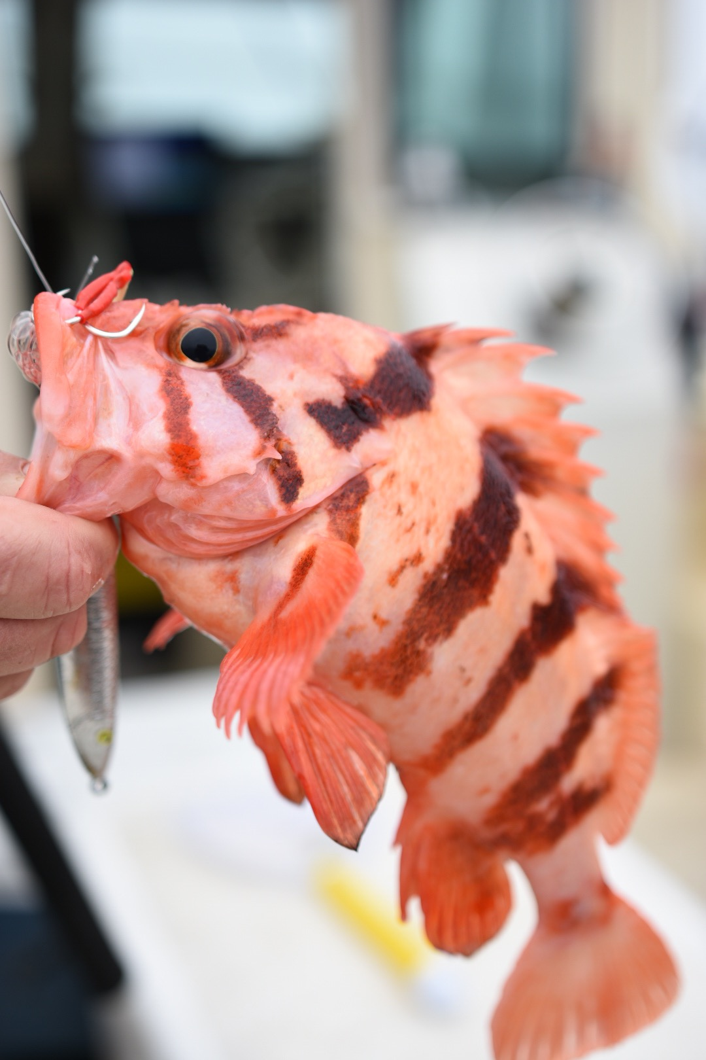
Fishing effort data provided by RecFIN
Angler spending estimates and economic contributions are provided by NOAA
  Fisheries Economics of the United States
  2020 is the most recent year available
These data sources were combined to estimate the potential impact of a prolonged closure of Northern CA’s nearshore groundfish fishery

Slide 4

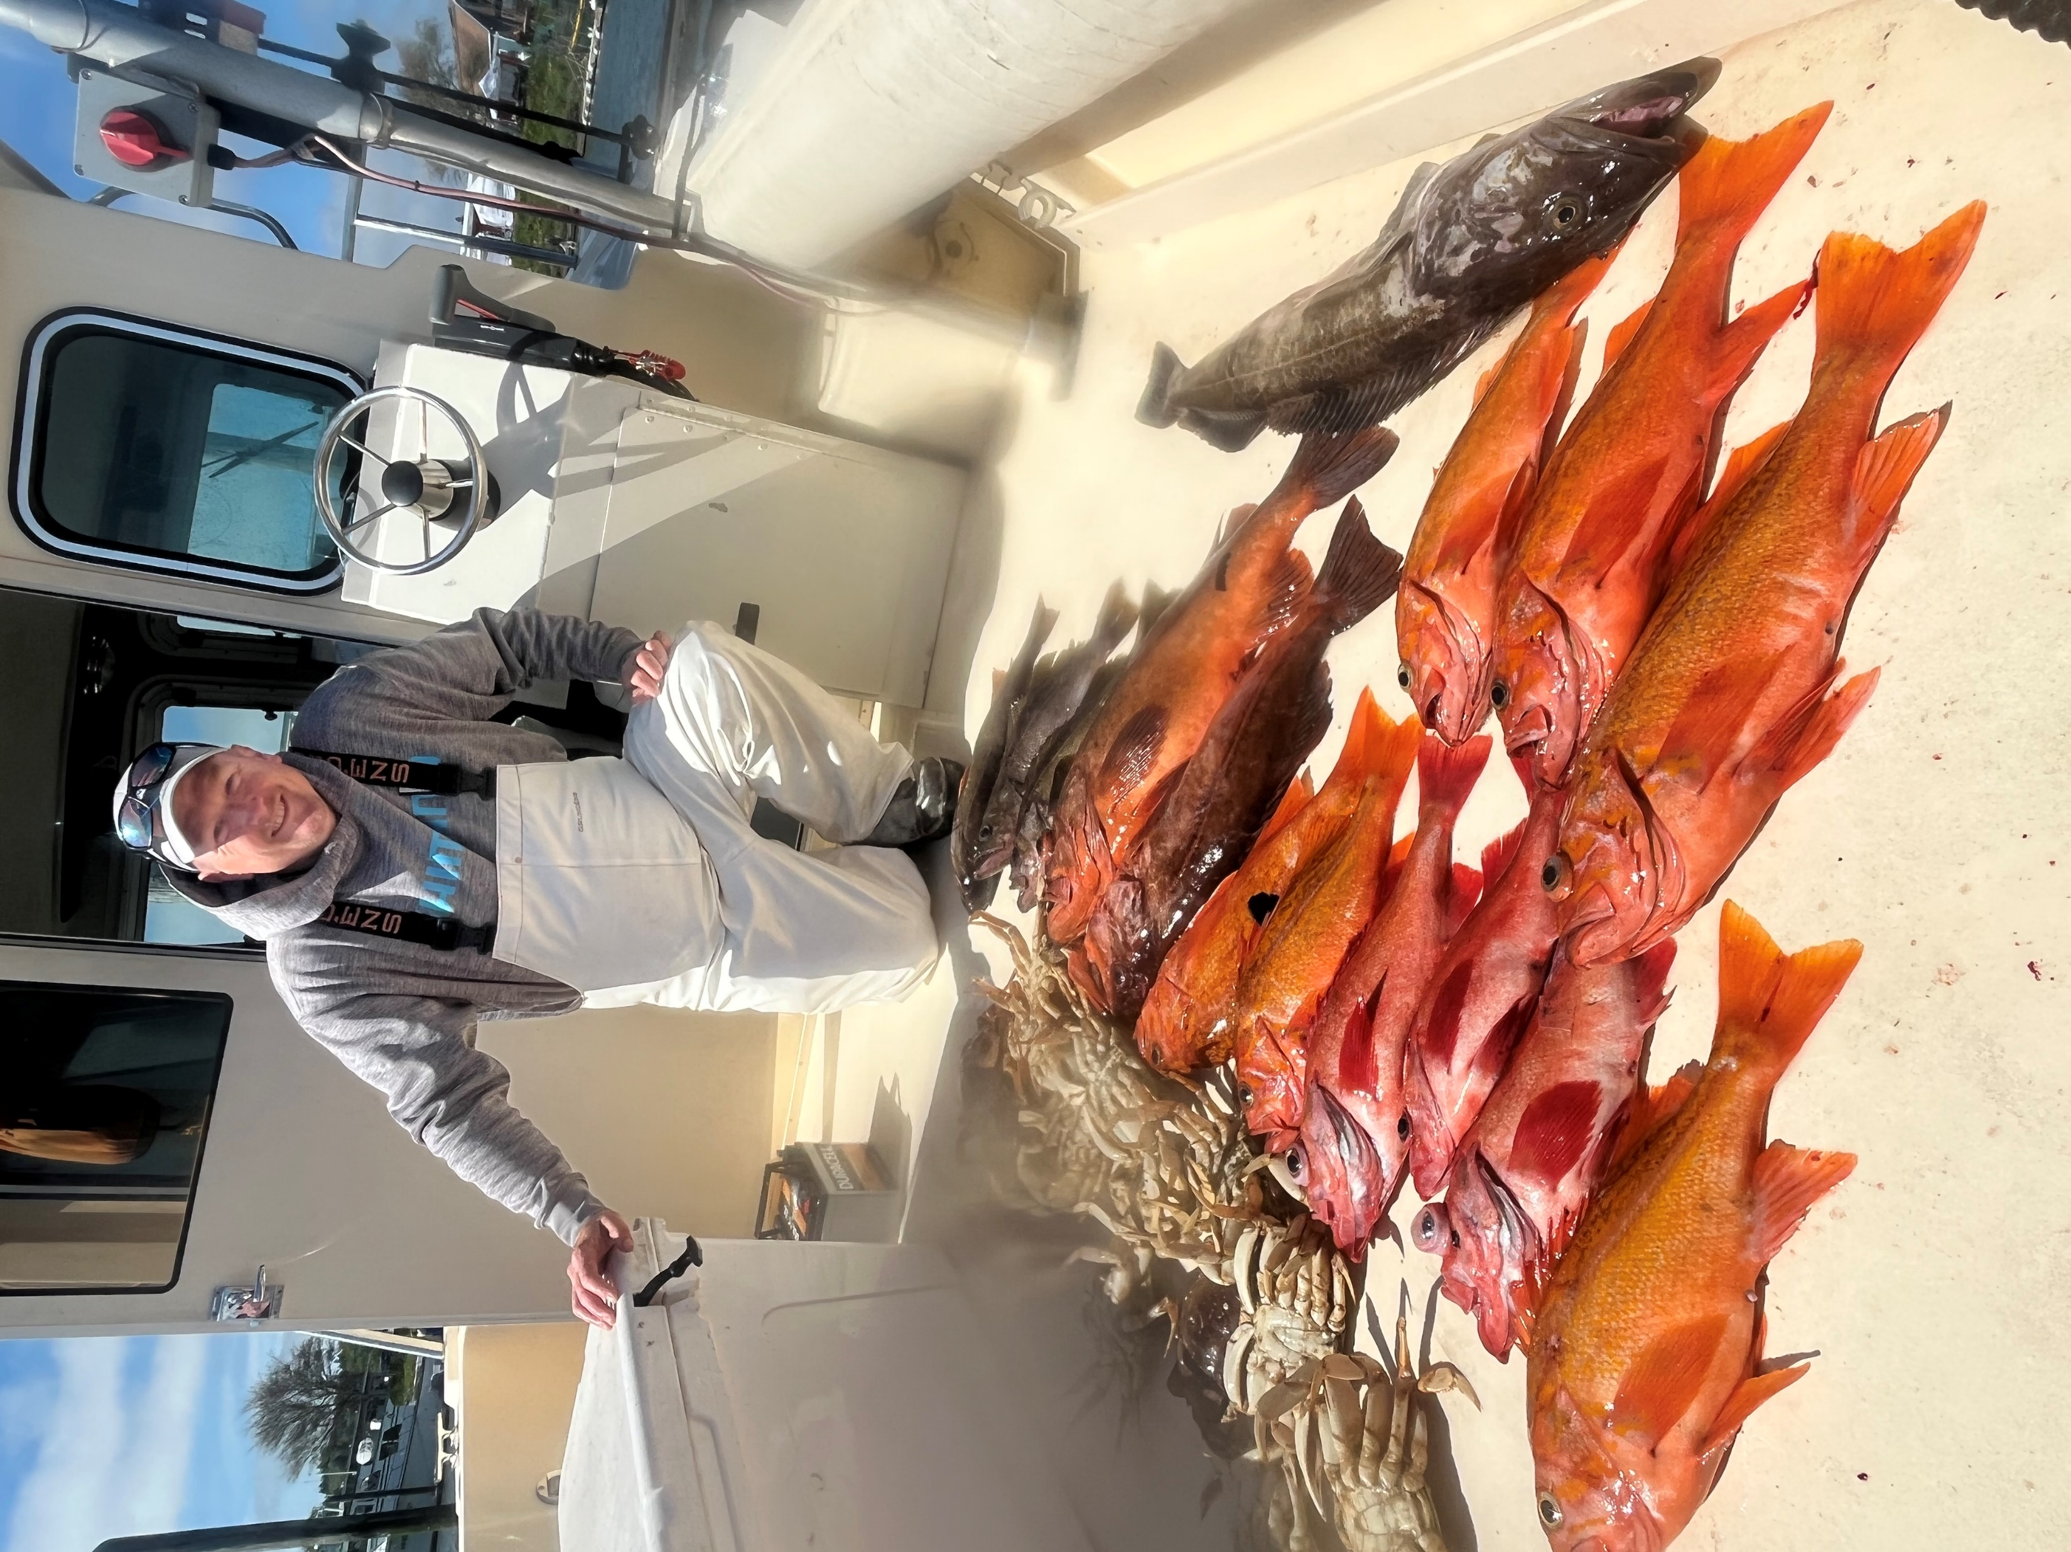
Year | Private / Rental Boat Trips | Party / Charter Boat Trips | Total
2021 | 111,280 | 98,352 | 209,632
2022 | 118,592 | 79,073 | 197,665
Total | 229,872 | 177,425 | 407,297
Annual Average | 114,936 | 88,713 | 203,648
Notes:
According to RecFIN, anglers took over 407,000 boat-based recreational fishing trips for groundfish in the ocean off the Northern California coast between 2021 and 2022. That’s an average of more than 203,000 angler trips per year.

Slide 5

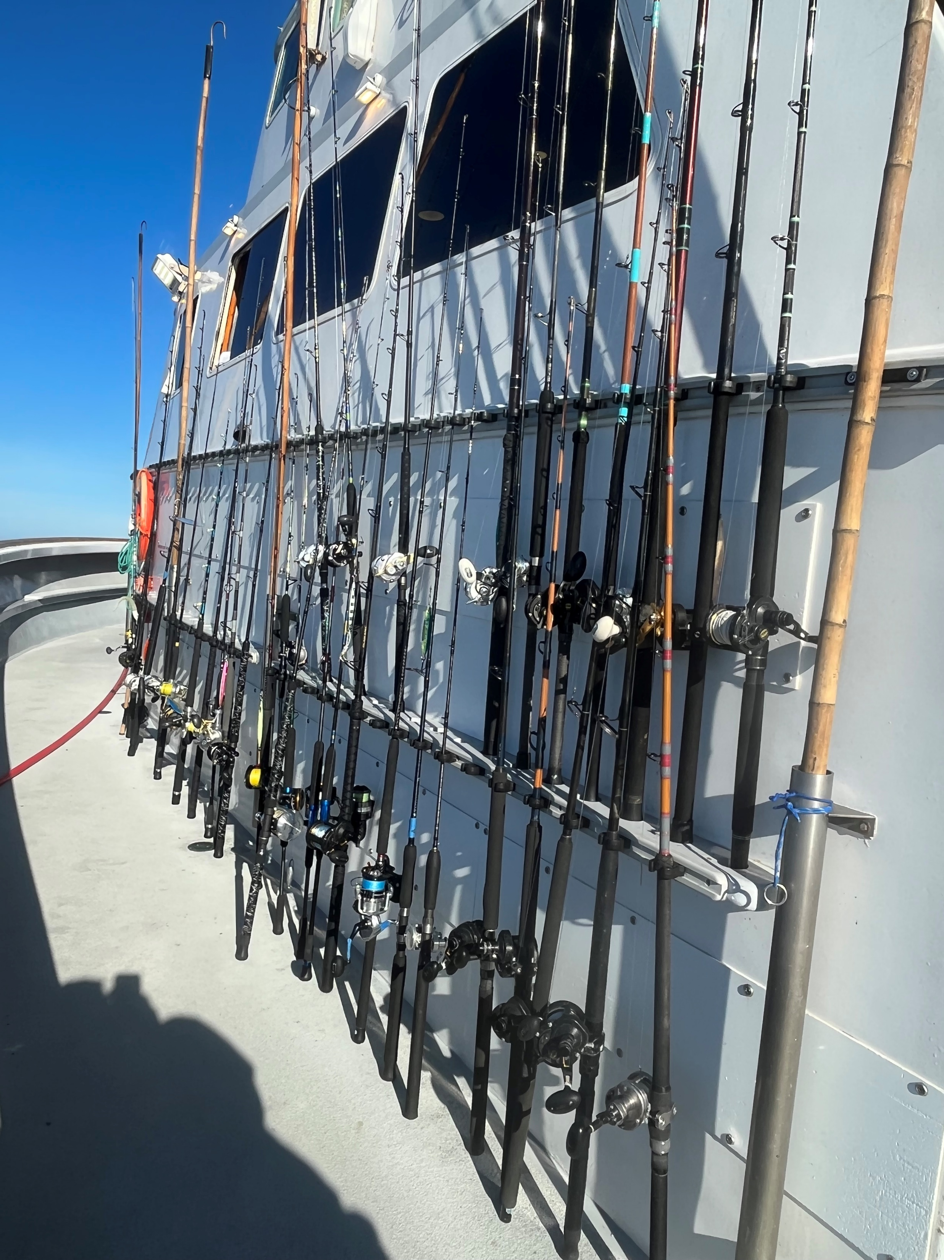
Year | Private/ Rental Boat Trips | Party / Charter Boat Trips | Total
2021 | $21,772,000 | $36,349,000 | $58,121,000
2022 | $25,056,000 | $31,558,000 | $56,614,000
Total, 2021-2022 | $46,828,000 | $67,907,000 | $114,735,000
Annual Average | $23,414,000 | $33,954,000 | $57,367,000
Does not include spending for durable goods!
Notes:
Anglers spent an estimated $57 million on trip expenditures (food, fuel, bait, ice, etc.) per year while targeting groundfish the ocean off Northern California during 2021-2022. This spending is expected to be drastically reduced if not eliminated if the current groundfish closures stay in place.
It’s important to note that spending for durable goods (rods, boats, etc.) is not reported here, so these are likely conservative estimates. It’s unclear how angler spending for durable goods would be affected by a prolonged nearshore groundfish closure, but the negative impact on fishing effort would be expected to have an impact on spending for durable goods, and therefore coastal retailers and other businesses, in the long run as well.

Slide 6
ANNUAL ECONOMIC CONTRIBUTIONS
Fishing Mode | Angler Spending | Jobs | Income | Output (Multiplier Effect) | Value Added (GDP Impact)
Private / Rental Boat Trips | $23,414,000 | 210 | $11,611,000 | $35,161,000 | $22,070,000
Party / Charter Boat Trips | $33,954,000 | 816 | $22,495,000 | $110,838,000 | $35,987,000
Annual Total | $57,368,000 | 1026 | $34,106,000 | $145,999,000 | $58,057,000
Notes:
Angler spending for boat-based bottomfishing trips off the Northern California coast create an annual multiplier effect of nearly $146 million, contributing over $58 million to the state’s gross domestic product (GDP). This spending also supports over 1,000 jobs in California, which provide wages of more than $34 million.

Slide 7
SUMMARY
The economic impact associated with future nearshore rockfish closures is likely in the hundreds of millions of dollars (including durable goods).
There is common agreement regarding the uncertainty of the 2021 quillback Rockfish assessment (Maunder report).
Given these uncertainties, we respectfully request that the Council pause the implementation of a rebuilding plan and the recommendation of a future OFL until we can collectively be more certain our estimates of abundance are accurate.

