Slide 1
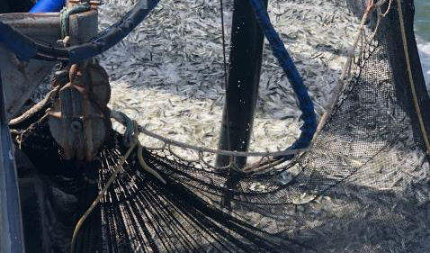
SARDINES IN CALIFORNIA
Agenda Item E.4.b
Supplemental Public Presentation 1
April 2021
FISHERY IN CRISIS ~ part 2

Slide 2
This conflict is between what fishermen say is out there, based on what they see, and what biologists say, based on insufficient science
2021 catch-only projection was based on incomplete data / methods from 2020 benchmark assessment
    No surveys (although CDFW did conduct aerial survey in 2020)
    No new age data (despite CWPA directed fishery bio sampling)
  Catch-only projection did estimate larger recruitment / biomass in 2019 … BUT
  Assumed the Mexican fishery must have taken most of the fish
      MexiCal S2 catch( 33,070 mt – only 705 mt from US) was higher than
      2020 age 1+ assessment 28,276 mt (WHY?)
  F of 4, or even F of 1.95 is not realistic
  Catch-only projection = only 14,001 mt (@50% decline in 1 year)
      (Avg. R 10-19 S-R relationship used in forecast – est. 14,,456 mt)
  STAT ARGUMENT: “Biomass levels are low, and it is likely that recruitment will continue to be low in the near term.”
  WHY DISMISS RECRUITMENT DESPITE MULTIPLE LINES OF EVIDENCE?

Slide 3
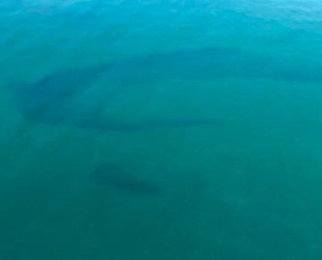
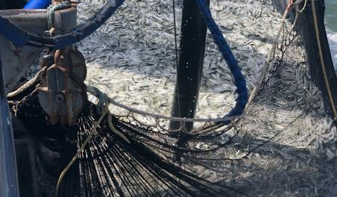
Conflict is between what fishermen say is out there, based on what they see, and what biologists say, based on insufficient science
Big uncertainty (now acknowledged): the abundance of sardine inshore of AT surveys
Since the sardine fishery closed in 2015, every year fishermen have testified to the abundance of sardine they’re seeing in nearshore fishing grounds (including 3-5 inch fish).
64 ton point set – 61 degree water 4/1/19
“Tremendous amount of fish – too many schools to count” ~ Corbin Hanson
6,000 tons sardine observed in 60 ft. water near Seal Beach – 61 degree water 4/1/19

Slide 4
Sardine assessment says low recruitment ~ BUT
Abundant evidence of recruitment since 2015
  (in addition to fishermen’s observations)
~ Observations of YOY sardine and adults documented in Juvenile Rockfish Surveys (RREAS)
(2015 – 2018 )
~ CalCOFI Report Vol. 60:
“The CCE experienced a mild El Niño from late 2018 into 2019… In central California, market squid and Pacific sardine (Sardinops sagax) were also abundant. ”

Slide 5
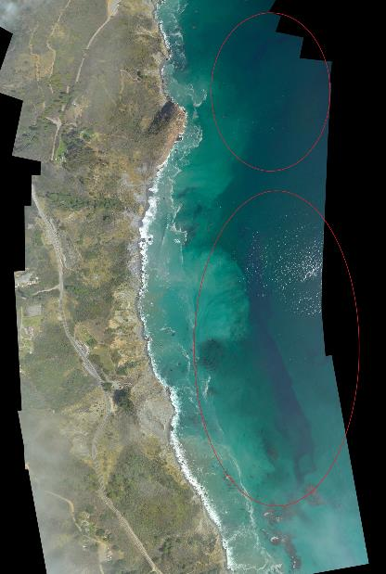
70%+ of sardine fishery in CA is NOT documented
Most CA catch inside 20 fa curve
4,000 of est. 13,000+ tons observed near Big Sur ~ Oct. 2018
47% of est. coast-wide biomass of 27,547 mt that year
All inshore of NOAA AT and CalCOFI surveys

Slide 6
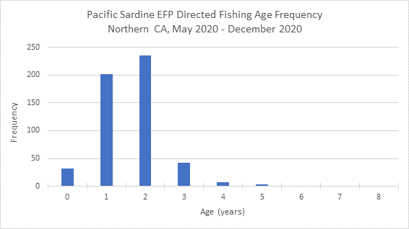
Many Many Many Many Observations ~
Focus on CWPA EFP data for 2020
Directed fishing – bio sampling in Monterey
    S2 May 14 – Jun 30 12 sets ~ 241 mt
    S1 Jul 1– Dec 31 7 sets ~ 220.5 mt

Slide 7
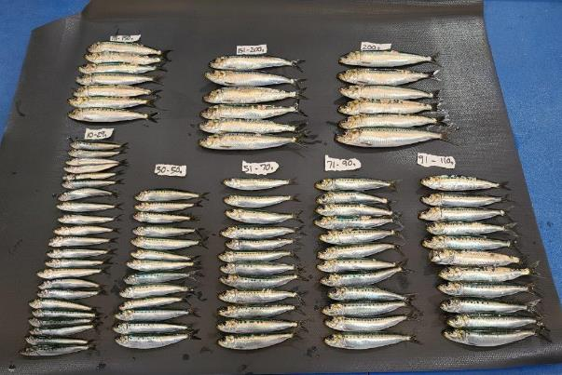
Evidence of Recruitment & Abundance the good news
From CWPA testimony Agenda Item G.1.b, Supp. Pub. Comm. June 2020
Thanks to Council support for our ”biological sample fishing” EFP, NMFS approved it and we are producing new evidence:
10-70g = YOY
70-90g = 1yr
90-110g = 2 yr
122g = 4 yr
200g+ = 5-6 yr
Based on
Butler et al 1993
CalCOFI
&
R.Parrish model
Sample from 32 ton landing in Monterey on 6/8/20

Slide 8
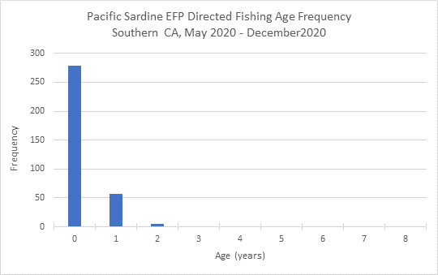
Many Many Many Many Observations ~
Focus on CWPA EFP data for 2020
Directed fishing – bio sampling in So Cal
    S2 May 14 – Jun 30 10 sets ~ 345 mt
    (7 sets in water 62°F or colder)
    S1 Jul 1– Dec 31 7 sets ~ 146 mt
    (5 sets in water <59°F)

Slide 9
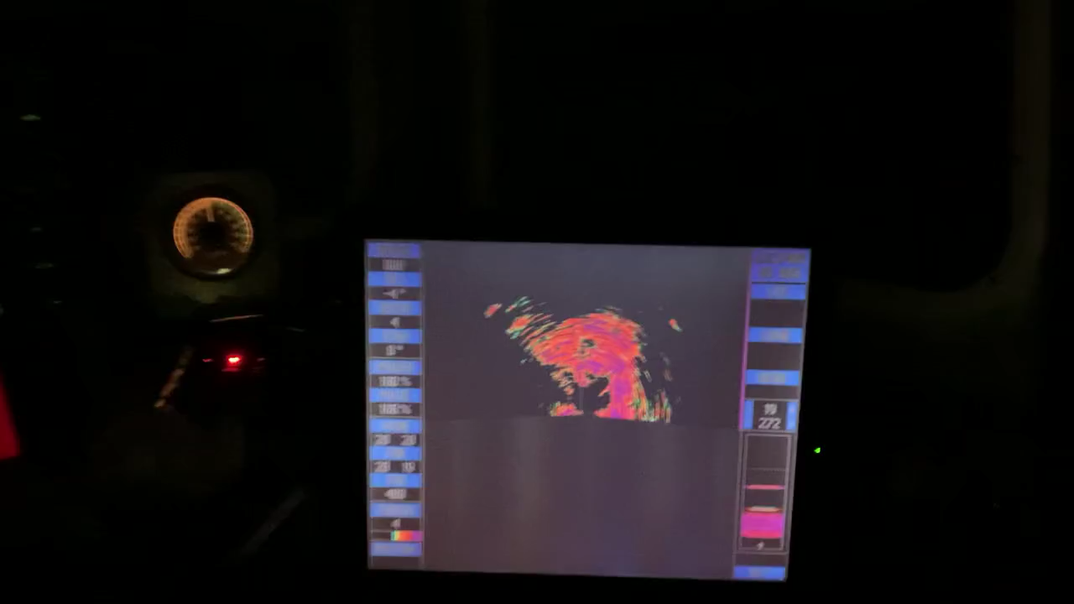
Many Many Many Many Observations ~
Focus on CWPA EFP data for 2020
Recent example: bio sampling in So Cal
  36 mt, – Av. Size of fish 29.88 g – SST 56°F March 25, 2021

Slide 10
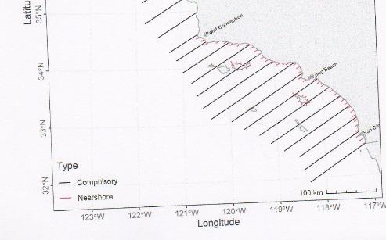
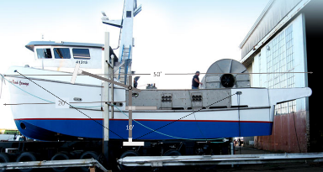
Many Many Many Many Observations ~
CWPA just finished running nearshore acoustic survey in the SoCal Bight, in cooperation with the SWFSC (3/21-3/31/21), while CDFW conducted aerial survey of the same area in synchrony

Slide 11
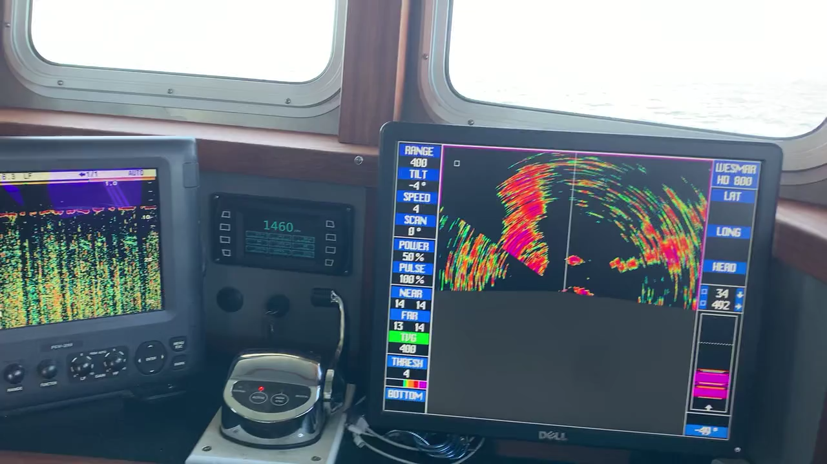
Observations from the field ~
Transect 29-28 San Onofre to Oceanside, Mar. 22, 2021

Slide 12
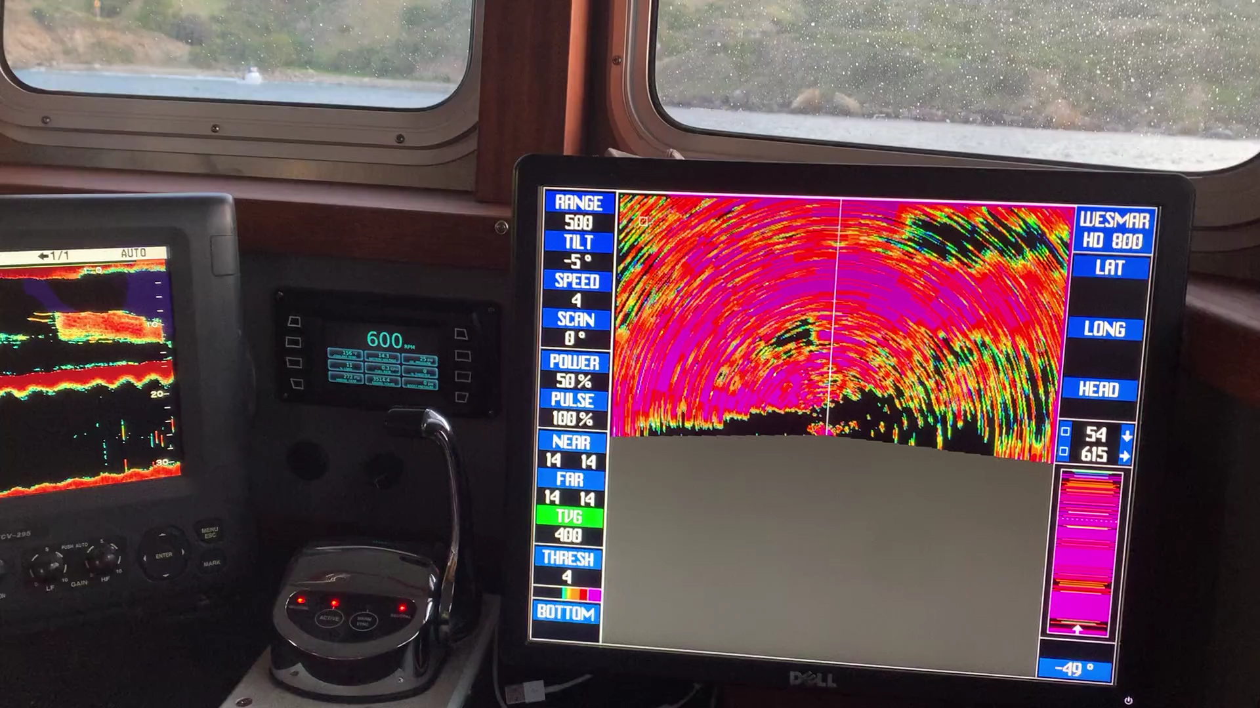
Observations from the field ~
Transect 211 ~ Catalina Island, Mar. 26, 2021

Slide 13
Nearshore abundance should be factored into the assessment
Evidence on the ground needs to be considered:
  Avg. R 05-19 age 1+ estimate was 32,647 mt
  EXCLUDING NEARSHORE BIOMASS
  SSC, CPS Management Team and Council approved
  Avg. R 05-19 scenario for the sardine rebuilding plan…
    For consistency, the 05-19 SR curve should be used in assessment also.
  Draft catch-only projection belies reality: should be rejected
  50% cut in already precautionary harvest policy would exact harsh impact on industry, live bait fishery
    Most of current catch is (quietly) acknowledged to be ‘southern stock’ sardine
    Need to stop deducting ‘southern’ sardine landings from ‘northern’ sardine harvest limits!

Slide 14
High priority recommendations
Please consider these recommendations:
  Support use of multiple indices at various times of year in future stock assessments, not just one summer Acoustic Trawl survey with no replication.
High Priority :
  Conduct sardine STAR Panel review in 2022, incorporating all 2021 surveys and new biological data.
  In conjunction:
    Conduct a methods review to examine the basis for the habitat model
      SSC and CPSAS recommended this review in 2019
    Conduct a methods review of the Juvenile Rockfish Survey (RREAS) so it can be used to inform recruitment in the sardine assessment model
    Conduct a workshop to evaluate use of AT surveys in the model and carry out improvements in methodology recommended in the 2018 AT Methods Review and other earlier reviews.
  Re-evaluate model assumptions to learn why the assessment model predicts a continued decline in age 1+ biomass when AT survey abundance data and evidence in the field show an increase

Slide 15
Importance of CA Wetfish Industry to
CA fishing economy
Until recent years, CA’s complex of of CPS fisheries produced 80+% of volume, 37% dockside value of total statewide commercial fishery harvest
Important to many harbor communities ~ Volume is essential to maintain infrastructure, jobs
Sardines are the foundation of CA wetfish industry
Port | Wetfish % of Total Port Landings | Wetfish % of Total Port XV Value
Monterey Harbor | 97.5% | 76.3%
Moss Landing | 96.2% | 66.3%
Ventura | 98.7% | 82% (squid)
Port Hueneme | 99.9% | 99.9%
San Pedro | 99.6% | 93.4%
Terminal Island | 97.7% | 81.4%
Contribution to Statewide Landings | 82% | 37%

Slide 16
Take Home Message
CA wetfish processors and fishermen are really hurting:
  @50% reduction in processing crews since sardine fishery closure in 2015
  Boats tied to the dock for weeks on end
Before 2015, CA’s sardine fishery produced average annual sales impact > $16 million
  That value plummeted to $61,453 (1%) in 2017
  and even lower now
Employment reduced 50% or more due to loss of fishing opportunity
All CPS landings have plummeted due to restrictions on sardine
  mandated 20% incidental catch rate limits fishing on other CPS – even squid
CA’S WETFISH INDUSTRY NEEDS HELP NOW

Slide 17
How the Council can help:
Support CWPA efforts to improve the science
  EFP renewal for point sets supports continuing work to expand aerial survey research for Cen. Coast
  Bio sampling EFP necessary to produce updated fishery age data
    No new FISHERY age data in model since fishery closed in 2015
    STAT did not use age from sardines caught incidentally in other fisheries Prefers age data from directed fishing
    Bio sampling EFP is built on Scientific Framework:
      Minimum 6 samples per semester per area – Monterey and S.CA.
      S 1: July – December ~ S 2: January – June

Slide 18
What next?
The logical conclusion is that NOAA ATM surveys are not seeing the total biomass (Q is not 1), and should be considered as bare minimum relative estimates when considering management measures (and a rebuilding plan).
Please approve ACT no lower than 2020 level
  The 3 EFP requests can be accommodated within a 4,000 mt ACT (including 2,500 mt for live bait),
    without curtailing incidental catch in other fisheries or small-scale landings)
  In-season management is accurate and effective
In reality, sardines are NOT OVERFISHED and overfishing is NOT occurring!

Slide 19
If boats are tied to the dock, processors’ doors closed
If CA’s wetfish industry is further decimated due to even more cuts in an already precautionary harvest policy …
Then the Council has not accounted for the socio- economic needs of fishing communities.
  Balance is a key mandate of the Magnuson Act
  MSA requires Council and NMFS to consider the needs of fishing communities, not just biology, in developing rebuilding measures, including harvest limits
  Please consider these issues and the uncertainties raised and “combine scientific underpinning with common sense.”
  (Chris Oliver, Assistant Administrator for NOAA Fisheries ~ 2018)
Please help save California’s historic wetfish industry!

Slide 20

Questions?

Slide 21
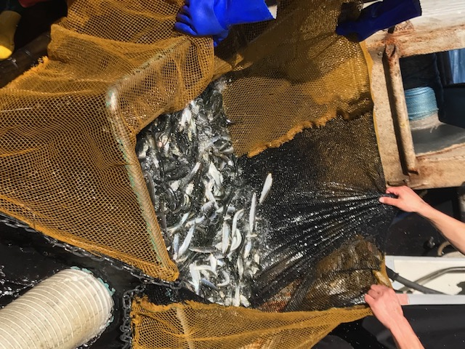
Supplemental slides

Slide 22
Abundance data from the AT Survey contradicts continuing decline
(from 2020 stock assessment report)
Why does the assessment model have a sharp decline in age 1+ biomass when the ATM abundance data show a strong increase?
Year Table 6 Table 8 Table 15
Index Abundance Age 1+ Biomass
2017 14,103 171,695,016 33,082
2018 25,148 253,466,083 32,942
2019 33,632 343,115,319 28,275
“The logical conclusion is that the ATM surveys are not seeing the total biomass, and should be considered as a bare minimum estimate when considering management measures and a rebuilding plan.” (Richard Parrish, D.3 Pub. Comm. Apr ‘20)

