Slide 1

Salmon Bycatch in the Pacific Coast Groundfish Fisheries:
Overview of Biological Opinion and Incidental Take Statement
Agenda Item H.5.a
Supplemental NMFS Presentation 1
March 2018
West
Coast
Region
March 2018
http://www.westcoast.fisheries.noaa.gov/fisheries/groundfish/salmon_bycatch_goundfish_fisheries.html

Slide 2
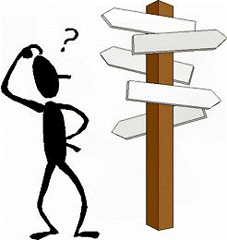
How we got here….
Reinitiation – 2013
Workshop seeking stakeholder/manager input - 2015
Council motion with bycatch scenarios – Sept 2015
Final Council Recommendation - spring 2017
Biological opinion completed December 2017
Previous opinion remained in effect while consulting.

Slide 3
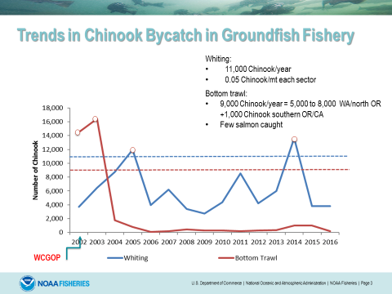
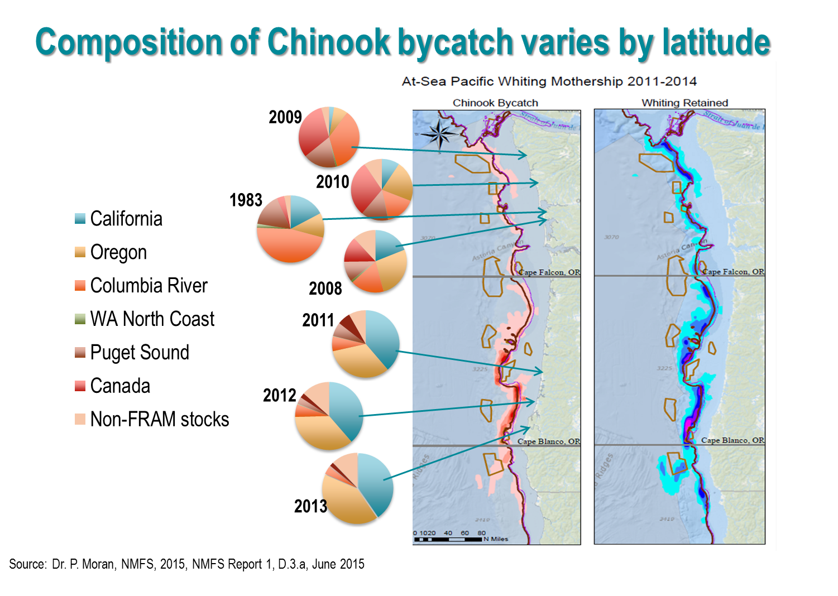
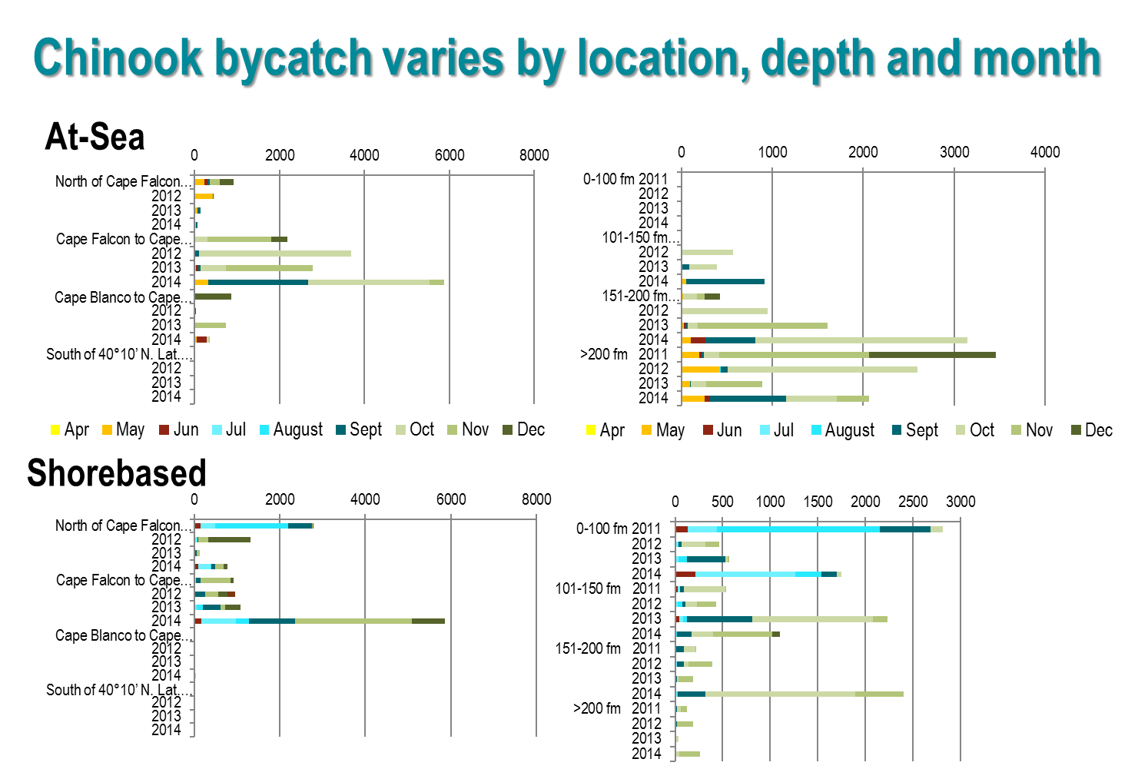

Slide 4
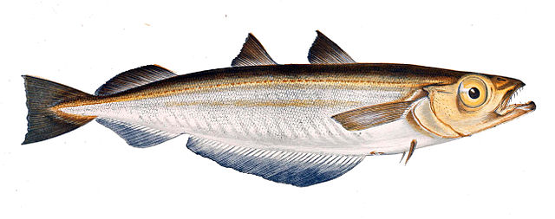
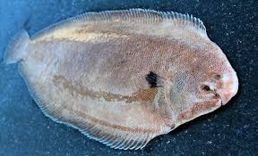
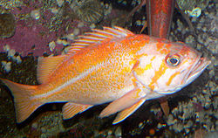
RESERVE
3 scenarios
Whiting
(Scenario 1)
Non-whiting
(Scenario 2)
Full geographic distribution of fleets (1A)
Resumption o at-sea processing S. of 42° (1B)
Baseline
(Scenario 2A):
Less constrained (Scenario 2B)
Proposed Action
Recent landings
Recent bycatch rates
Hybrid (2B1)
1990s (2B2)
1990s landings
recent bycatch rates
2017/18 EFPs included
1990s landings
EDCP (1990s) bycatch rates

Slide 5
Whiting Proposed Action (Scenario 1A)
Assume geographic footprint unchanged
  Northern and southern footprints
  Potential for greater tribal participation
TAC up to 500 metric tons; 100% attained
Chinook guideline of 11,000
At-sea, shoreside, tribal sectors

Slide 6
Non-whiting Proposed Action
(Scenario 2B1)
Bycatch guideline of 5,500
Harvest effort/footprint similar to 1995-99 BUT recent bycatch rates
RCA removed off OR/CA (Council PPA)
Defined attainment rates by species
Includes 2018 EFPs
Bottom/midwater non-whiting trawl, fixed gear, recreational

Slide 7
Reserve
The Council recommended that NMFS consider the Reserve not as an entitlement or a de facto increase in the bycatch threshold; but rather, as a safety net to minimize disruption to the fishery where actions that were already actively being taken to reduce bycatch were insufficient
RESERVE
Reserve of 3,500 total Chinook/year available to either fleet
Evaluate Reserve taken entirely by:
  whiting
  non-whiting bottom trawl
  non-whiting midwater trawl
Efforts taken to dampen catch prior to access
Development of access rules underway

Slide 8

Approach
To make the most out of limited data, to boldly go where no analyst has gone before….
Focused on Chinook and Coho
Projected range of bycatch and distribution based on Proposed Action
Chinook bycatch managed < bycatch guidelines + Reserve
Likelihood that either sector > guideline without active management
Most circumstances, not every eventuality = robust but realistic
Reserve addresses unexpected situations
Revised previous approach based on advisory body recommendations
Starship from Smithsonian; field of stars from NASA

Slide 9
Utility of Reserve?
Compare with bycatch guidelines
*Range of Chinook bycatch expected 80% of time by sector,
*Latitudinal distribution of effort
Estimate stock composition by ESU (whiting data or FRAM)
Impacts by ESU by sector and scenario
Scenario 1 of 4, Reserve 1 of 3
Scenario 2 of 4, Reserve 1 of 3

Slide 10
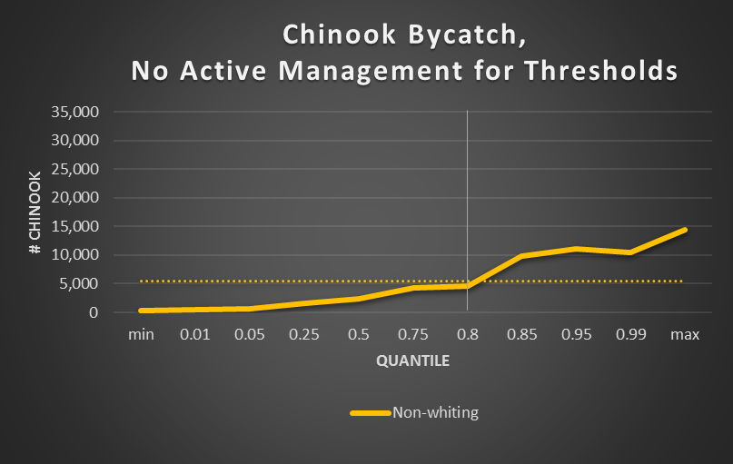
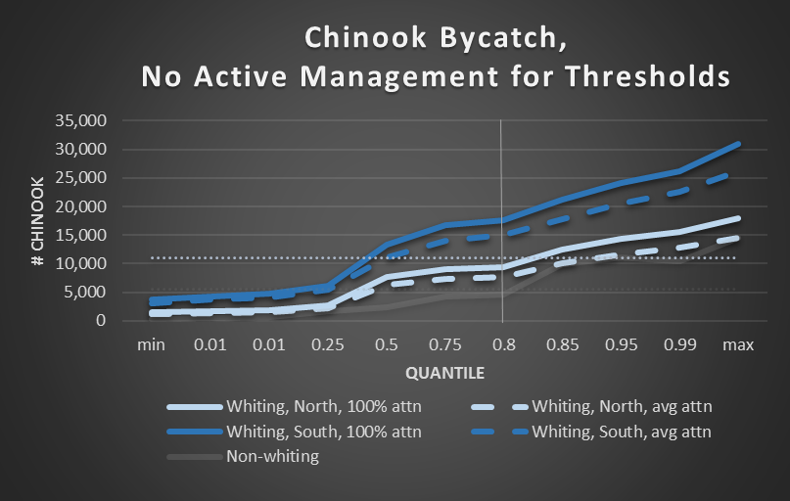
Tables 2-49, 2-52, pg 2-130 and 2-144, BiOp

Slide 11
Whiting
Distribution of Bycatch
Figures 2-12 and 2-13, pg 2-131 and 2-132, BiOp

Slide 12
Non-whiting
Distribution of Bycatch
Figure 2-16, pg 2-147, BiOp

Slide 13
Puget Sound, Snake River fall, Lower Columbia River, CA Coast Chinook
Bottom Trawl = CA Coast Chinook
Contribution influenced by whiting footprint

Slide 14
Results:
Whiting fishery likely to exceed threshold under Southern footprint without active management
Non-whiting fleet generally below threshold but significant uncertainty
PS, Snake River fall, LCR and CC Chinook; Oregon Coast coho.
Impacts to individual ESUs are very low; south uncertain

Slide 15
Incidental Take Statement
Amount of extent of Take
Reasonable and Prudent Measures
  nondiscretionary measures to minimize the impact of incidental take.
Terms and Conditions
  implement RPMs by monitoring incidental take and reporting progress of action and impact on the species.
Conservation Measures
  discretionary measures to minimize or avoid adverse effects or develop information

Slide 16
Amount/Extent of Take
Whiting
Guideline of 11,000 Chinook
Bycatch will not exceed
  14,500 Chinook per year including the Reserve
  474 coho bycatch per year.
Non-Whiting
Guideline of 5,500 Chinook
Bycatch will not exceed
  9,000 Chinook per year including the Reserve
  560 coho bycatch per year.
Distribution of bycatch will not change substantially from the results of the analysis
Sector takes actions to remain within its guideline
Re-initiated if any of the Reserve is used in three out of any consecutive five years

Slide 17
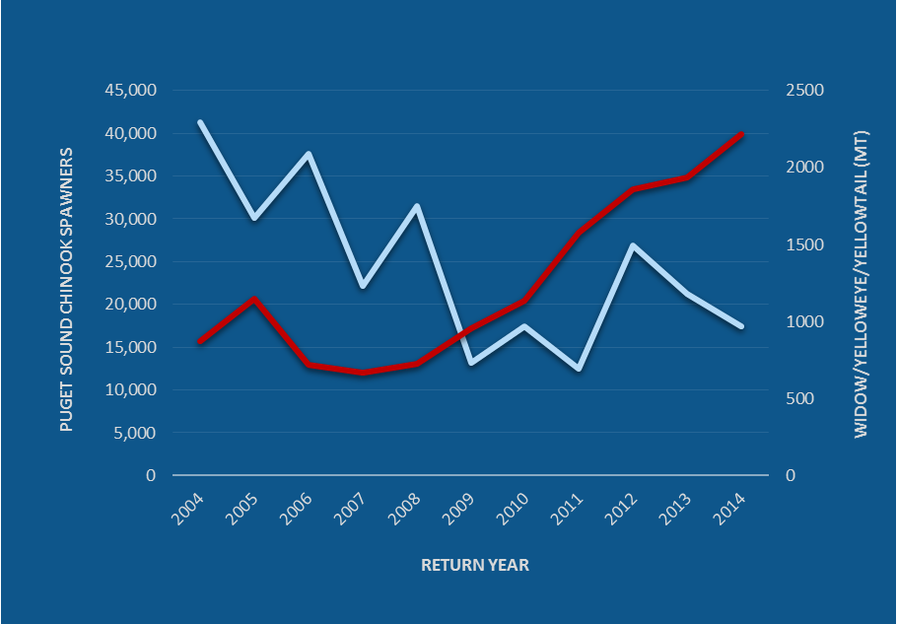
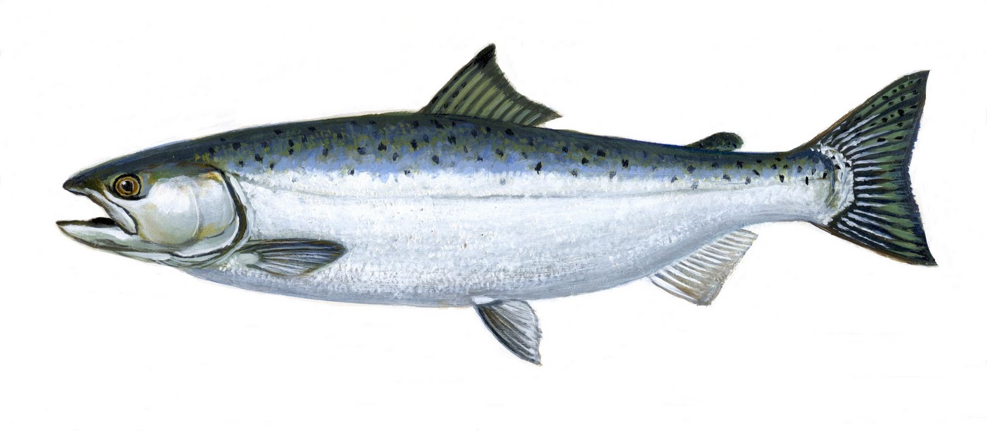
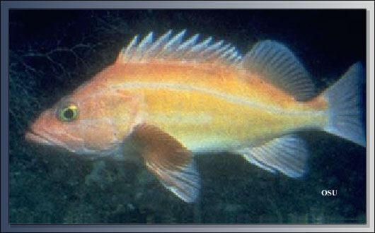
Reasonable and Prudent Measures
Monitoring
Measures to Reduce Bycatch and Keep within Guidelines
Regulations to Implement Reserve
Adaptive Management for New Times and Areas
Identification of High Bycatch Times/Areas/Conditions
Reporting and Evaluation

Slide 18
RPM 1 – Monitoring
Review existing mechanisms for monitoring salmon bycatch in the groundfish fishery, and develop mechanisms that provide a) timely inseason data regarding the amount and location of salmon bycatch by sector, and; b) timely inseason data regarding the geographic distribution of the at-sea whiting fleet.
Terms and Conditions
1.a.(i) Monitor salmon bycatch inseason for the trawl sectors weekly.
1.a.(ii) Collect data of comparable or better quality .
1.a.(iii) Monitor and evaluate bycatch control measures and salmon bycatch amount and location by sector, fleet distribution, results of biological sampling.
1.a.(iv) Track and report distribution of fishing effort.
1.b. Evaluate changes in geographic and temporal distribution of fishing effort. If different from the opinion, determine if the change has resulted in impacts on listed salmon ESUs outside the effects analysis.

Slide 19
RPM 2 – Keep Bycatch Within Guidelines
Review existing mechanisms for reducing salmon bycatch, and revise mechanisms or develop and implement new mechanisms to ensure that, should inseason data show the annual coastwide bycatch will exceed any thresholds, NMFS and the PFMC will take timely and effective inseason action to avoid an exceedance of these bycatch thresholds.”
Terms and Conditions
2.a. Review existing mechanisms/regs to reduce salmon bycatch and evaluate efficacy for inseason use (e.g.,Ocean Salmon Conservation Zone, Bycatch Reduction Area). Provide recommendations to increase effectiveness.
2.b. Develop any new measures and recommend them to NMFS within three years of December 2017.
2.c. By May 15th, 2019, NMFS to amend provisions for reapportionment of the treaty tribes’ whiting allocation to the non-treaty sectors to require NMFS consideration of the level of Chinook bycatch when determining whether to reapportion whiting.

Slide 20
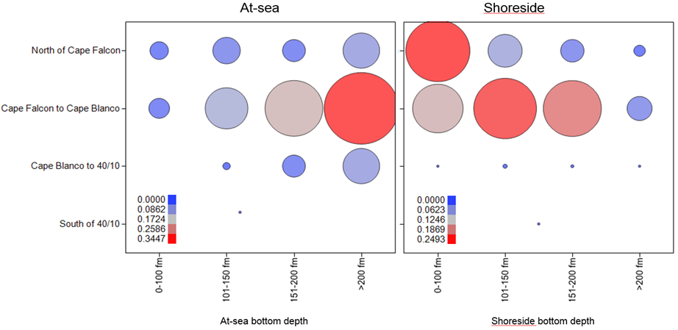
OSCZ
OSCZ
March 2017 I.1.a, NMFS Report 1, Figure 11, pg 45

Slide 21
Terms and Conditions for RPM 2 (continued)
2.d. Restrictions to minimize Chinook bycatch for the duration of this opinion retained:
  10,000-lb trip limit restriction on targeted harvest of whiting inside of 100 fathoms in the Eureka area,
  Prohibition on at-sea processing south of 42°00' N. latitude,
  Delay of the start of the primary Pacific whiting season until May 15th for all sectors, north of 40°30' N. latitude.
  When shore-based fishing for whiting beginning April 15 south of 40°30' N. latitude is allowed, no more than 5 percent of the shore-based allocation may be taken prior to the opening of the main shore-based fishery on May 15.
2.e. All whiting trawling within the nearshore Klamath and Columbia River Salmon Conservation Zones is prohibited. Within 2 years of December 2017, prohibit the following within these areas:
  Bottom trawling (except with a selective flatfish trawl gear), and
  All non-whiting midwater trawling.

Slide 22
RPM 3 – Reserve
Develop and implement regulations regarding the Reserve and its use, ensuring that the Reserve will be available only to address unexpected high bycatch levels, and it will not be available as a matter of course to allow the sectors to exceed their bycatch guidelines.
Terms and Conditions
3.a. Develop and implement initial regulations governing the Reserve as part of the 2019-2020 biennial specifications and management measures. At a minimum, they should allow for inseason action to prevent full exceedance and minimize the chance that the Reserve is used in 3 out of any consecutive 5 years.
3.b. Monitor use of the Reserve in 2019 and provide a report to the Council during development of biennial specifications for 2021-2022
3.c. If either sector exceeds its guideline + Reserve, sector will close for the remainder of the year. Develop and implement regulations governing closure of the fishery sector(s) as part of the biennial harvest specifications and management measures for 2019-2020.

Slide 23
RPM 4 – New Times/Areas
Take steps to eliminate data gaps and implement adaptive management to minimize and avoid take of coho and Chinook salmon prior to allowing fishing at times and in areas where it has not been allowed since the year 2001.
Terms and Conditions
4.a. Opening the trawl RCAs off Oregon and California - proceed cautiously and include measures to ensure the impacts are consistent with the analysis in this opinion. If salmon bycatch rates in the RCAs exceed the rates used in this analysis by more than 25 percent, evaluate whether the change could subsequently result in salmon bycatch levels higher than the thresholds or impacts to listed salmon ESUs that would be outside the effects analysis in this opinion. If so, the Council and NMFS will develop and implement measures to reduce those rates to keep within the bycatch thresholds and ESU impacts of the opinion.

Slide 24
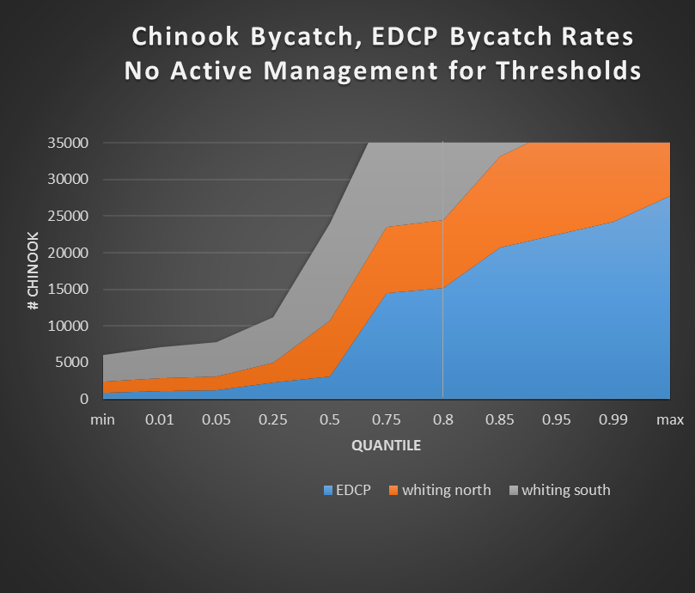
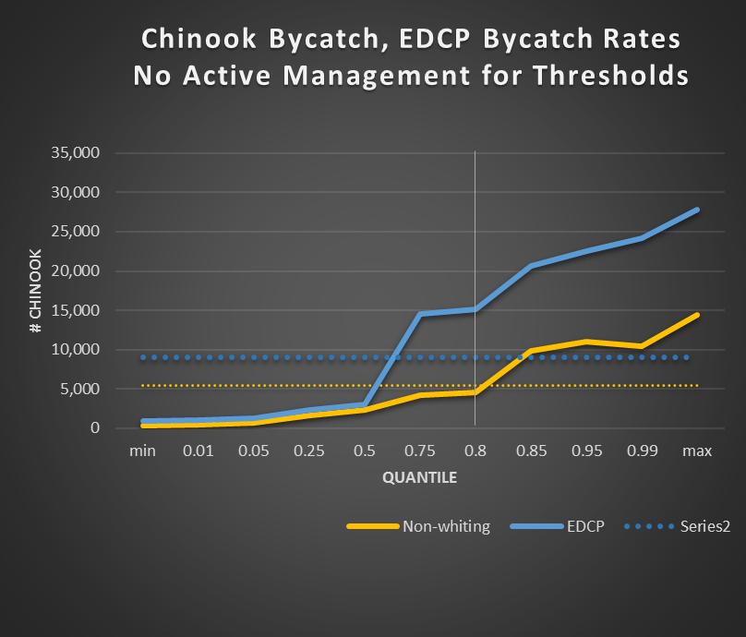

Slide 25
Terms and Conditions for RPM 4 (continued)
4.b. Prior to allowing additional non-whiting trawling south of 42° N. latitude, implement one or more EFPs designed to collect information about Chinook and coho bycatch levels and stock composition from fishing in those areas or at those times for a minimum of three years.
4.c. Prior to allowing additional open non-whiting trawling from January through mid- May, NMFS shall implement EFPs designed to collect information about Chinook and coho bycatch levels and stock composition from fishing during that time for a minimum of three years. In doing so, NMFS should take into account relevant information from existing EFPs. Information from the EFPs will be used to inform measures the Council may adopt to ensure the impacts are consistent with the analysis in this opinion.
4.d. The Council and NMFS will consider data collected as described in 4.a. and 4.b. in developing future management measures for the fishery.

Slide 26
RPM 5 – High Bycatch Times/Areas/Conditions
Identify factors that contribute to greater bycatch of Chinook and coho salmon in order to improve our ability to predict when greater levels of bycatch may occur, and to address these factors in the future. The Council shall consider this information when developing bycatch reduction management measures.
Terms and Conditions
5.a. Identify areas (‘hot spots’) and times of consistently high Chinook and coho bycatch and incorporate as appropriate in developing mitigation measures to reduce bycatch.
5.b. Over the next 2 years then every 5 years, conduct analysis to identify:
i. Indicators that are most useful in indicating anomalous ocean conditions that are likely to result in high Chinook bycatch, and;
ii. The most important indicators or combinations of circumstances that are likely to result in extreme salmon bycatch events in the whiting and non-whiting trawl fisheries.
5.c. Produce a report(s) summarizing the findings of its analyses in T&C 5a and 5b and recommendations on how the information could be incorporated into management. The first report(s) is due within 2 years of December 2017 and every 5 years thereafter.

Slide 27
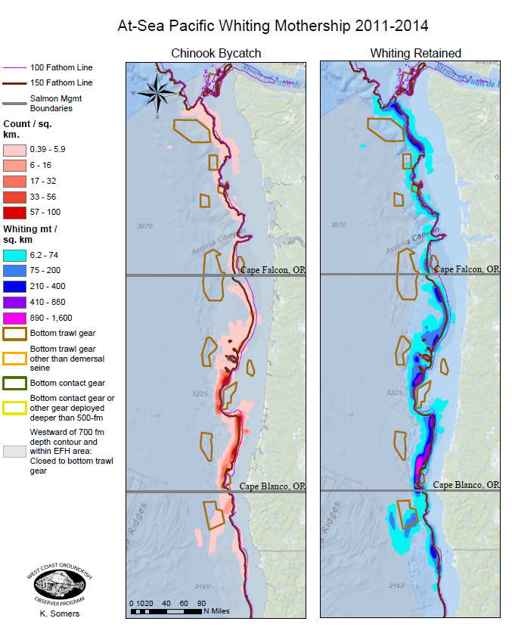
Hot Spots

Slide 28
Salmon Indicators: Bad - > Fair - > Good
1998 = worst
2005 = 3rd worst
2016 = 2nd worst
www.nwfsc.noaa.gov

Slide 29
RPM 6 – Monitoring and Evaluation
Compile and provide an annual report summarizing the following: a) all observed, reported, and estimated take of salmon by fishery sector, species, gear type, and location of bycatch in the groundfish fishery; b) stock composition of the Chinook bycatch by fishery sector and gear type including analysis of genetic data and expanded CWTs recovered by fishery sector, species and gear type, and c) the use of bycatch reduction measures in that year and evaluation of their effectiveness.
Terms and Conditions
6.a. annual postseason report by November 1 the year following the season:
observed salmon bycatch by season, fishing depth, bottom depth, and area for the previous fishing year.
stock composition (genetic data and available estimated CWTs) and other biological information.
bycatch reduction measures used and an evaluation of their effectiveness.
Compare fishery’s geographic distribution during the season against the assumptions made about that distribution in the opinion.

Slide 30
Terms and Conditions for RPM 6 (continued)
6b. Review existing monitoring and reporting systems used in the commercial fixed gear and recreational groundfish fisheries with respect to the timeliness of bycatch reporting and assessment of salmon bycatch.
NMFS shall produce a report summarizing the findings of this review and recommendations to address deficiencies in existing systems within two years of issuance of this opinion.
NMFS shall work with the Council and states to implement the recommendations within one year after issuance of its report.

Slide 31
Questions?

Slide 32
