Slide 1
Agenda Item F.2.a
Supplemental EWG PowerPoint 1
March 2018
Fishery Ecosystem Plan Initiative 3:
Climate and Communities Initiative
Ecosystem Workgroup Presentation for F.2.a.
March 2018

Slide 2
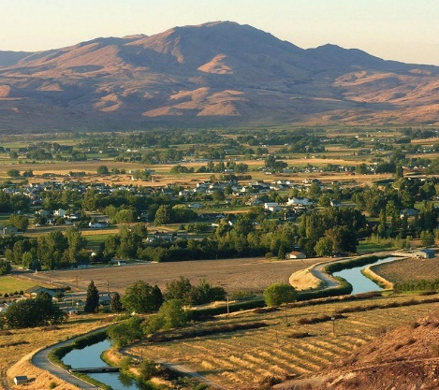
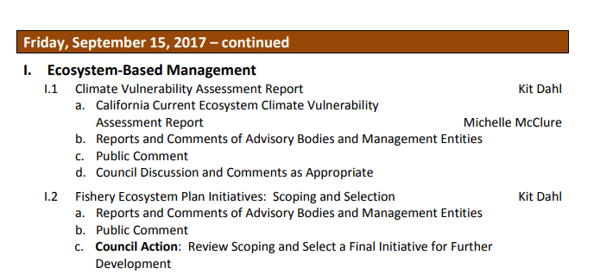

Slide 3
✓
Understand what science we have available
Understand the potential effects of changing climate on our managed stocks and fishing communities
Evaluate the connections between fish stock vulnerability and fishing community vulnerability to climate shift and change
Enhance original climate initiative with pieces of communities initiative
✓
?
?
?

Slide 4
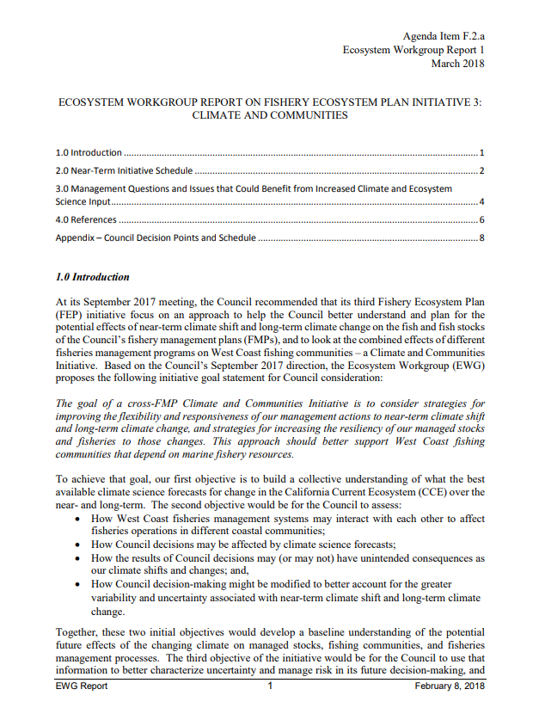
Pages 1-2:
Introduction
Draft Goal
Draft Objectives

Slide 5
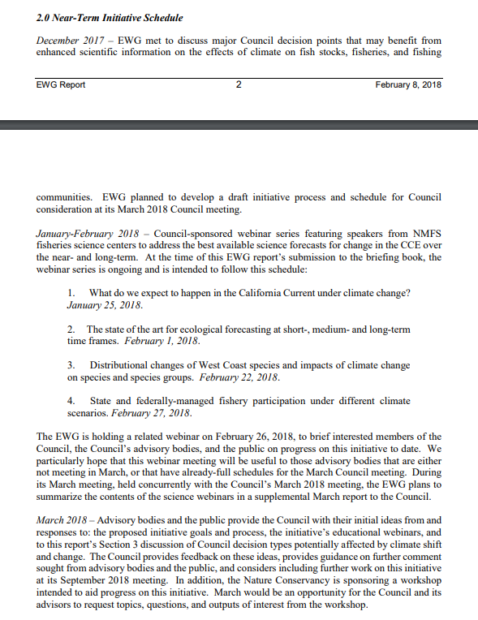
Pages 2-3:
Initiative Schedule
Understand what science we have available
https://www.pcouncil.org/ecosystem-based-management/fishery-ecosystem-plan-initiatives/climate-and-communities-initiative/climate-and-communities-initiative-2018-webinar-series/

Slide 6
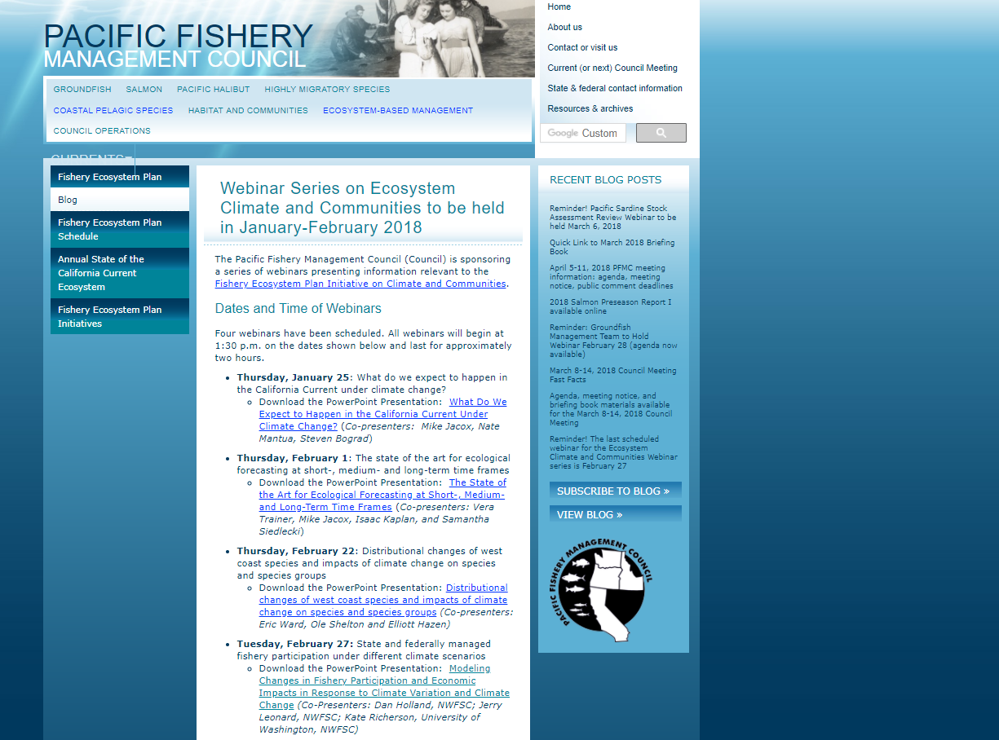

Slide 7
Part 1: Anticipated climate change in the California Current System
Coastal upwelling
Sea surface temperature
Primary production
Oxygen, pH
Part 2: A ‘Climate Stress Test’: recent anomalies in the CCE
The Blob
El Niño
Wacky biological shifts
Part 3: Fisheries management challenges in a changing climate
Whale entanglements in fishing gear
Salmon fishery declines and fishery disaster declarations

Slide 8
Introduction: The forecasting toolbox
Part 1: Short-term forecasts: ‘real-time’ to 1 month
Harmful Algal Blooms (Pseudo-nitzschia)
Part 2: Seasonal ocean forecasts: 1-12 months
Upwelling
Climate anomalies
Distribution of bycatch species
Part 3: Medium-term forecasts: 1-20 years
Oceanographic anomalies
Salinity changes
Part 4: Long-term forecasts: Decades
Effects of ocean acidification on food webs,
coastal economies

Slide 9
Part 1: Chinook Salmon
Changes in ocean distribution
Abundance and distribution shifts associated with climate
Part 2: Groundfish
Spatially explicit modeling of fish biomass
Associations with habitat, multispecies modeling
Relationships between climate and forecasting
Part 3: Large Pelagic Species
Identifying predator hotspots for highly migratory species (not just “official” HMS)

Slide 10
Part 1: The Dynamics of Adaptation to Climate-Driven Variability in California Current Fisheries and Fishing Communities
Part 2: Atlantis and Input Output Model for Pacific Coast Fisheries Collaborations
Part 3: Quantifying and Predicting Impacts of Salmon Ocean Fishery Closures

Slide 11
✓
Understand what science we have available
Understand the potential effects of changing climate on our managed stocks and fishing communities
Evaluate the connections between fish stock vulnerability and fishing community vulnerability to climate shift and change
Enhance original climate initiative with pieces of communities initiative
✓
?
?
?

Slide 12
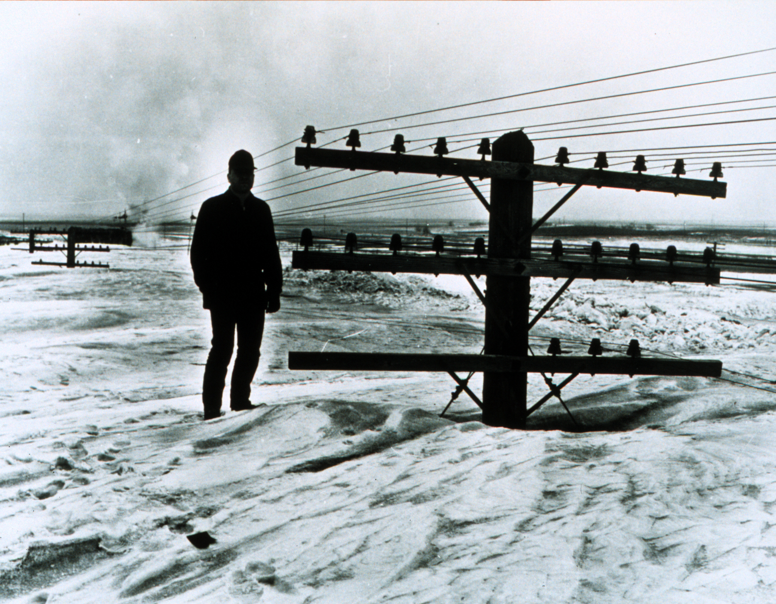
Assess how different federal, state, and tribal fisheries regulations and management systems – including Council FMPs – interact with each other to affect how fishing fleets operate in different coastal communities. This assessment would help identify potential changes to our regulations that the Council could consider to help increase operational flexibility for fisheries participants, bring more stability across fisheries for fishery participants, improve the safety of fishing operations, better support fishing-related community infrastructure, and benefit West Coast fisheries’ access to markets.
Notes:
So, how do we think about helping fishing communities weather climate anomalies, shift, and change? [CLICK] We looked to the language of the Communities Initiative and focused on those phrases in green – increasing flexibility and bringing stability.

Slide 13
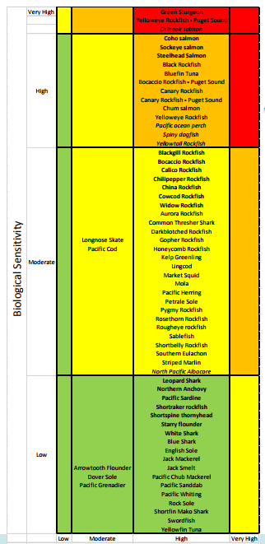
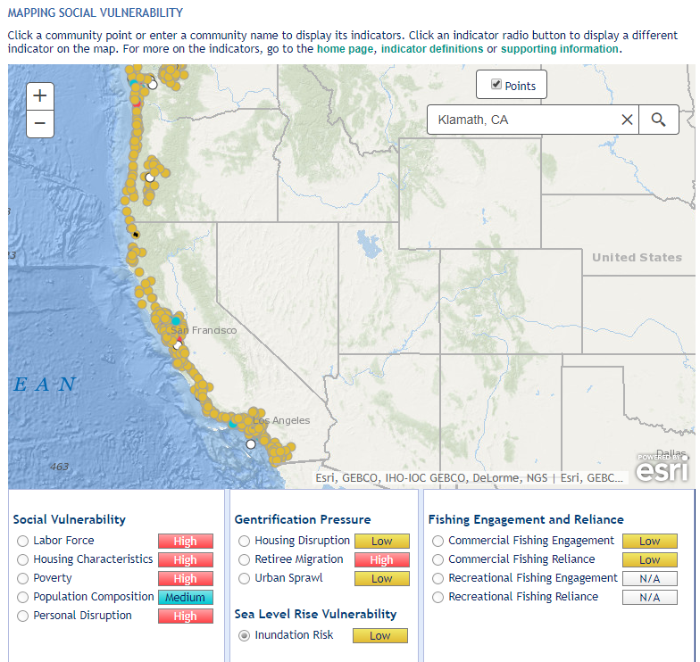

Slide 14
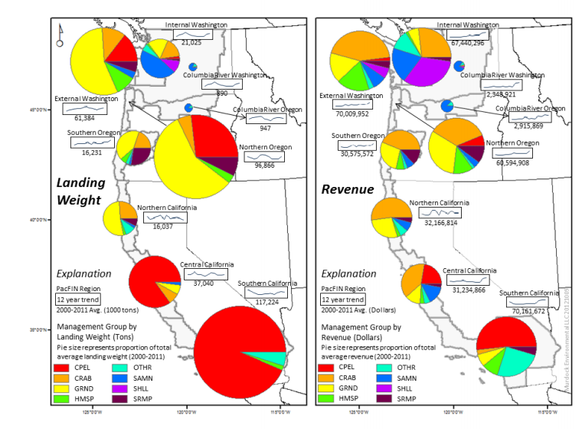
From FEP at 72: Maps, Murdock Environmental; data, PacFIN

Slide 15
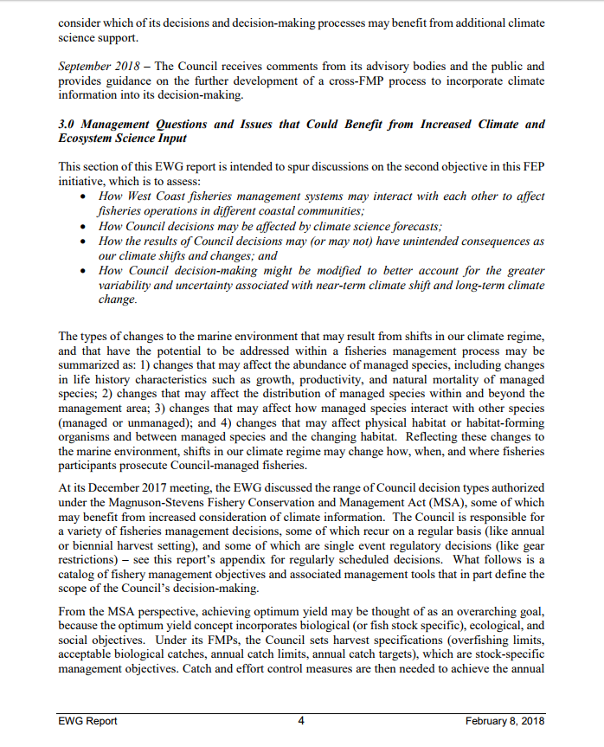
. . . help increase operational flexibility for fisheries participants, bring more stability across fisheries for fishery participants . . .

Slide 16
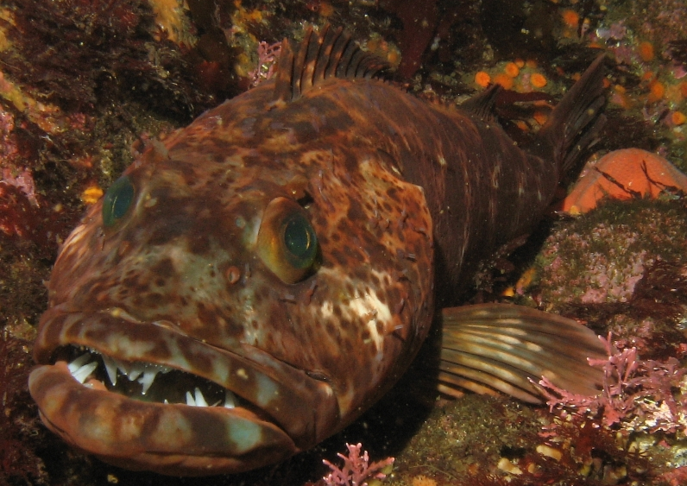
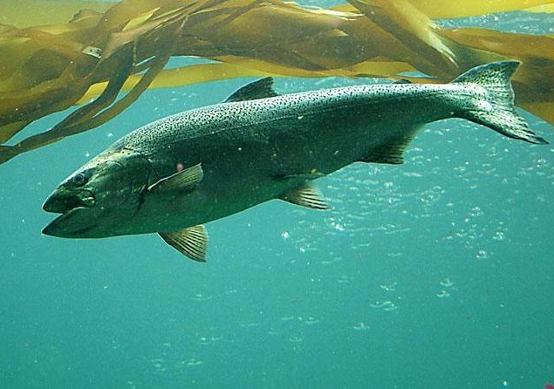
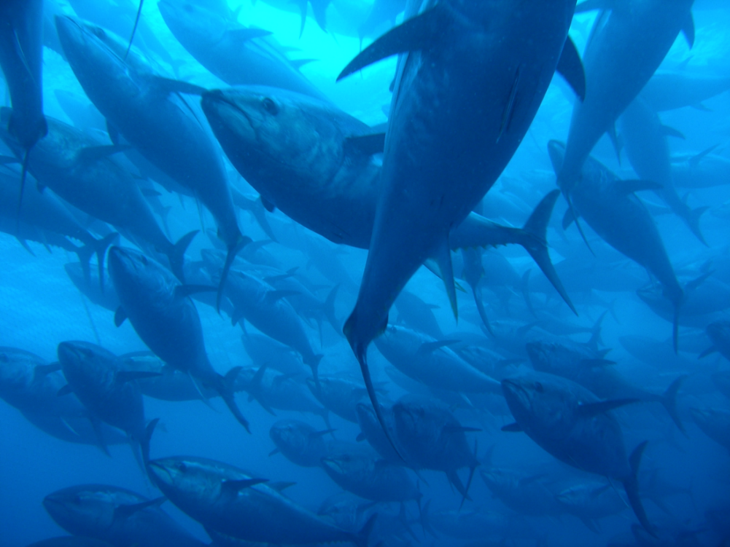
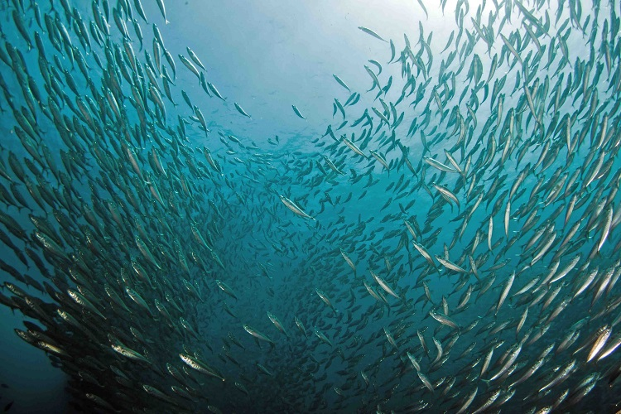
Catch control?
Effort control?
Bycatch control?
Allocation?
EFH protection?
. . .increase operational flexibility . . . bring more stability

Slide 17
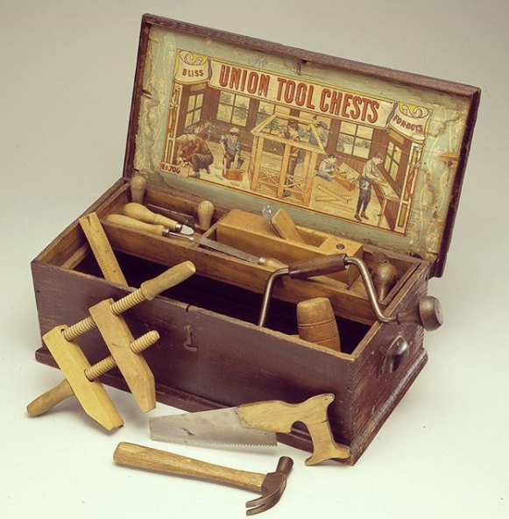
Pages 4-6

Slide 18
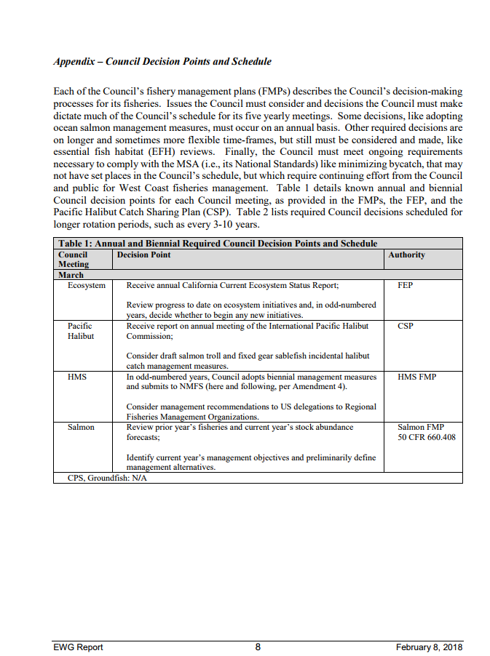
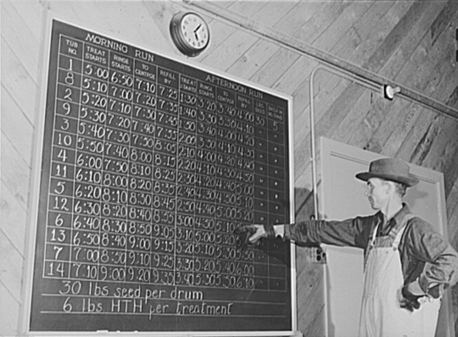
Pages 8-10
Appendix

Slide 19
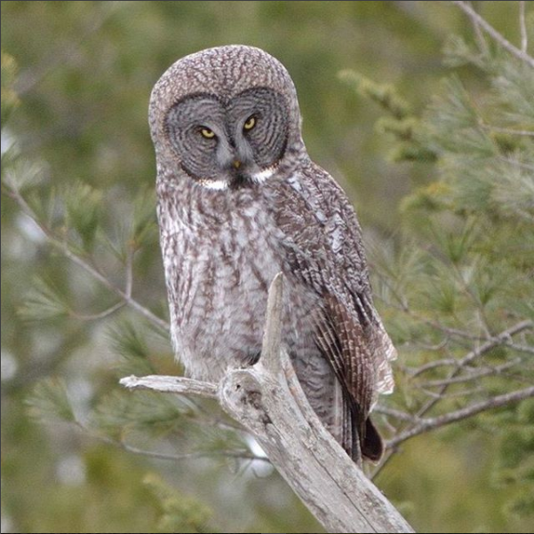
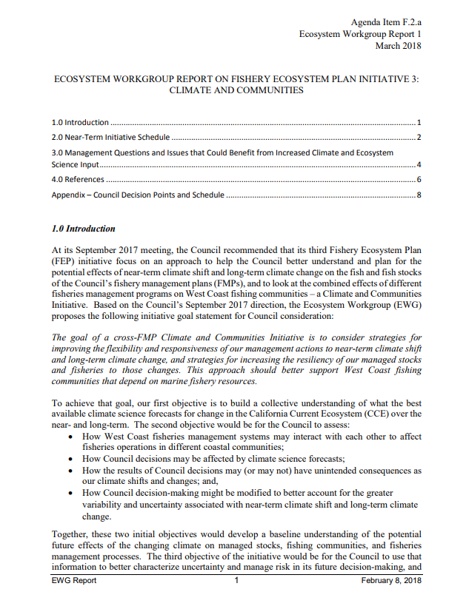
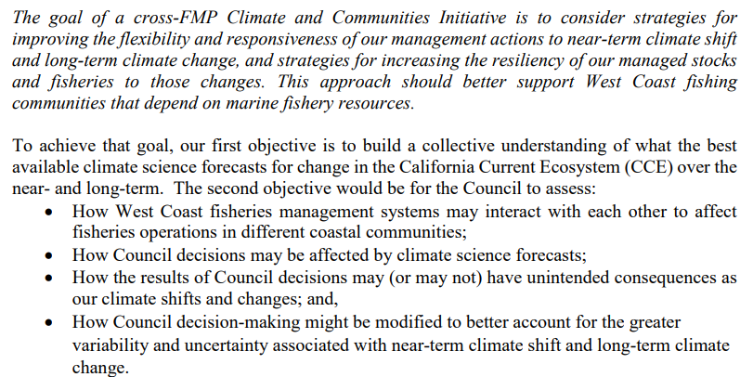

Slide 20
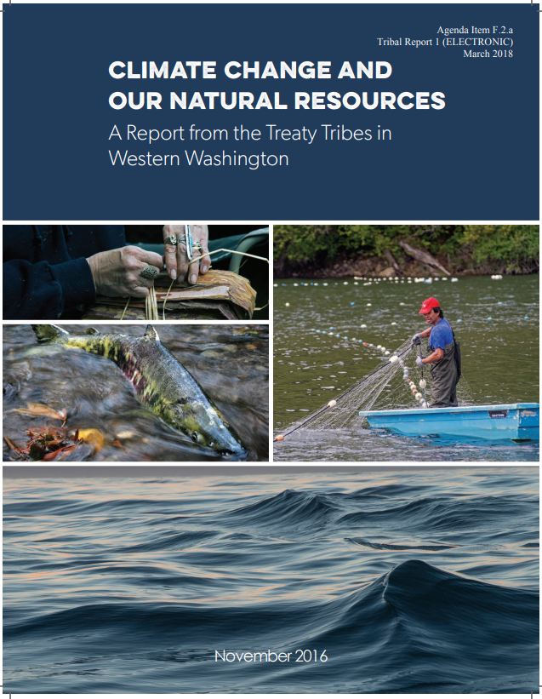
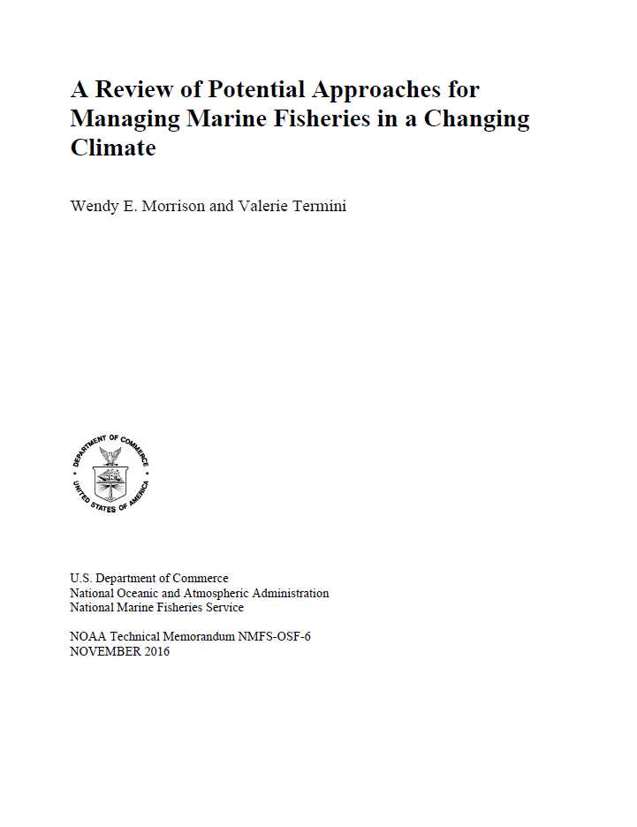
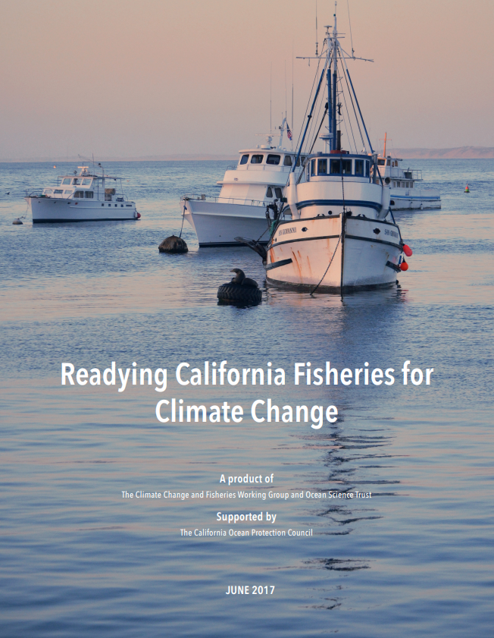
https://www.pcouncil.org/ecosystem-based-management/fishery-ecosystem-plan-initiatives/climate-and-communities-initiative/ (Scroll down)

Slide 22
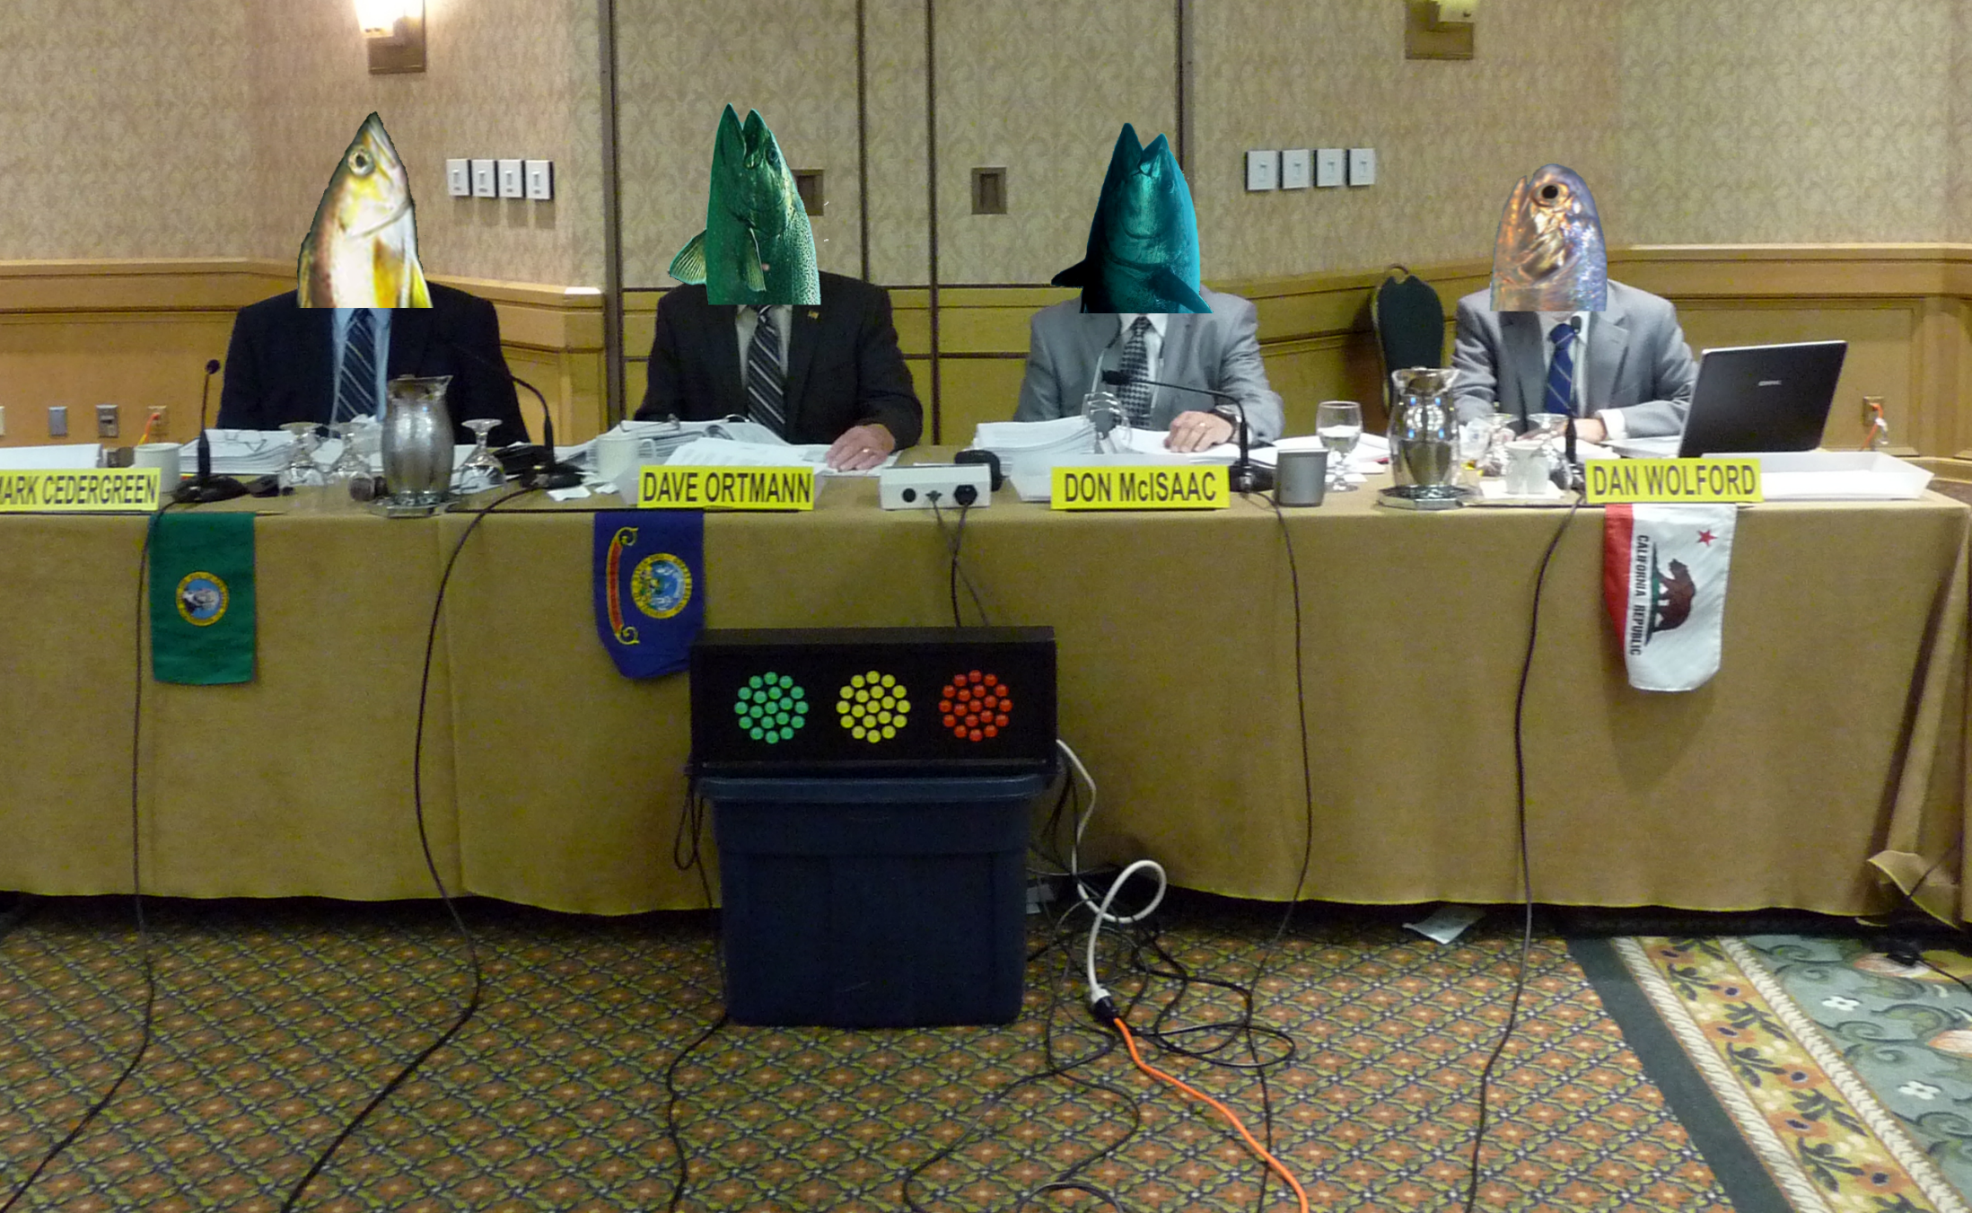
. . .increase operational flexibility . . . bring more stability
ROCKFISH
CHINOOK
BLUEFIN
ANCHOVY

Slide 23
Council guidance on:
Goal and objectives OK?
Publications or policies to look at?
Science forecast
Ocean conditions that matter most?
PFMC forecasting needs?
Cross-FMP flexibility and stability?
Public thinking period: March-September

Slide 24
For those images where sources are not shown directly on image, :
Slide 2: Boise, ID, U.S. Bureau of Reclamation
Slide 12: Jamestown, North Dakota, winter 1966
Slide 16: All images, NOAA, except Le Penseur by Rodin, National Gallery of Art, Le Penseur repeated at Slide 22
Slide 17: Early 20th century toy tool chest, Smithsonian
Slide 18: Charts showing schedules for treating guayule seeds in Salinas, CA, Library of Congress
Slide 19: Great gray owl, USFWS
Slide 22: Pacific Fishery Management Council in session, PFMC

