Slide 1
Salmon Bycatch in the Pacific Coast Groundfish Fisheries: Scenario Analysis
Agenda Item I.1.a
Supplemental NMFS PPT (Bishop)
March 2017
West
Coast
Region
March 2017

Slide 2
How we got here….
Reinitiation – 2013
Workshop seeking stakeholder/manager input - 2015
Council motion with bycatch scenarios – Sept 2015
Range of fishery structure
Overall bycatch, distribution and stock specific impacts
Results in March; Final Recommendation in April 2017
Biological opinion by end of 2017

Slide 3
Whiting
(Scenario 1)
Non-whiting
(Scenario 2)
Recent historical footprint and northern footprint (1A)
Resumption of at-sea processing S. of 42° (1B)
Baseline
(Scenario 2A):
Less constrained (Scenario 2B)
Recent landings
Recent bycatch rates
Hybrid (2B1)
1990s (2B2)
1990s landings
recent bycatch rates
1990s landings
EDCP (1990s) bycatch rates

Slide 4
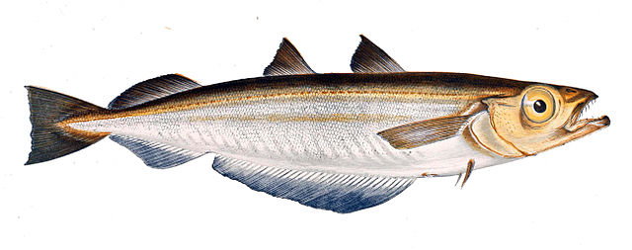
Scenario 1:
Whiting

Slide 5
Whiting analysis (Scenario 1)
Recent historical footprint and northern footprint (Scenario 1A)
Resumption of at-sea processing S. of 42° (1B)
Assume geographic footprint unchanged
Full north/south distribution
Northern footprint
Chinook bycatch level of 11,000

Slide 6
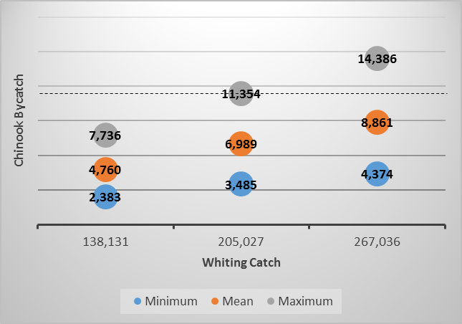
Table 4c

Slide 7
Figure 11

Slide 8
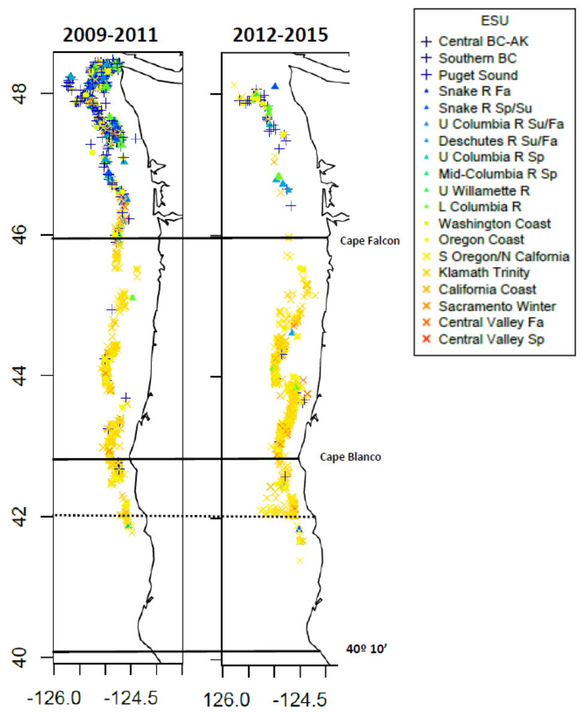
Fleet distribution and stock composition reflects a shift south along the coast.

Slide 9
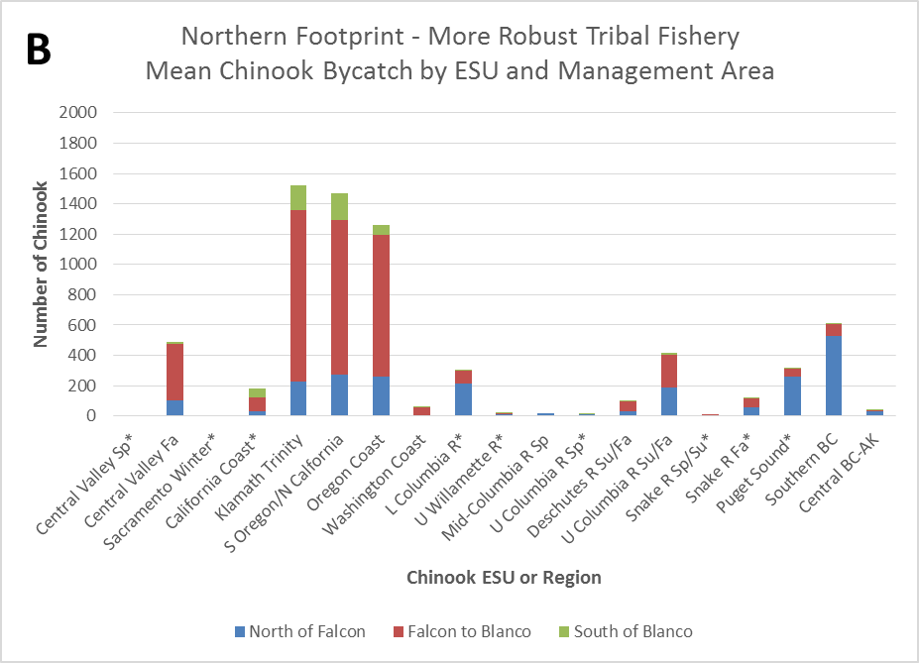
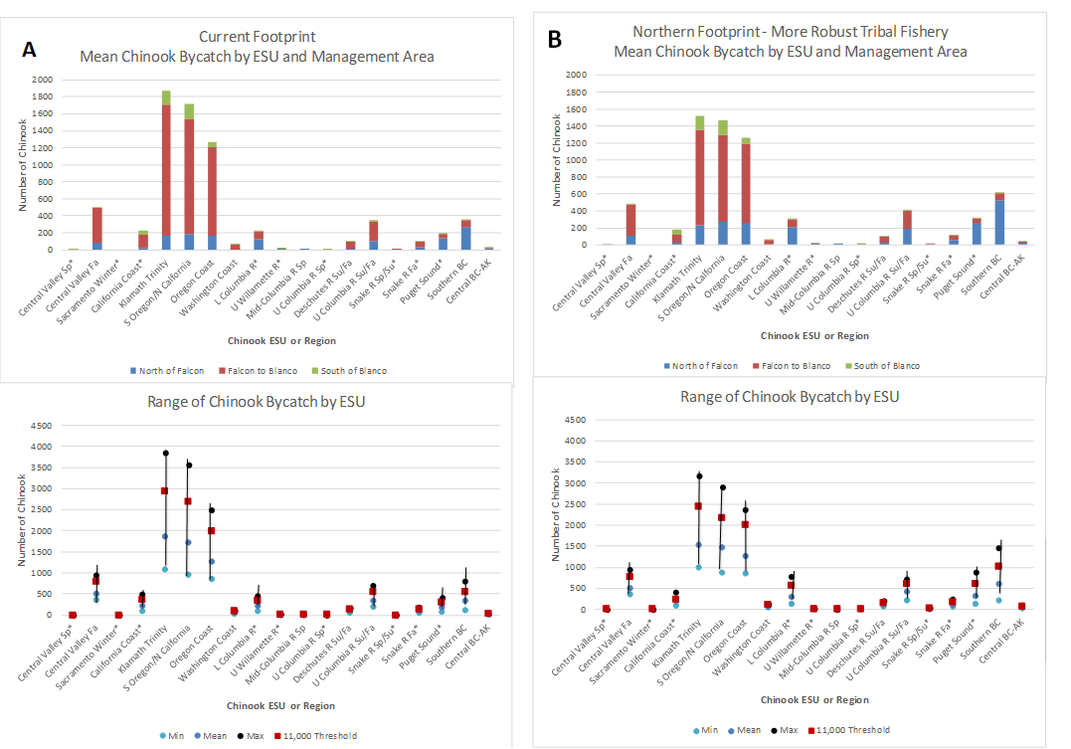
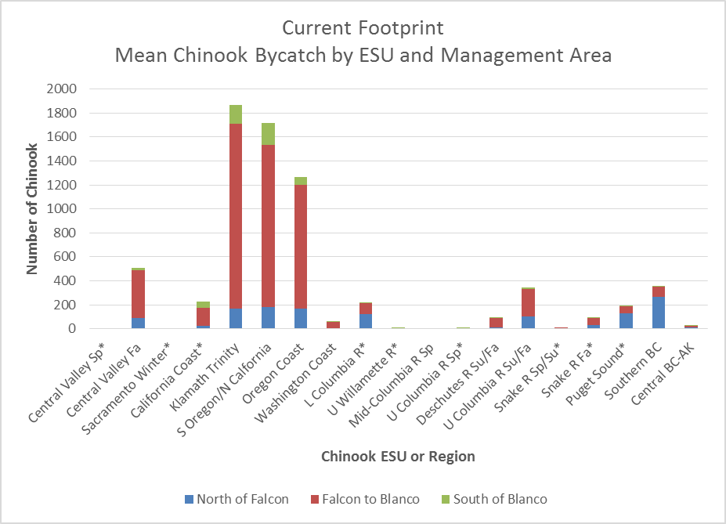
Bycatch by ESU/Region
Figure 12

Slide 10
Whiting analysis (Scenario 1)
Recent historical footprint and northern footprint
(Scenario 1A)
Resumption of at-sea processing S. of 42° (Scenario 1B)
Footprint expanded such that 10% of average whiting catch (2010-2015) occurs south of 42º
Chinook bycatch level of 11,000
Processing south of 42º currently prohibited
Otherwise, assume current constraints remain
Subcap amount for California KMZ explored

Slide 11
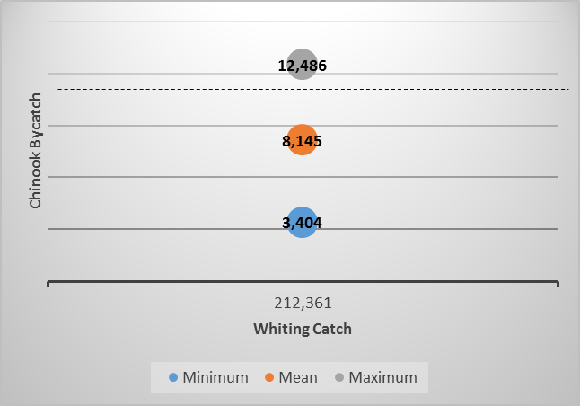
Table 9d

Slide 12
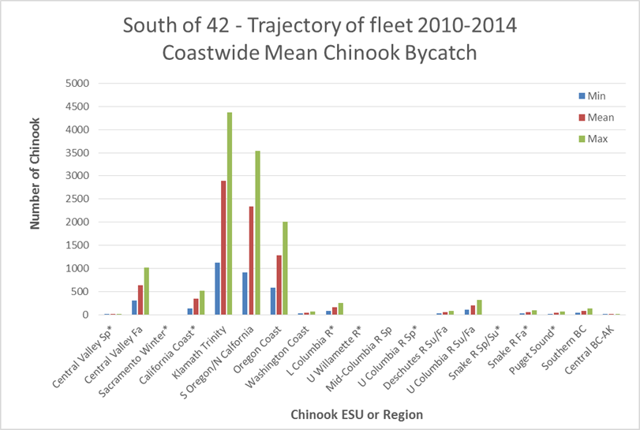
Bycatch by ESU/Region

Slide 13
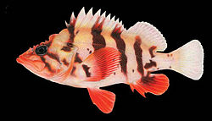
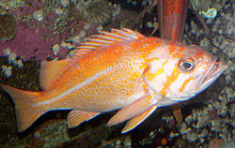
Scenario 2:
Non-Whiting

Slide 14
Non-whiting analysis (Scenario 2)
Less constrained (Scenario 2B)
Hybrid (2B1)
Baseline (Scenario 2A)
1990s (2B2)
Based on recent 3 years footprint, range of groundfish catch and bycatch patterns
Bycatch level of 1,000
Seasonality: winter (11/1-4/30), summer (5/1-10/31)
Significant increases in Chinook bycatch in mid-water non-whiting fishery

Slide 15
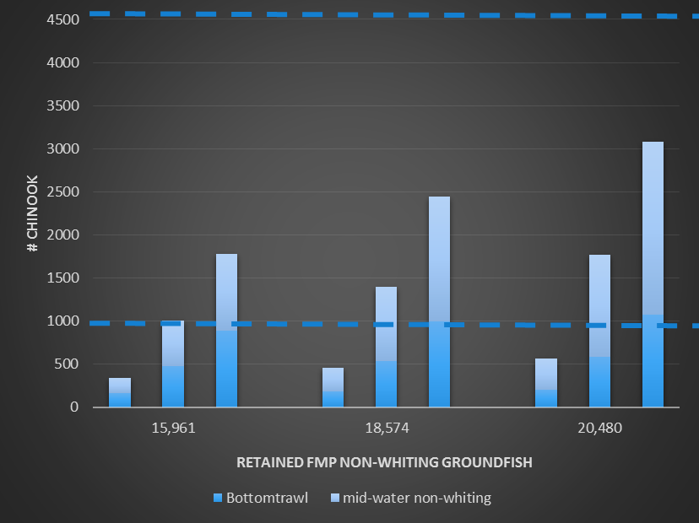
Table 11

Slide 16
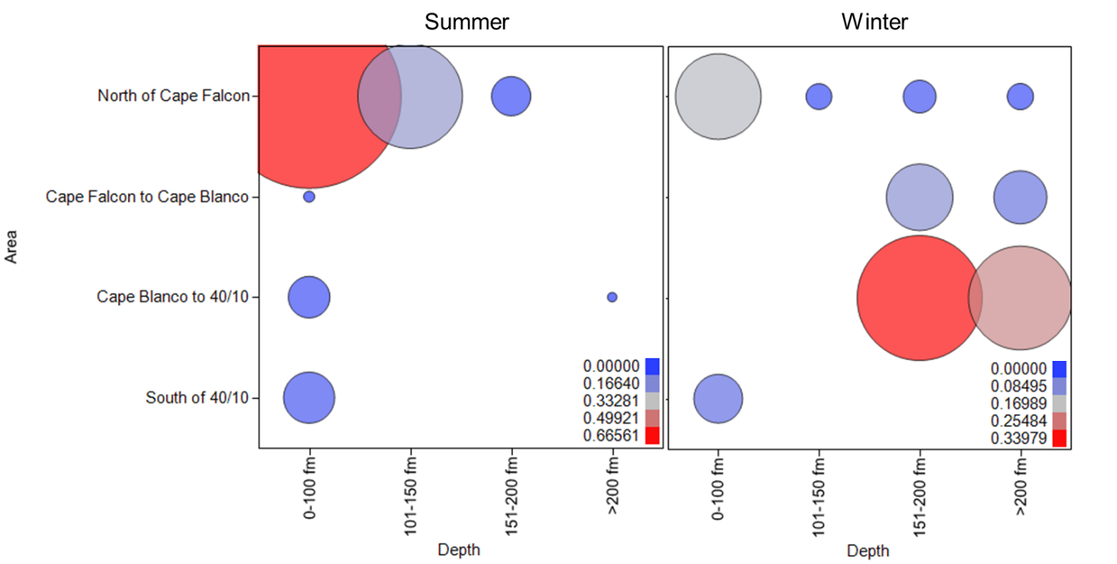
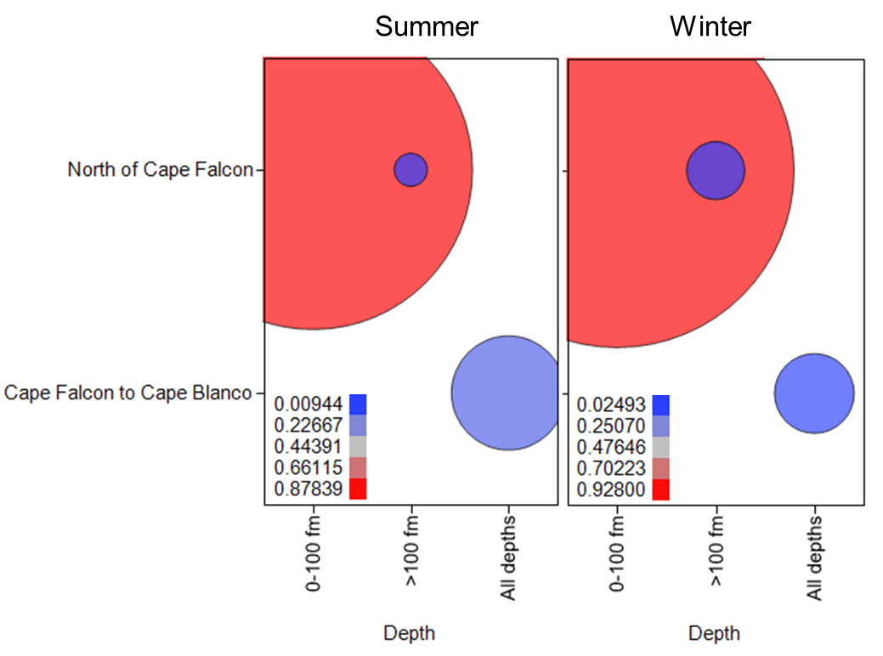
Figure 18
Bottomtrawl
Mid-water non-whiting

Slide 17
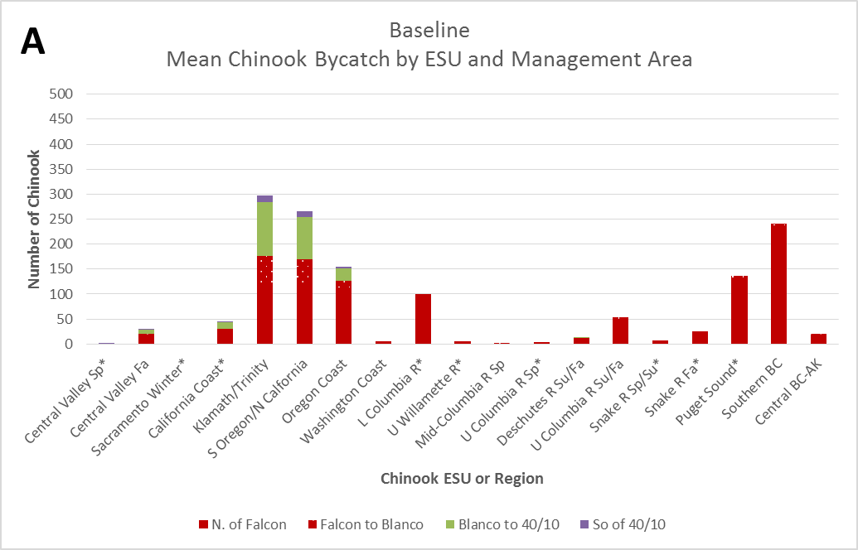
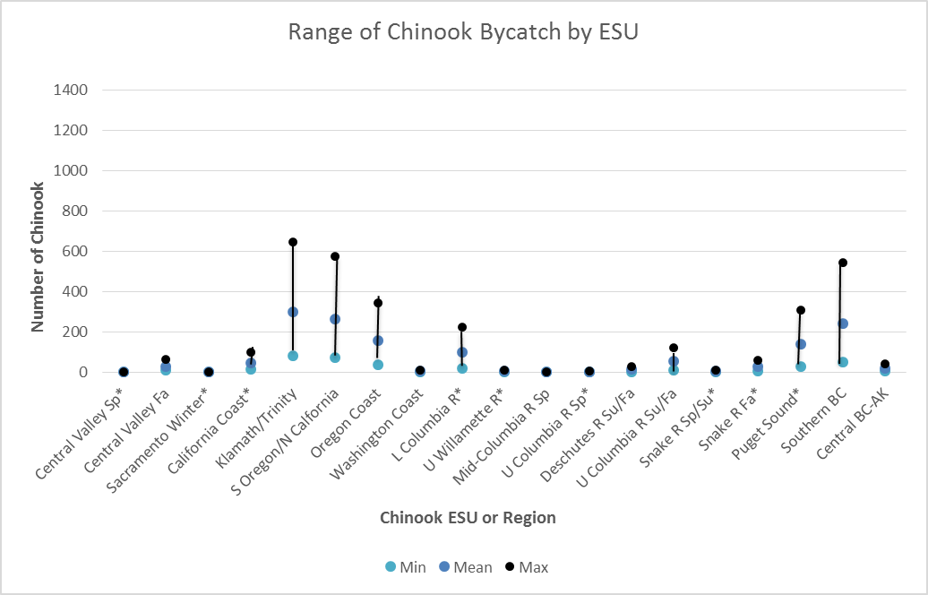
Bycatch by ESU/Region
Figure 22

Slide 18
Non-whiting analysis (Scenario 2)
Hybrid (2B1)
Baseline (Scenario 2A)
Less constrained (Scenario 2B)
Uncertainty
1990s (2B2)
RCA open to fishing
Harvest levels and footprint similar to 1995-99
Expanding mid-water non-whiting trawl fishery
Bycatch levels of 4,500 and 9,000
Different assumptions of bycatch rates and effort given limitations of available data
Seasonality: winter (11/1-4/30), summer (5/1-10/31)
S.S Sean Paul

Slide 19
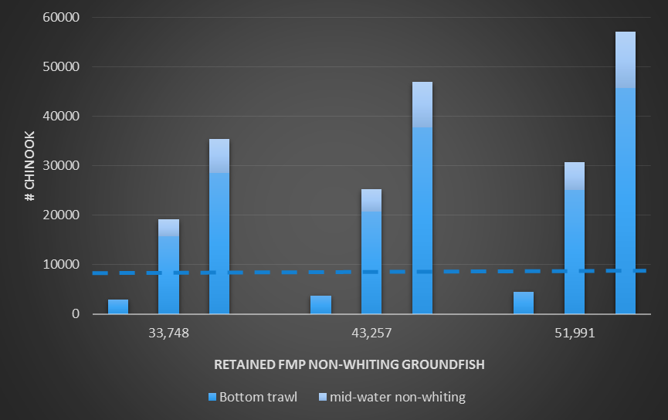
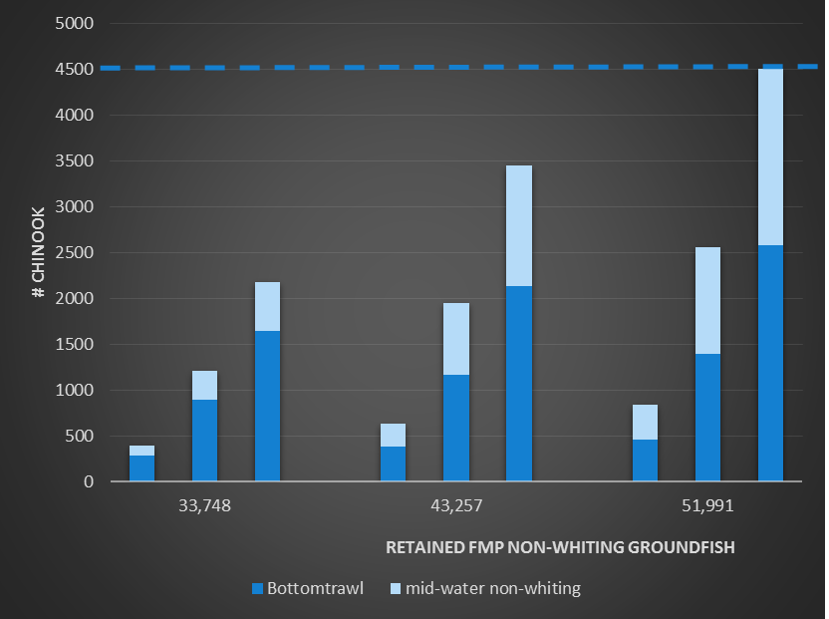
How much?
Scenario 2B1
Scenario 2B2
Tables 14 and 18

Slide 20
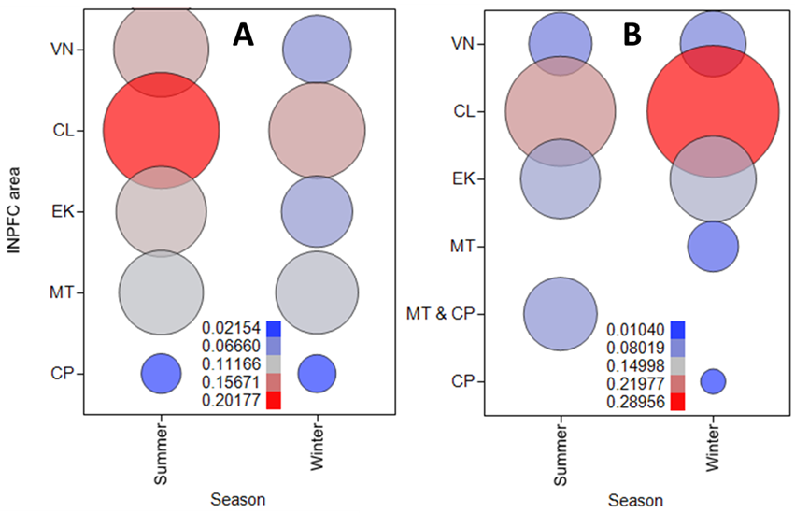
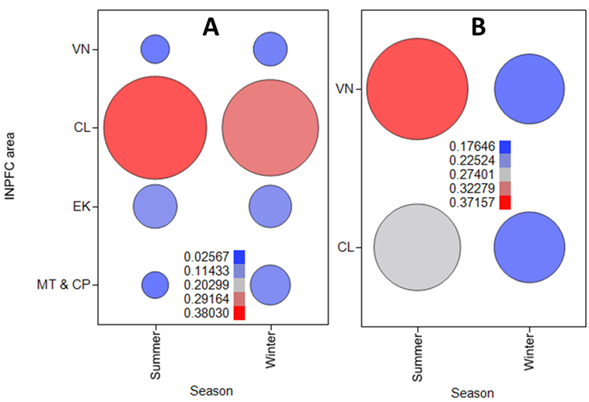
Figures 20 and 21
Bottomtrawl
Mid-water non-whiting
Panel A is Scenario 2B2; Panel B is Scenario 2B1

Slide 21
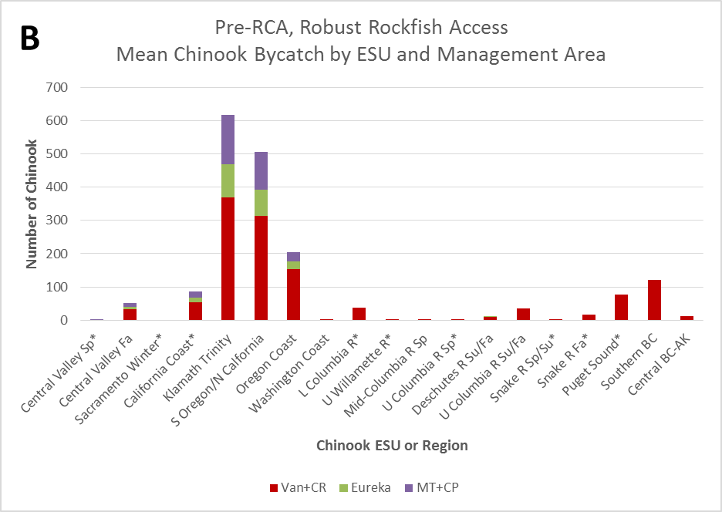
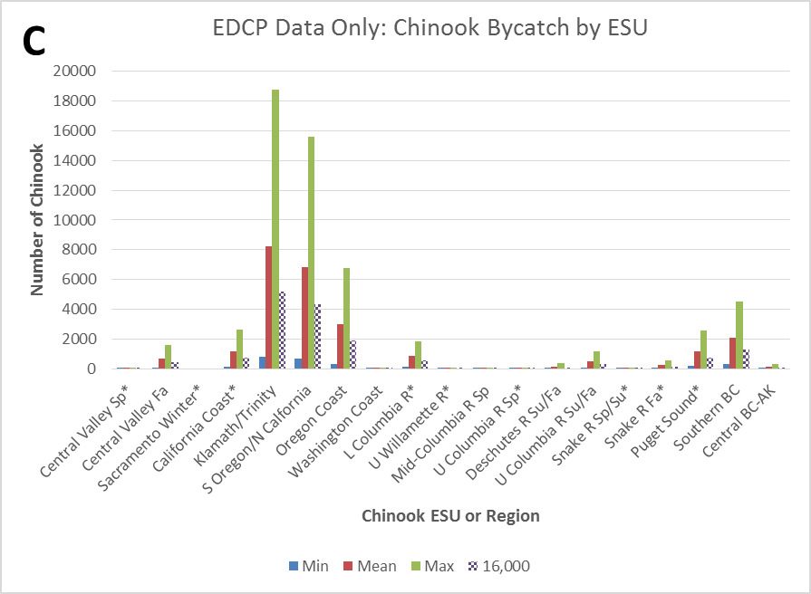
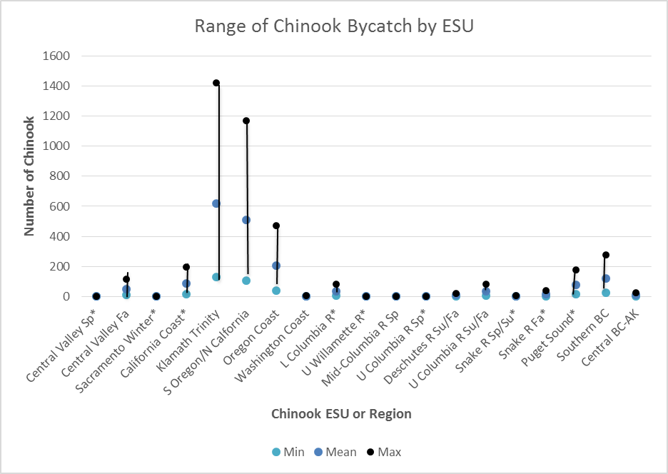
Bycatch by ESU/Region
Table 11

Slide 22
Scenario 3:
Reserve
Single, Combined

Slide 23
Reserve
Fishing scenarios associated with
Whiting Chinook bycatch of 11,000
Non-whiting Chinook bycatch of 4,500
Reserve of 5,500 Chinook
Rules of access to reserve undefined and beyond scope of this analysis

Slide 24
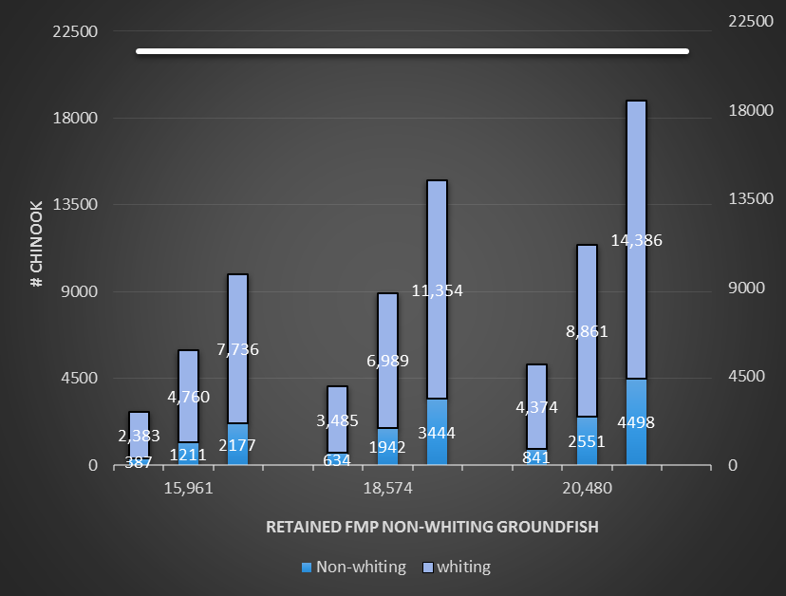
Conclusions:
Could be a valuable tool to:
promote a viable groundfish fishery,
accommodate uncertainty in both bycatch and salmon status = greater stability
provide incentives to reduce bycatch
address fishing equities without excessive constraint on groundfish fishing
Non-whiting fleet more likely to access reserve
Reserve should accommodate overages in most cases
Rules to access reserve to be defined

Slide 25
Combined, single threshold of 20,000
Overall Chinook bycatch less than 20K except in limited cases
More limited in responsiveness to stock comp.
Challenges to managing for a single threshold
Seasonality, location, distribution of fleets affect magnitude and composition of bycatch
Differences are important to analysis of effects
Single threshold does not recognize these important differences.

Slide 26
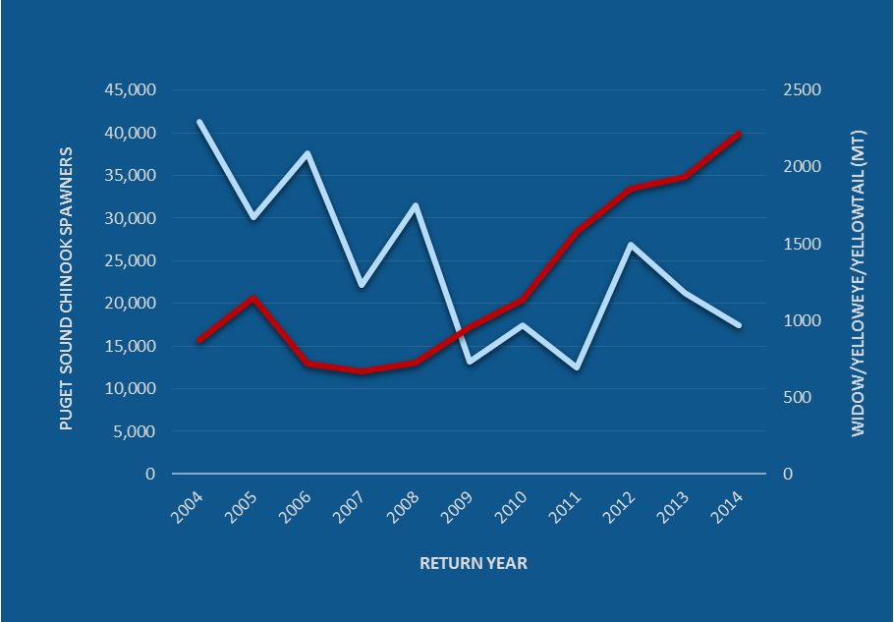
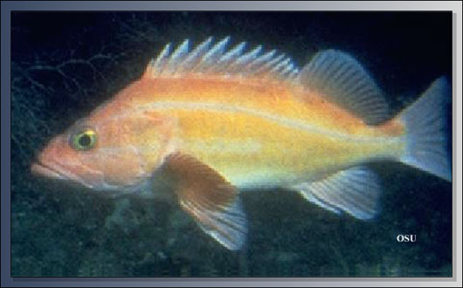
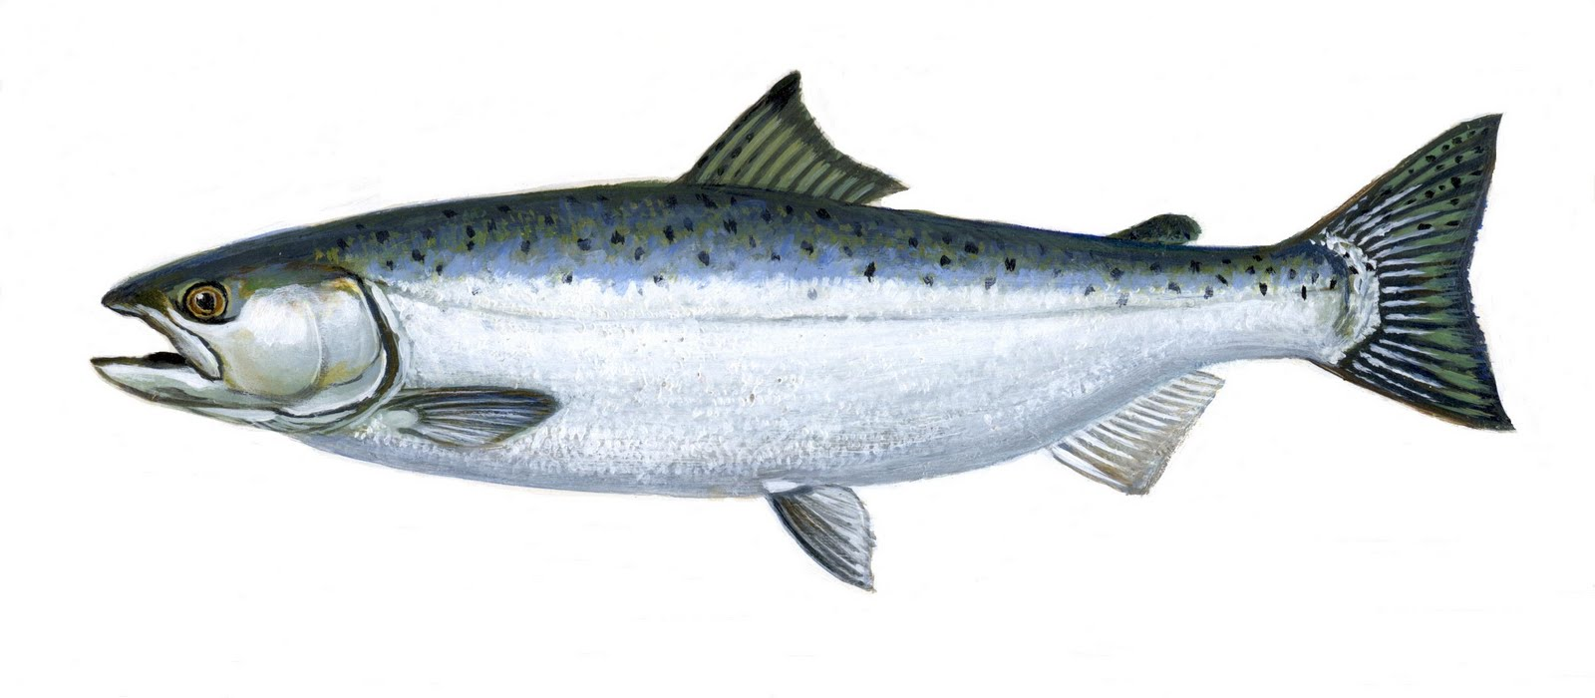
Proposed Action
What scenario best captures what you expect to see in the future in terms of…
Fishing structure
Fishing pattern
Magnitude or range of groundfish and whiting catch/effort
Associated estimated salmon bycatch
What actions will be taken to reduce Chinook bycatch to stay within the allowable limits?

