Slide 1
Progress on analyses to inform escapement targets
SRWG presentation August 7, 2024
Will Satterthwaite, will.satterthwaite@noaa.gov

Slide 2
Updating Munsch et al. 2020 spawner-recruit analysis

Slide 3
Changes made
Fixed treatment of sampling events where only Chinook above size cutoff were encountered
  Should be treated as zeros, not discarded
Changed flow metric location from Freeport to Verona
  Change in data reporting practices at Freeport gage
Changed units of spawners to natural-area SRFC adults
  Provides units of more direct interest to SRWG
Added brood years 2016-2022

Slide 4
Changes made
Fixed treatment of sampling events where only Chinook above size cutoff were encountered
  Should be treated as zeros, not discarded
Changed flow metric location from Freeport to Verona
  Change in data reporting practices at Freeport gage
Changed units of spawners to natural-area SRFC adults
  Provides units of more direct interest to SRWG
Added brood years 2016-2022

Slide 5
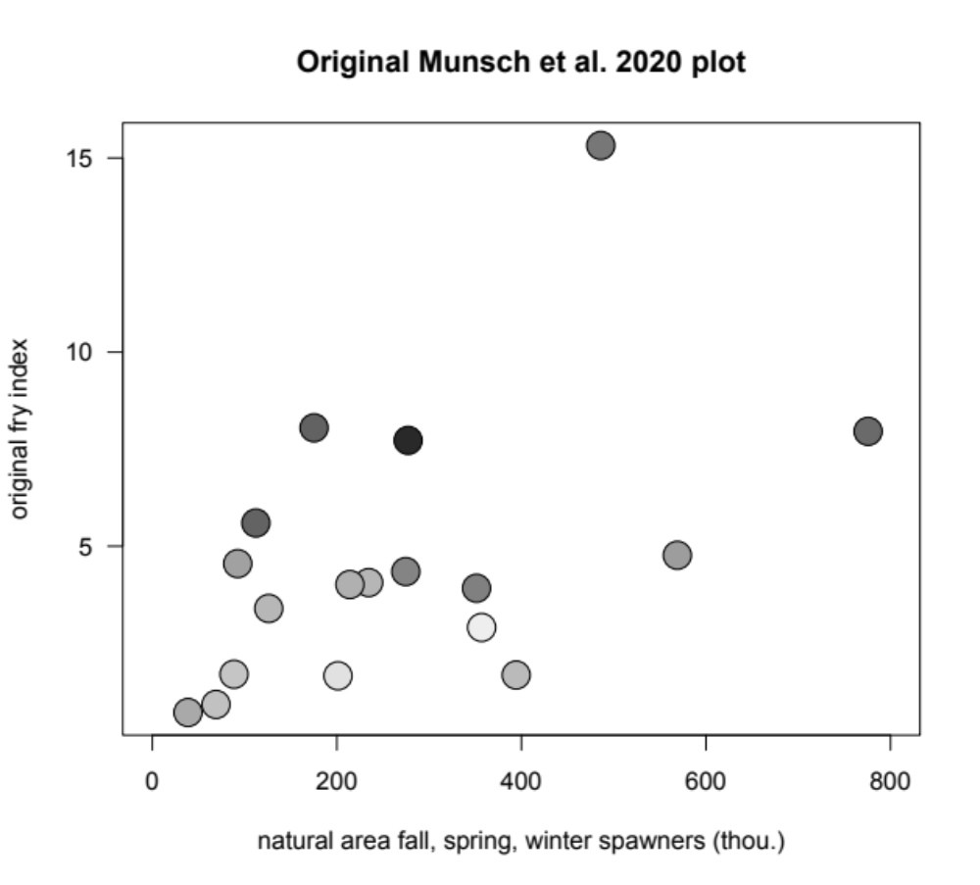

Slide 6
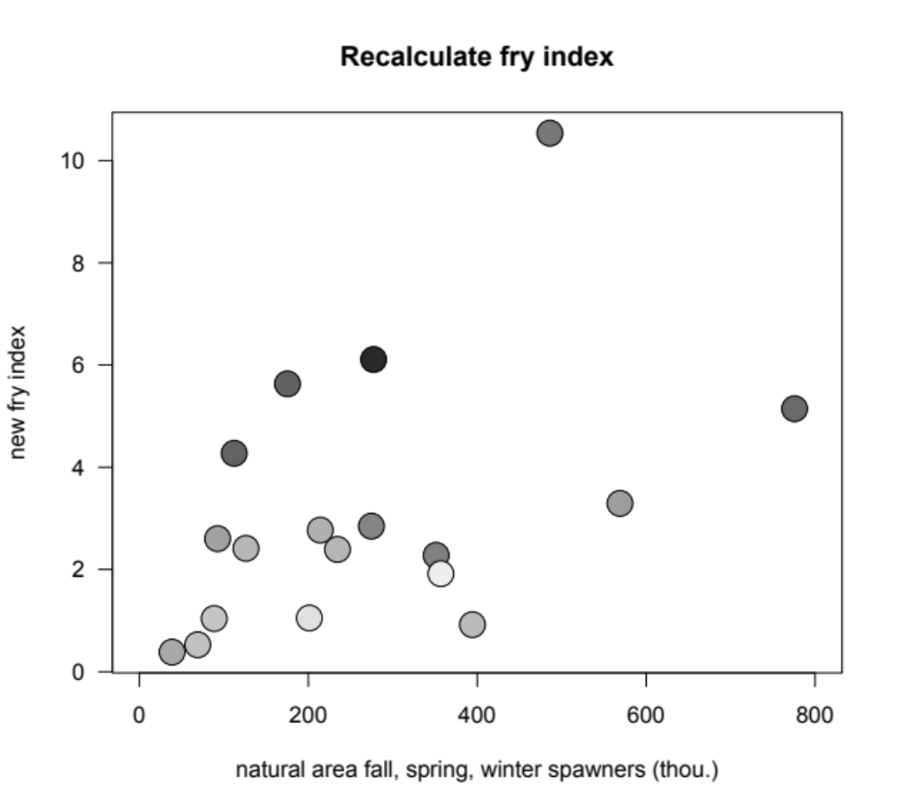
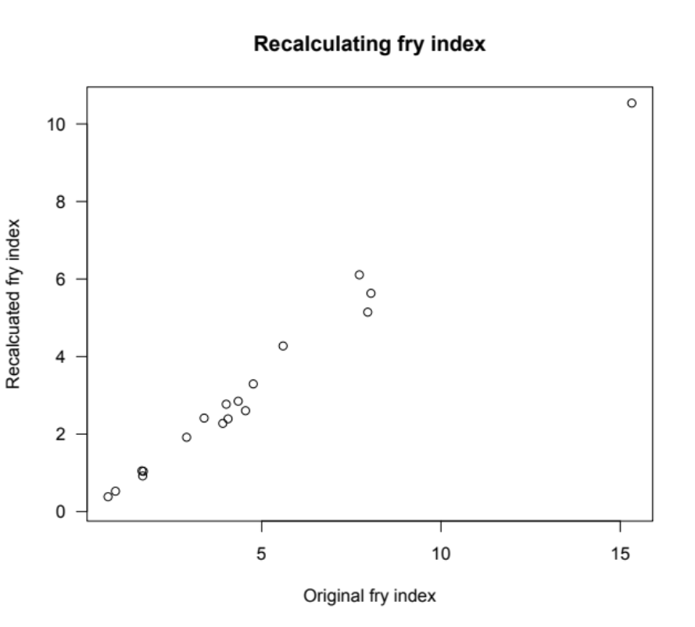
r=0.99

Slide 7
Changes made
Fixed treatment of sampling events where only Chinook above size cutoff were encountered
  Should be treated as zeros, not discarded
Changed flow metric location from Freeport to Verona
  Change in data reporting practices at Freeport gage
Changed units of spawners to natural-area SRFC adults
  Provides units of more direct interest to SRWG
Added brood years 2016-2022

Slide 9
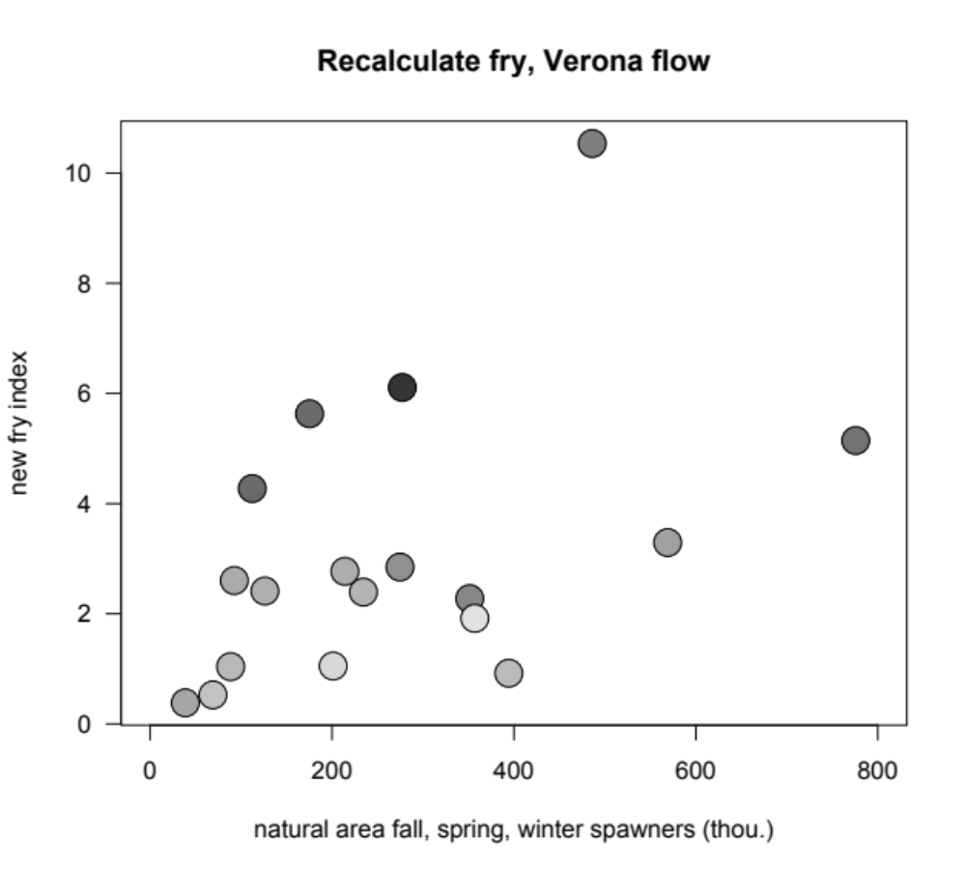
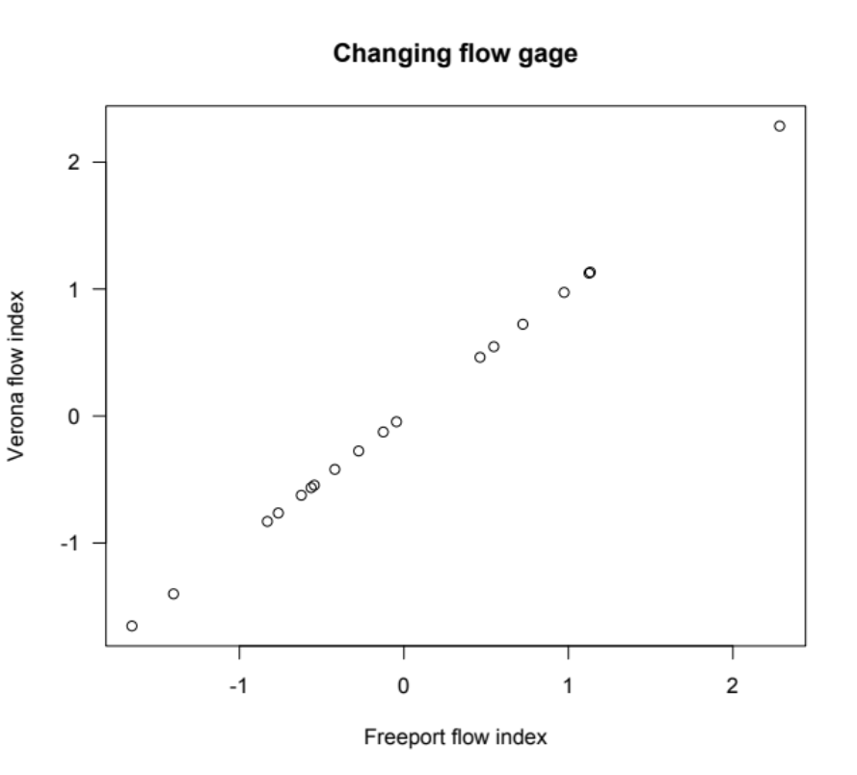
r=0.99

Slide 10
Changes made
Fixed treatment of sampling events where only Chinook above size cutoff were encountered
  Should be treated as zeros, not discarded
Changed flow metric location from Freeport to Verona
  Change in data reporting practices at Freeport gage
Changed units of spawners to natural-area SRFC adults
  Provides units of more direct interest to SRWG
Added brood years 2016-2022

Slide 12
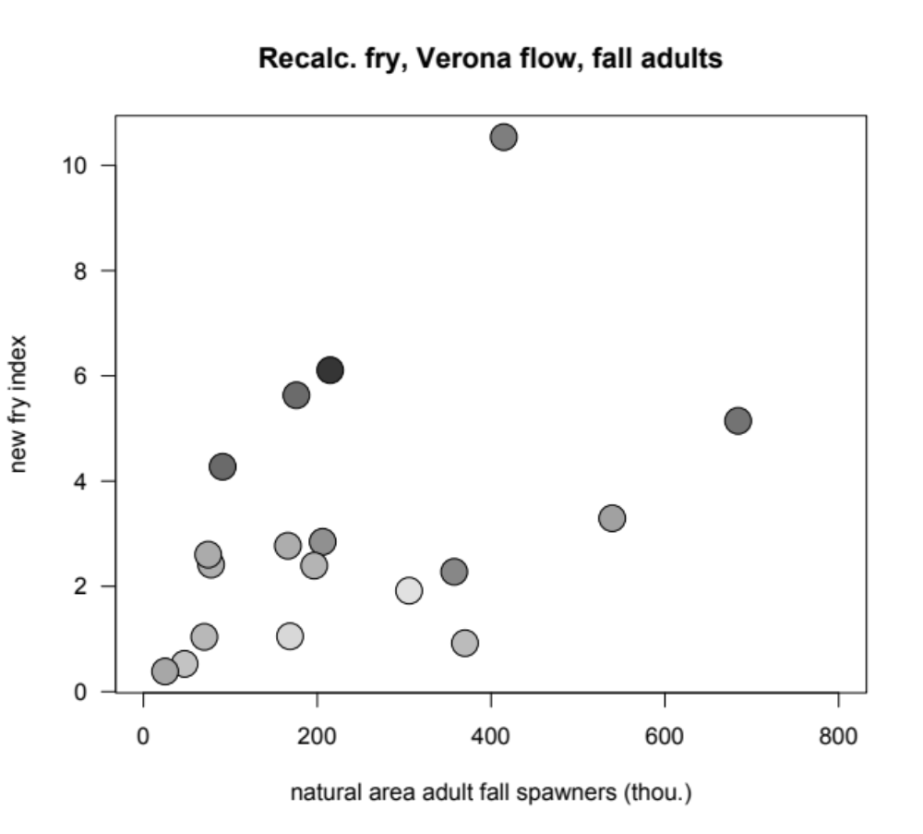
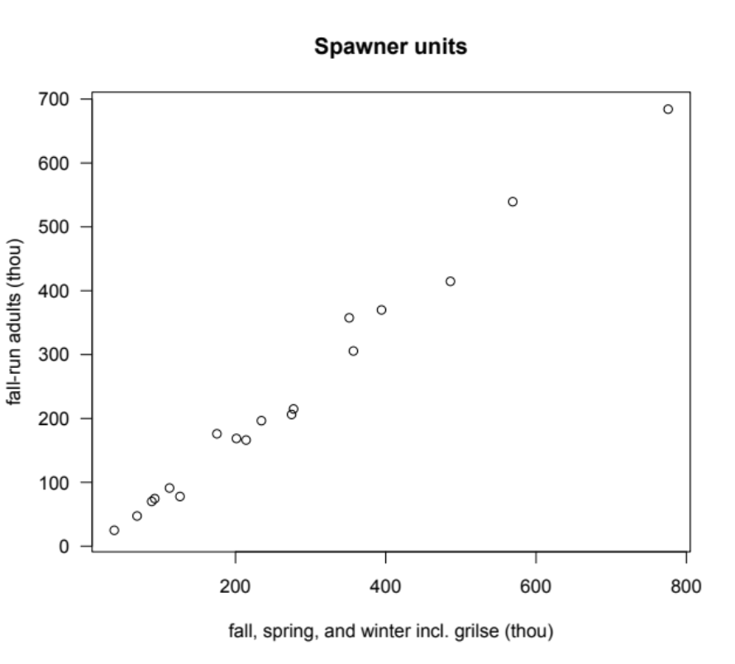
r=0.99
Notes:
It’s BY 98 and 99 that seem not to be reduced when looking at just SRFC adults. This reflect inconsistencies between GrandTAB (source of Munsch et al. spawner numbers) and Review Table B-1 (source of Sac Fall natural-area adults). For example, for 1998 GrandTAB (Azat 2022) reports 141,079 fall Chinook (including grilse) spawning in Sacramento tributary natural areas and 6,318 spawning in the Sacramento mainstem natural areas for a total of 147,397 Sacramento Fall Chinook (including grilse) spawning in natural areas in 1998, somehow less than the 175,992 adult SRFC reported as spawning in natural areas in 1998 in Review Table B-1 (online Excel version).

Slide 13
Changes made
Fixed treatment of sampling events where only Chinook above size cutoff were encountered
  Should be treated as zeros, not discarded
Changed flow metric location from Freeport to Verona
  Change in data reporting practices at Freeport gage
Changed units of spawners to natural-area SRFC adults
  Provides units of more direct interest to SRWG
Added brood years 2016-2022

Slide 15
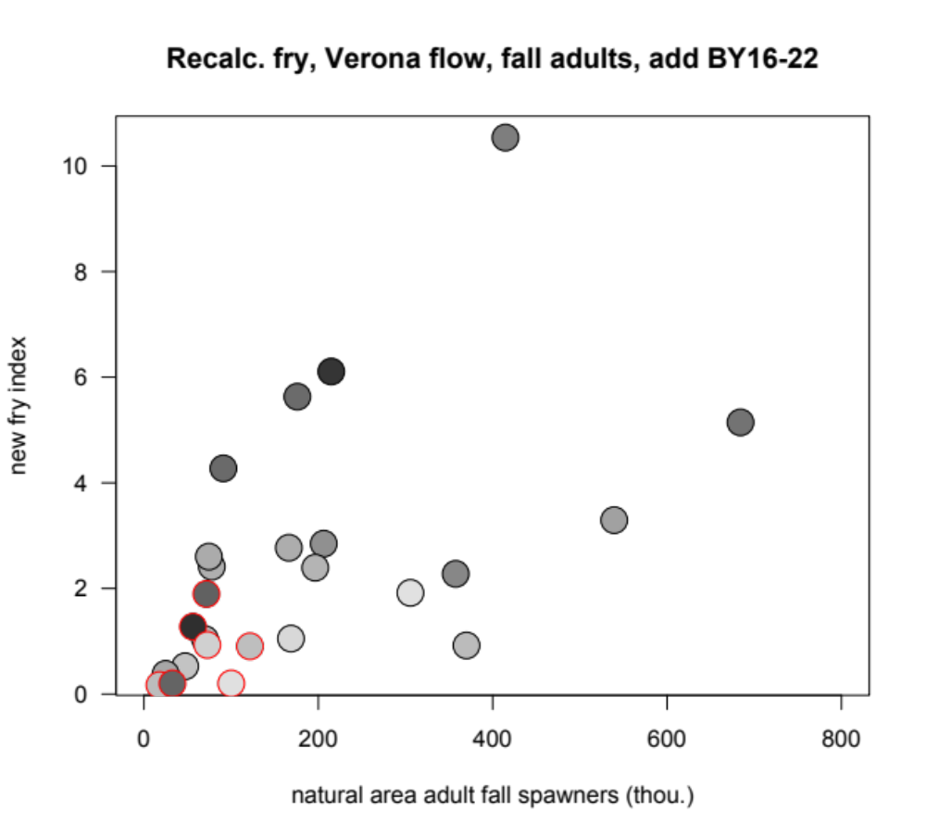

Slide 16
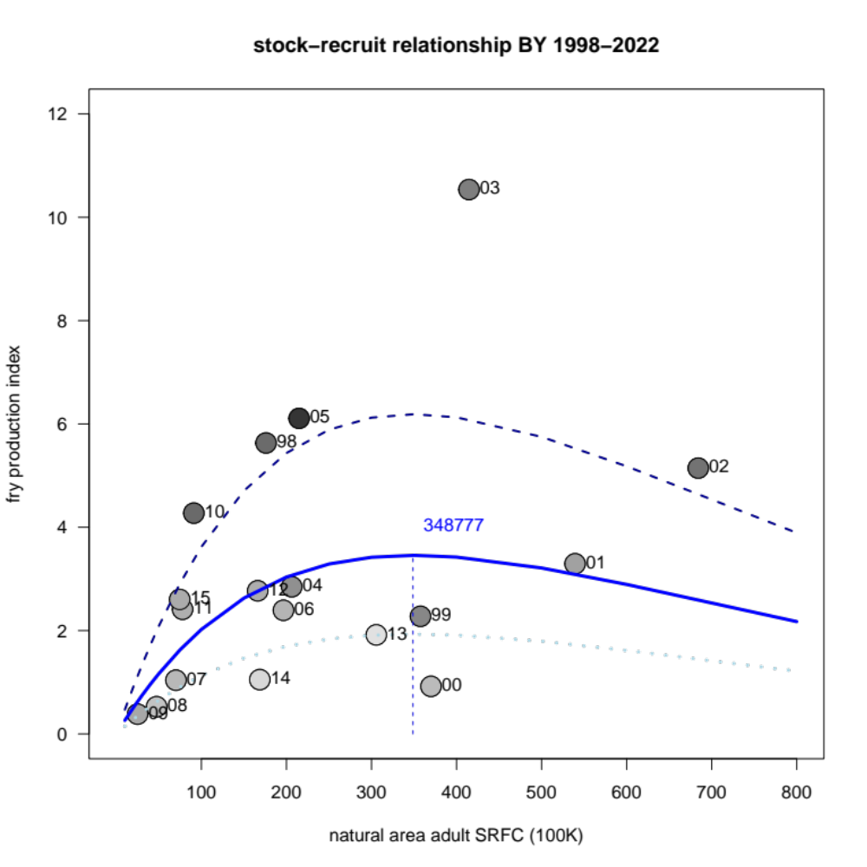
Spawner-recruit fit, BY 1998-2015
α = 2.69*10⁻⁵
β = 2.87*10⁻⁶
f = 0.582
Fits essentially tied:
ΔAIC favors B-H by 0.22
R² slightly favors B-H, 0.49 vs 0.41

Slide 17
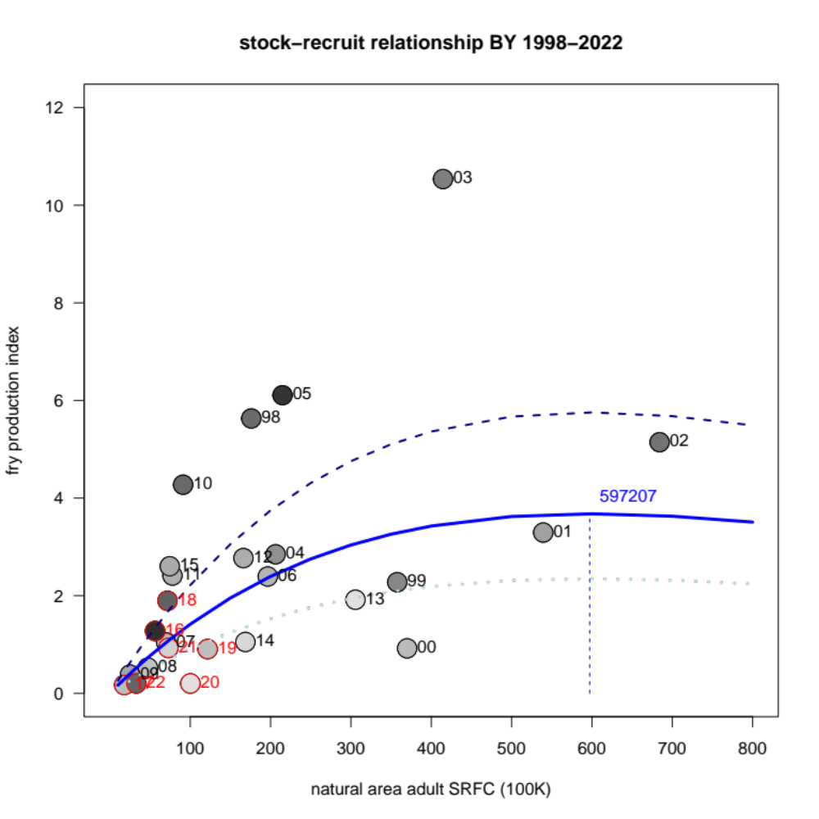
Spawner-recruit fit, BY 1998-2022
α = 1.67*10⁻⁵
β = 1.67*10⁻⁶
f = 0.447
Fits essentially tied:
ΔAIC favors Ricker by 0.41
R² 0.56 Ricker vs 0.55 B-H
Notes:
Why does adding points at low abundance change shape of curve at high abundance?
Shape of Ricker is constrained by the 2 parameters, can’t change just part of the curve.
Seven new years at low abundance, versus only a handful of years at high abundance.
Minimizing lognormal error, so sensttive to proportional errors which may look small at low abundance, not trying to minimize arithmetic-scale distance from points.

Slide 18
AIC strongly supports including spawners & flow
But little to no evidence for Ricker vs. Beverton-Holt
Model | ΔAIC
Ricker w/ log flow covariate | 0
Beverton-Holt w/ log flow covariate | 0.41
Ricker w/ flow covariate (not logged) | 3.6
Beverton-Holt w/ flow covariate (not logged) | 3.8
Linear model of spawners and flow | 4.8
Ricker spawner-recruit, no covariate | 8.1
Beverton-Holt spawner-recruit, no covariate | 8.2
Linear model of spawners | 8.6
Linear model of flow | 21.2
ΔAIC | Level of support
0-2 | Substantial
4-7 | Considerably less
>10 | Essentially none
Burnham and Anderson 2002
p. 70

Slide 19
Upper Sacramento spawner-recruit analysis

Slide 20
Considerations for Upper Sacramento evaluation
What’s a good environmental covariate?
  Using Munsch et al flow metric, <1 AIC unit in favor of inclusion
  So dropped for now, can we identify some good ones to explore?
What kind of error do we want to minimize?
  AIC (log / proportional errors) slightly favors Beverton-Holt (by 0.6 AIC units)
  R² (arithmetic scale errors) slightly favors Ricker (0.57 vs 0.44)
How sensitive to single data points / putative “outliers”?

Slide 21
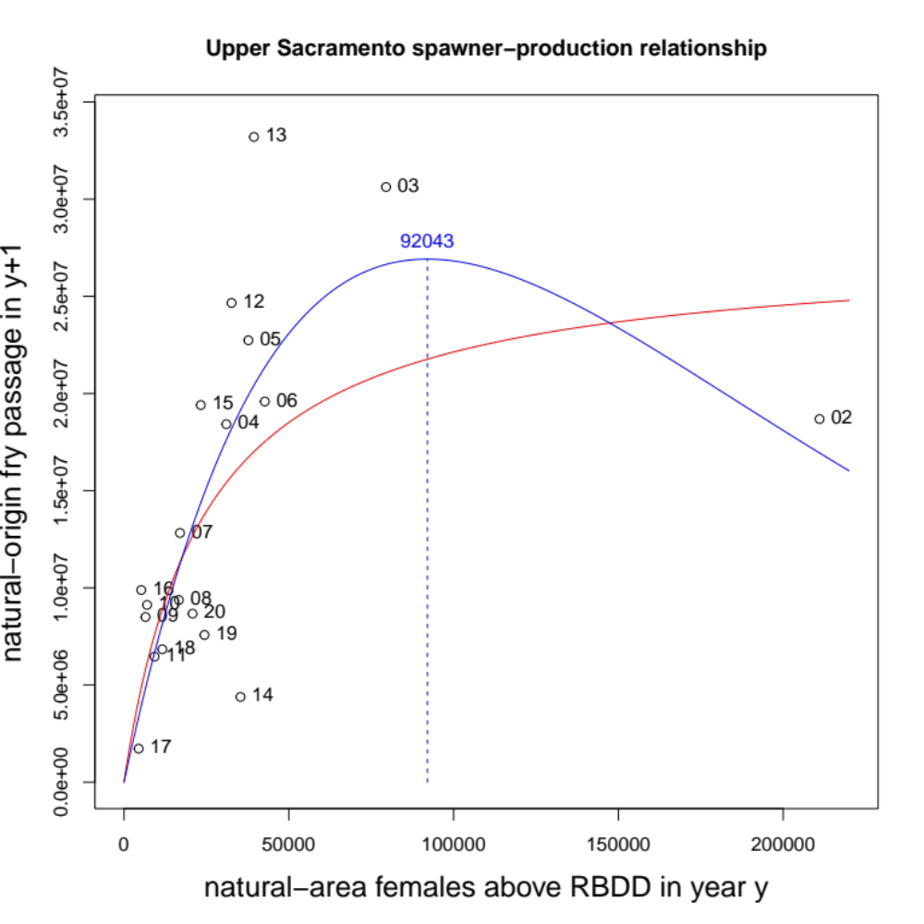
AIC (lognormal/proportional) slightly favors B-H
  0.6 units, essentially a tie
  BY 14, 16, 10, 09, 19 fit better
R² (arithmetic scale) slightly favors Ricker
  0.57 vs. 0.44
  Consistent with sense of better visual fit
  But proportionally big misses in years above
Notes:
Certain brood years may be having disproportionate effects on fit – 02 and 14 stand out visually, maybe 13 and 16 have stronger effects than it looks like too.

Slide 22
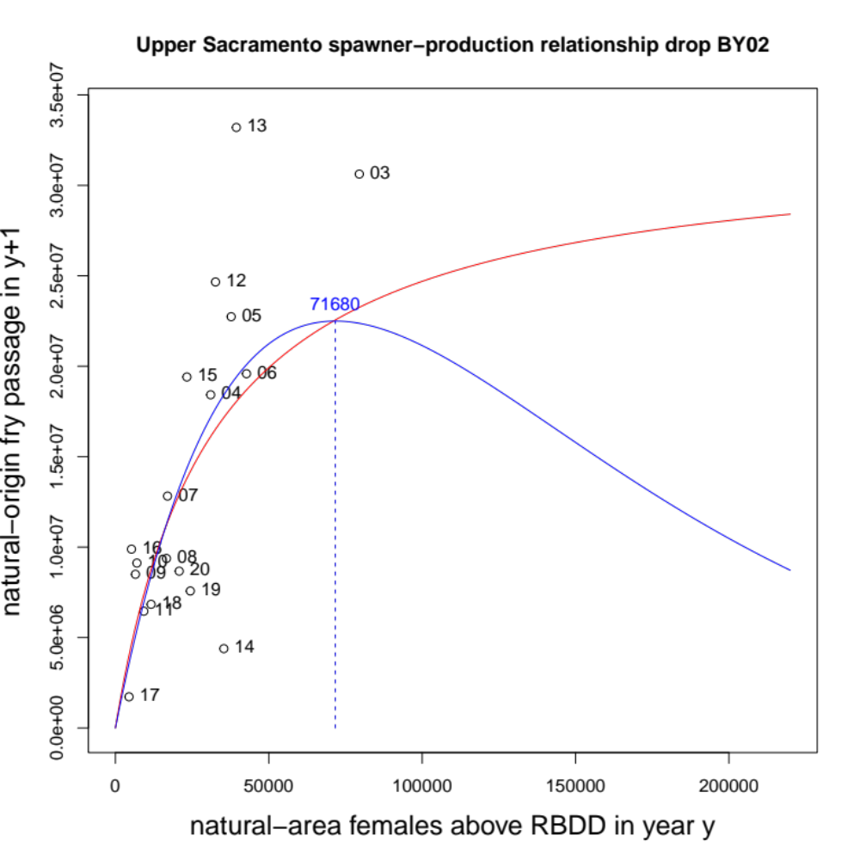
Effects of dropping BY 2002:
Dropping BY02 leads to 0.8 AIC units favoring B-H, with R² tied
Almost visually indistinguishable <20K spawners
Divergence between Ricker and B-H is mainly in data-free zone
Right side of B-H pulled up a bit
  Worse fit to 14, but better to high recruitments
Right side of Ricker pulled down a bit
  Not really what I expected
  But, not missing 06, 14 as badly as before
  Proportionately, not missing 13 by that much more
  Improved fit to 09, 10, 16 may be proportionately bigger deal than it looks like
  Free to be way under where 02 was

Slide 23
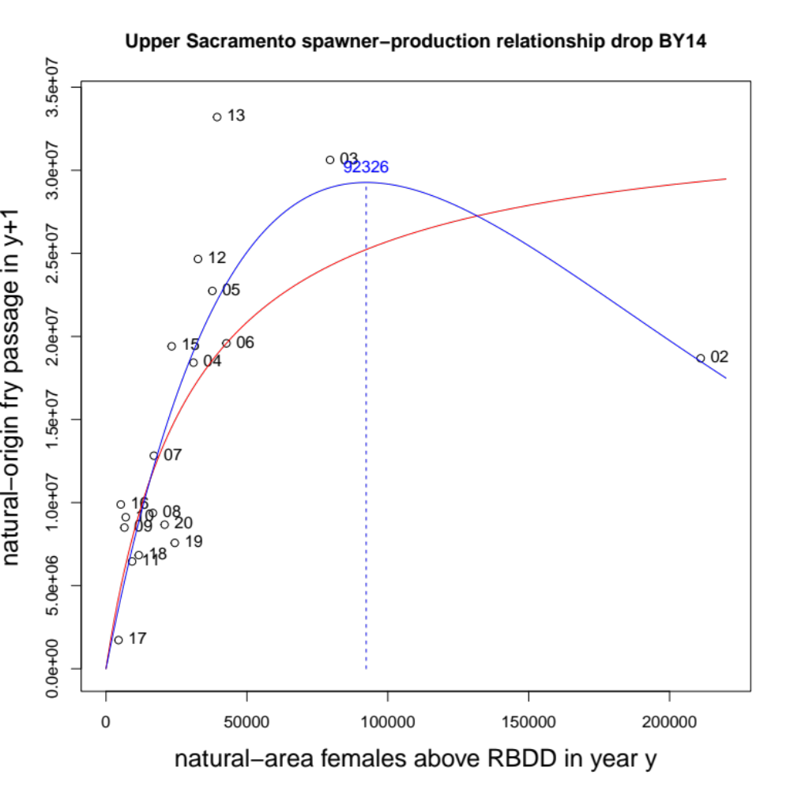
Effects of dropping BY 2014:
Dropping BY02 favors Ricker by 1.5 AIC units, with R² also favoring Ricker (0.74 versus 0.56)
Right side of B-H pulled up a little more by dropping BY14 than dropping BY02
Ricker peak location similar to full dataset, but higher

Slide 24
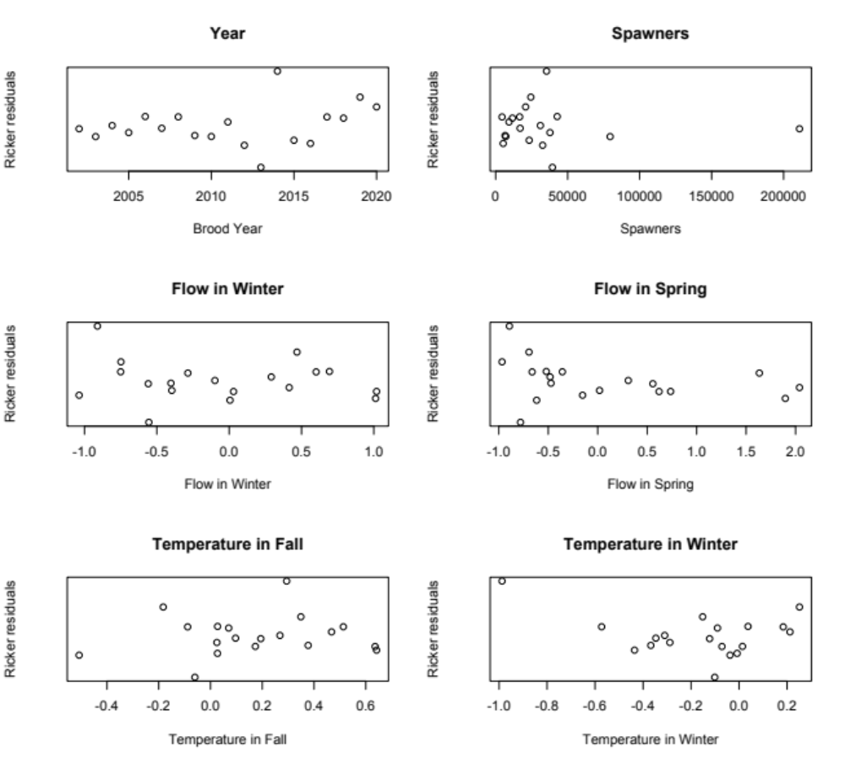
Other covariates to consider?
Updates to fry passage index?

Slide 25
“S_{MSY}” options
SSC and STT agreed we can’t calculate S_{MSY} directly from SRFC data
STT suggested estimating S_{MP} and typical S_{MSY}/S_{MP} ratio
  S_{MSY}/S_{MP} ratio for a Ricker is F_{MSY}, so “just” need an updated F_{MSY} proxy for that part
  But what if we can’t calculate S_{MP} (e.g. if a Ricker doesn’t fit or can’t be estimated with any confidence)
What about R_{MSY}/R_{MP}?
  How robust is this ratio to different S-R curve shapes?
Or some other “optimal” fraction of maximum production?
  Note that multiple S-R curve formulations can be similar over much of the range of escapement and production (Schnute and Richards 1998)

